Slide 1
WFIRST Data Analysis Challenge
Jennifer C. Yee

Slide 2
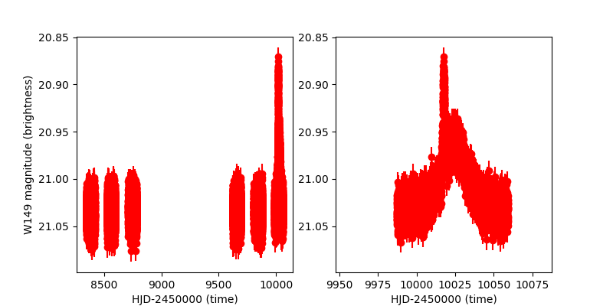
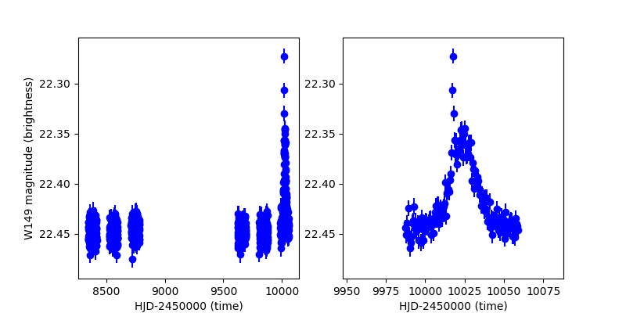
A Data Challenge Light Curve
Magnitude (brightness) vs. Time
2 wavelengths → 2 light curves

Slide 3
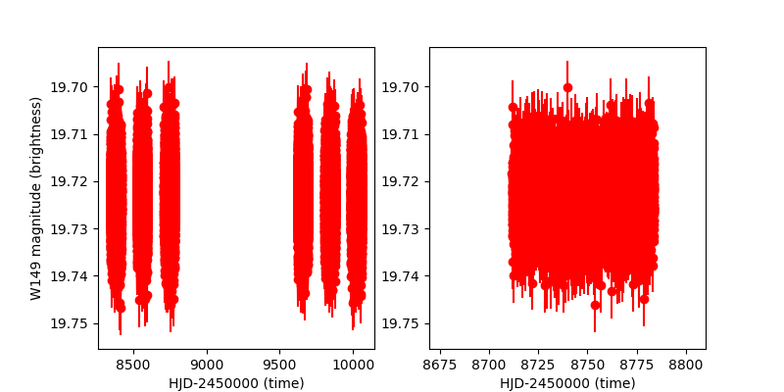
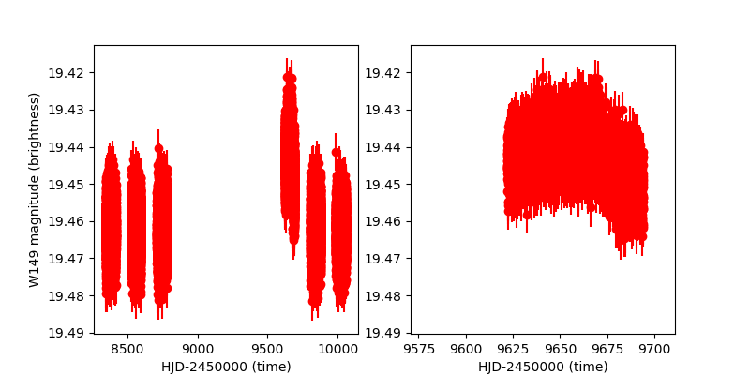
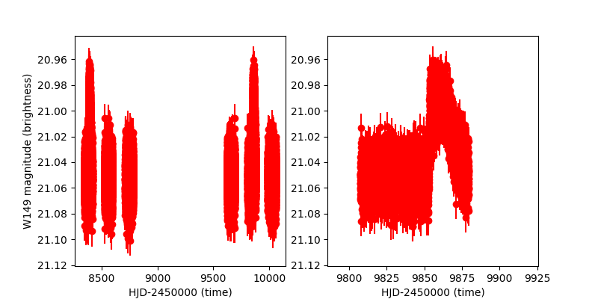
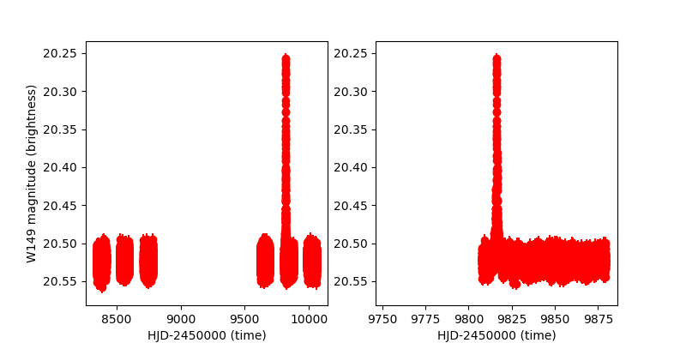
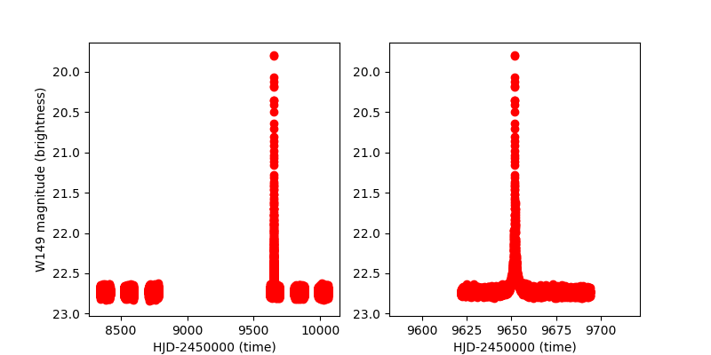
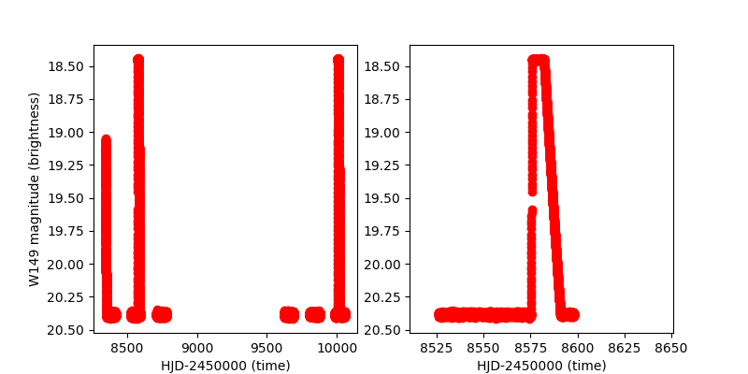
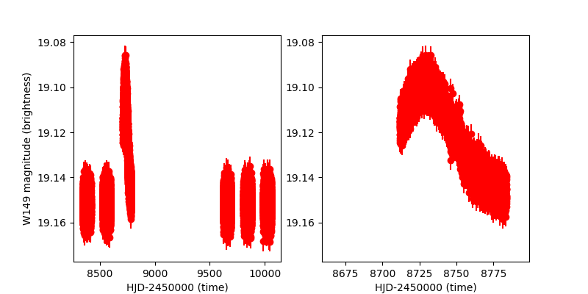
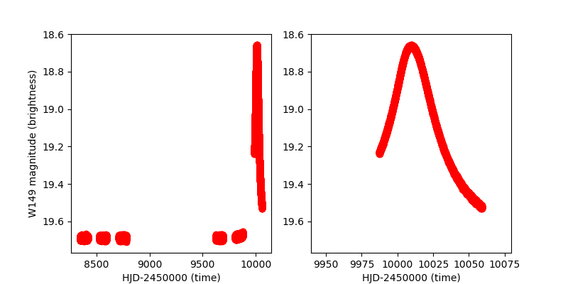
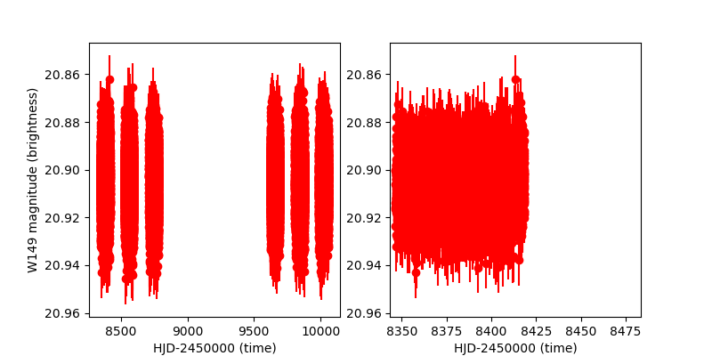
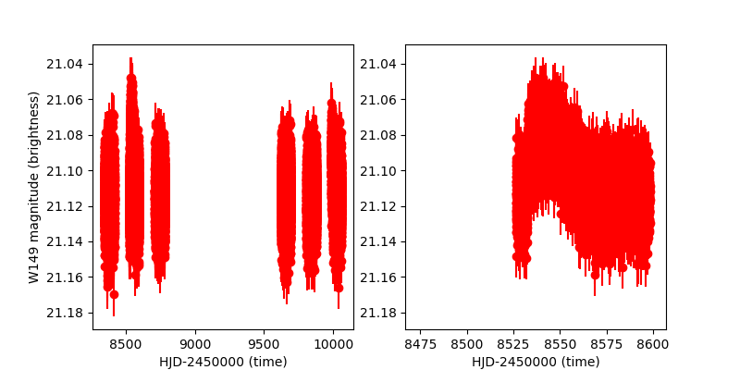
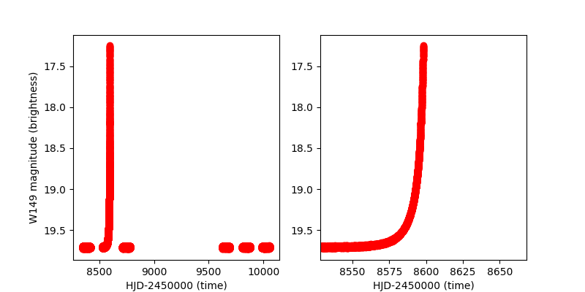

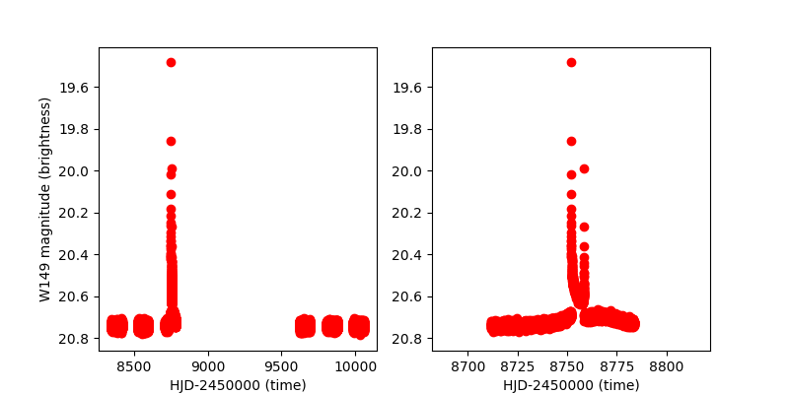
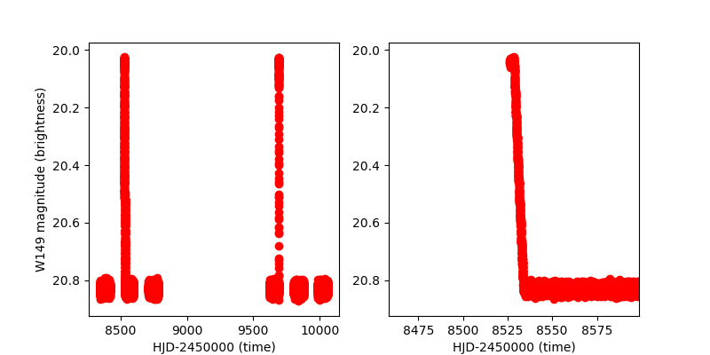
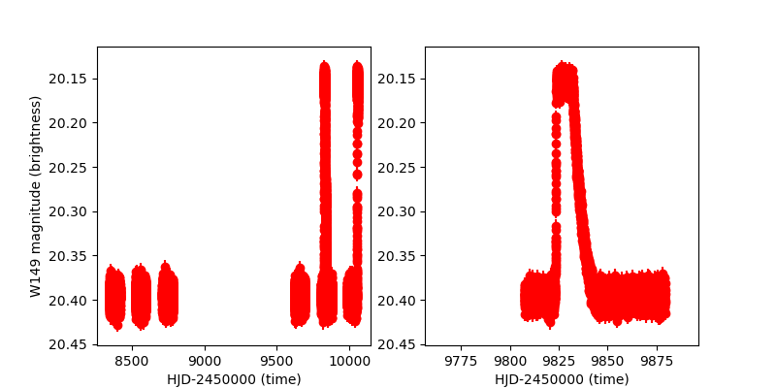
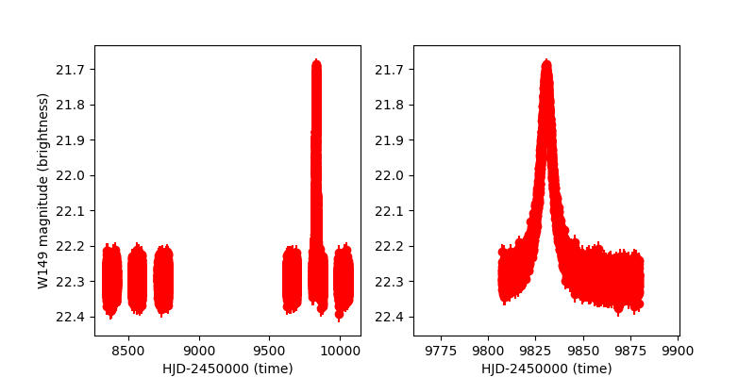
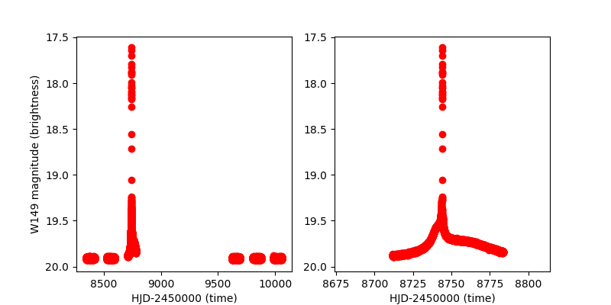
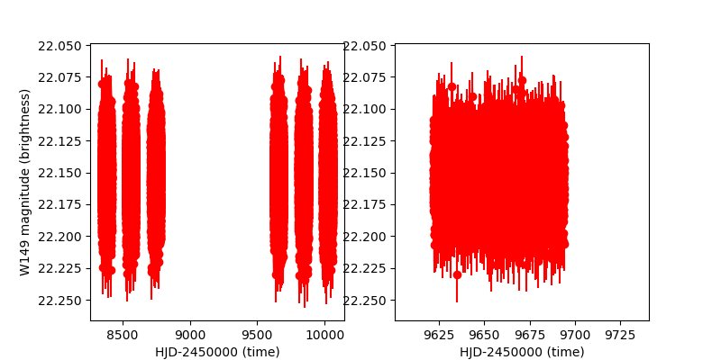
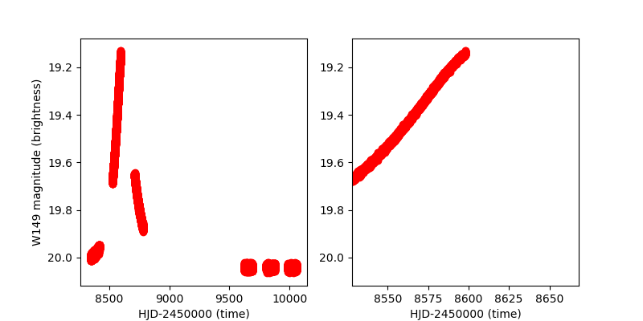
Data Challenge: “Solve” 293 light curves

Slide 4
Astronomer’s Question: Which ones have planets and what are their properties?

Slide 5
More General Questions:
Microlensing or Not Microlensing?
1-body or 2-bodies?
What are the parameters?

Slide 6
By-eye Identification

Slide 7
Grid Search for Best Model
Modelling by In-Gu Shin

Slide 8
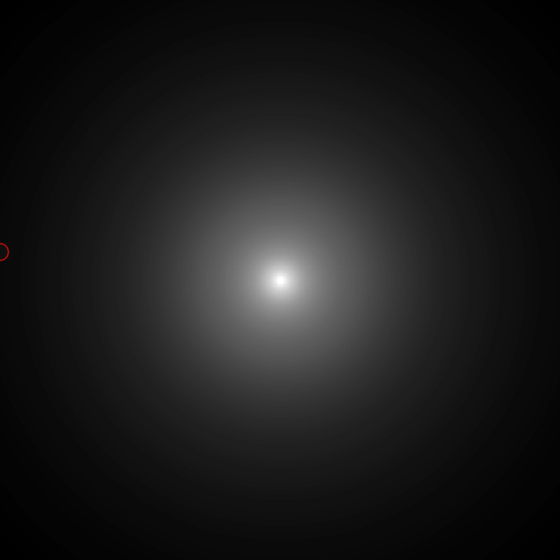
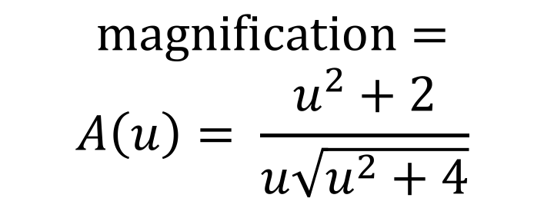
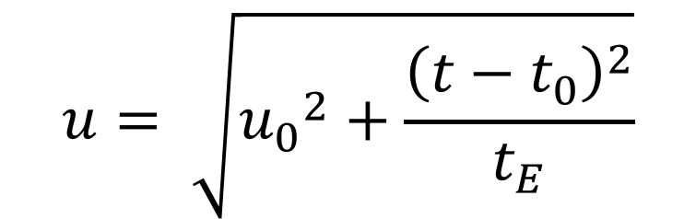
Microlensing with 1-body: t₀, u₀, t_{E}
$$\text{magnification}=$$
$$A\left(u\right)= \frac{u^{2}+2}{u\sqrt{u^{2}+4}}$$
$$u= \sqrt{{u_{0}}^{2}+\frac{{\left({t−t}_{0}\right)}^{2}}{t_{E}}}$$

Slide 9

Larger t_{E} = Slower
$$\text{magnification}=$$
$$A\left(u\right)= \frac{u^{2}+2}{u\sqrt{u^{2}+4}}$$
$$u= \sqrt{{u_{0}}^{2}+\frac{{\left({t−t}_{0}\right)}^{2}}{t_{E}}}$$

Slide 10
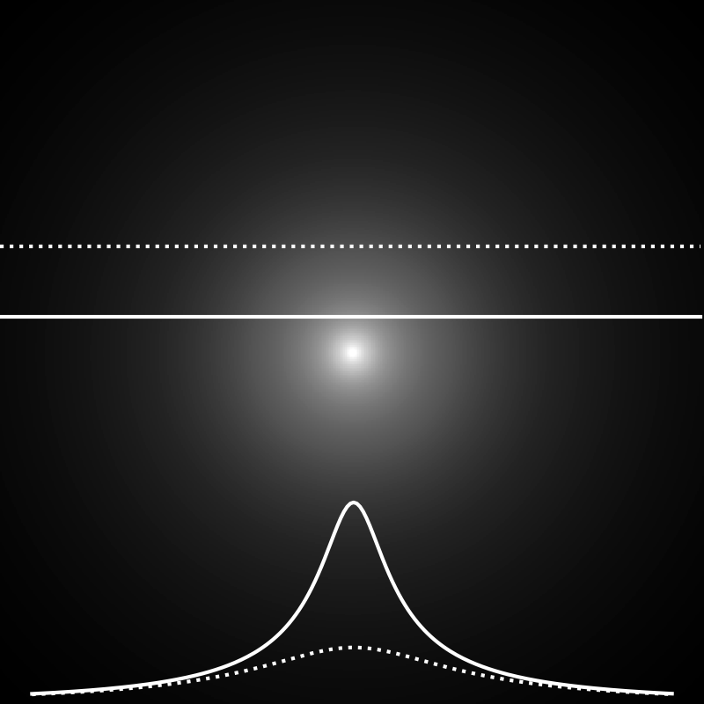
Larger u₀ = Smaller Magnification
$$\text{magnification}=$$
$$A\left(u\right)= \frac{u^{2}+2}{u\sqrt{u^{2}+4}}$$
$$u= \sqrt{{u_{0}}^{2}+\frac{{\left({t−t}_{0}\right)}^{2}}{t_{E}}}$$

Slide 11
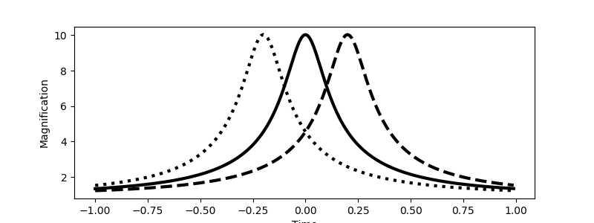
t₀ shifts the light curve in time
$$\text{magnification}=$$
$$A\left(u\right)= \frac{u^{2}+2}{u\sqrt{u^{2}+4}}$$
$$u= \sqrt{{u_{0}}^{2}+\frac{{\left({t−t}_{0}\right)}^{2}}{t_{E}}}$$

Slide 12
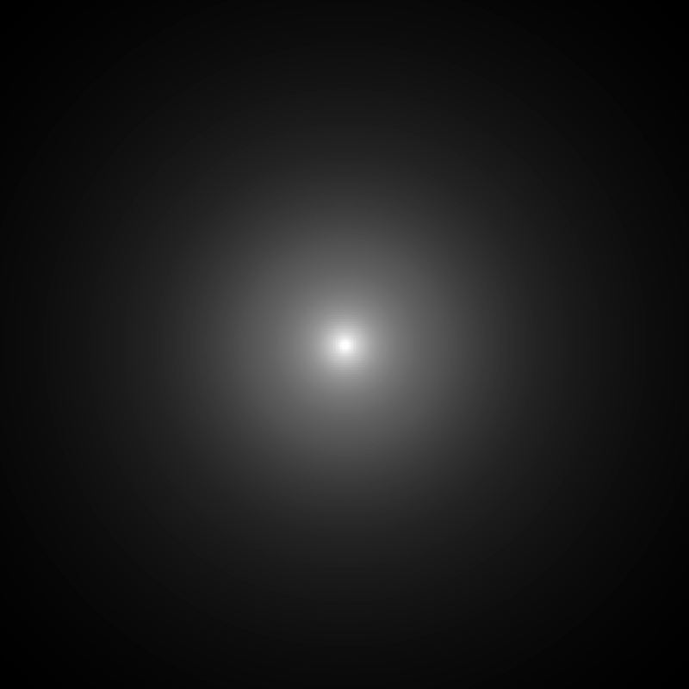
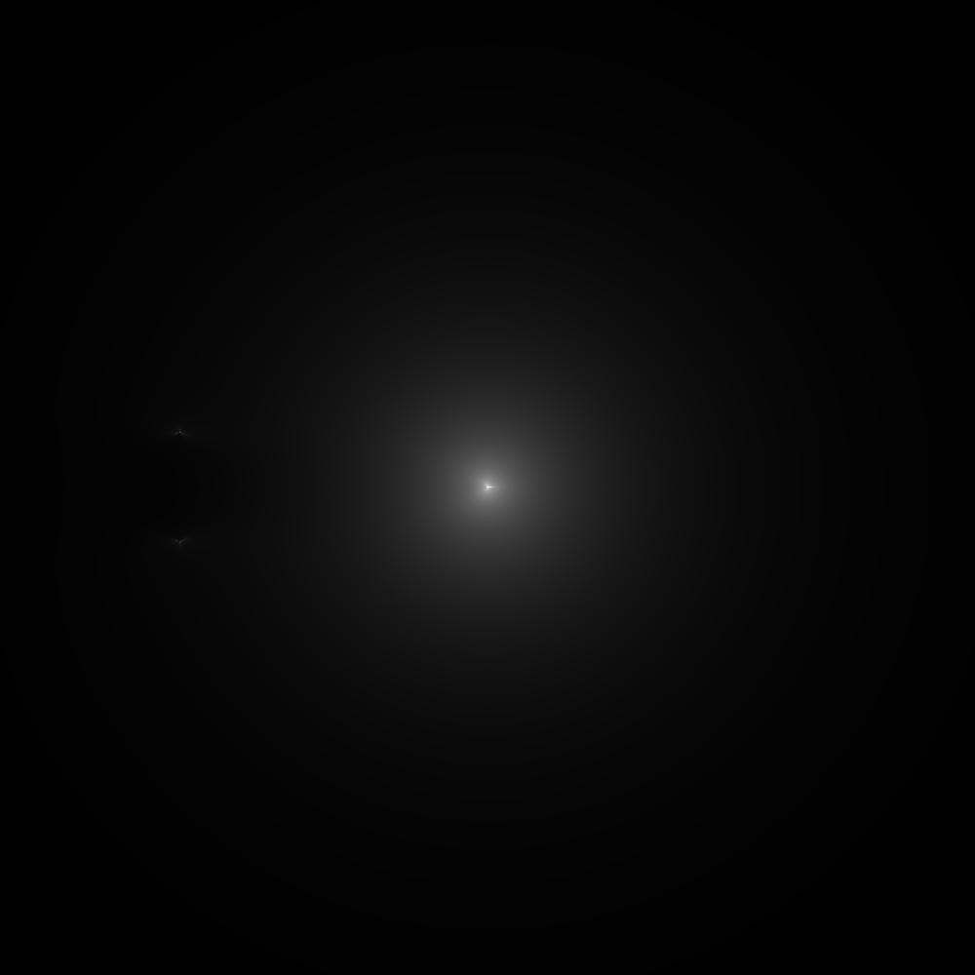
Microlensing with 2-bodies: s, q, alpha
1-body
2-bodies

Slide 13
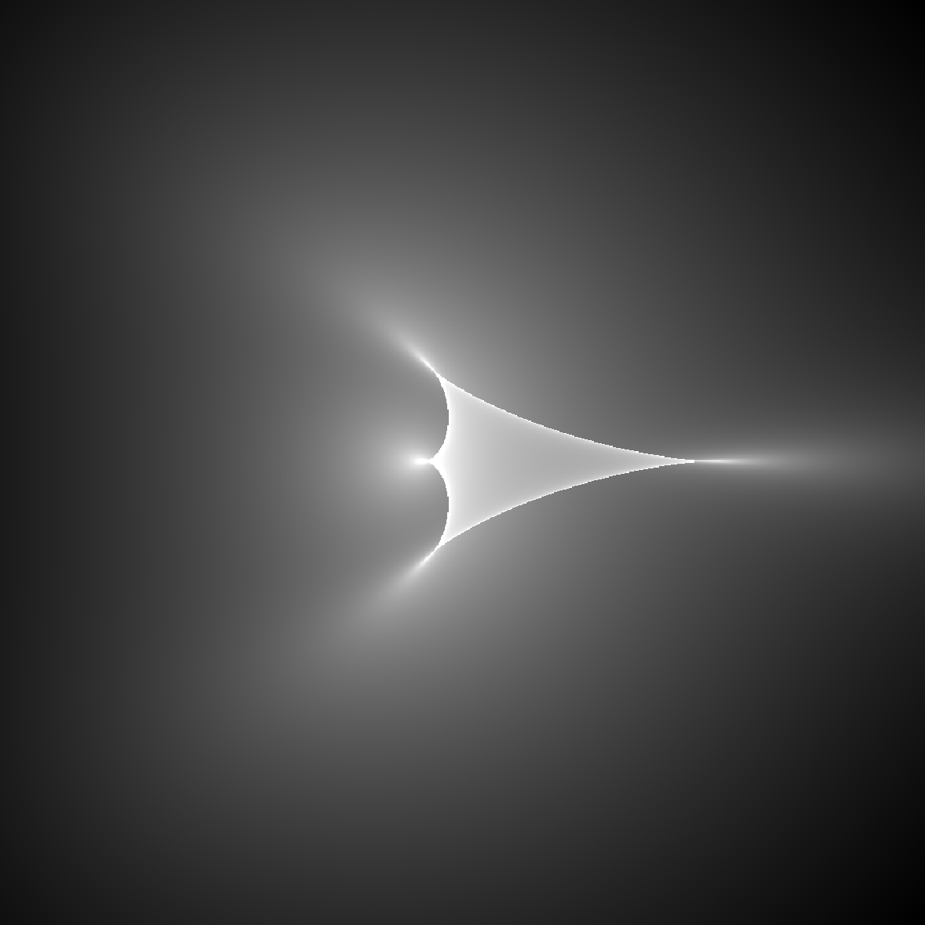
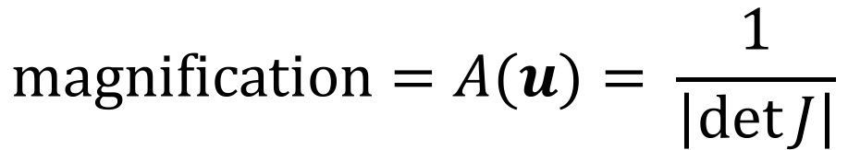
Microlensing with 2-bodies: Caustics
$$\text{magnification}=A(u)= \frac{1}{\left|\det{J}\right|}$$

Slide 14
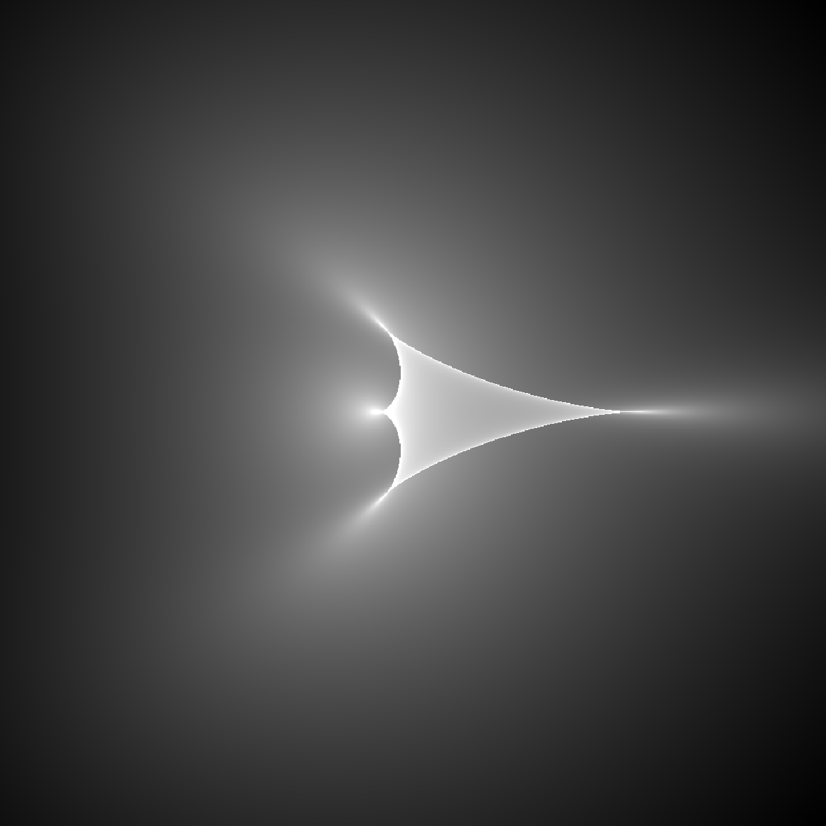
Microlensing with 2-bodies: Caustics
$$\text{magnification}=A(u)= \frac{1}{\left|\det{J}\right|}$$

Slide 15

s, q affect the topology of the caustic

Slide 16
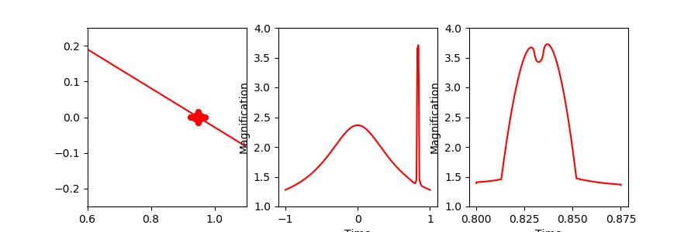
How do (s, q, alpha) affect the light curve?

Slide 17
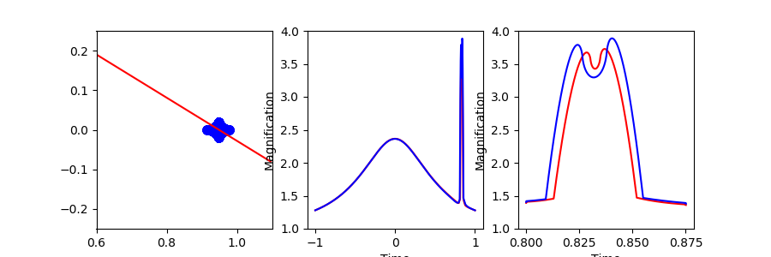
Bigger q = bigger caustic = bigger signal

Slide 18
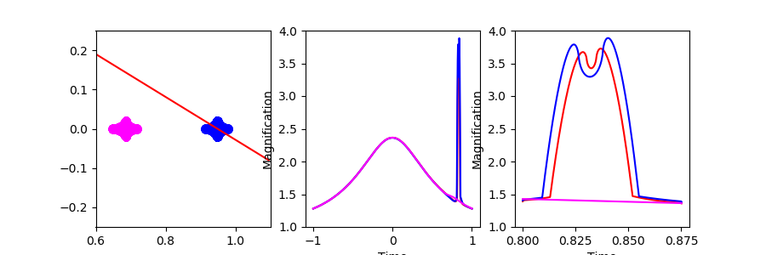
Smaller s moves the caustic → no signal

Slide 19
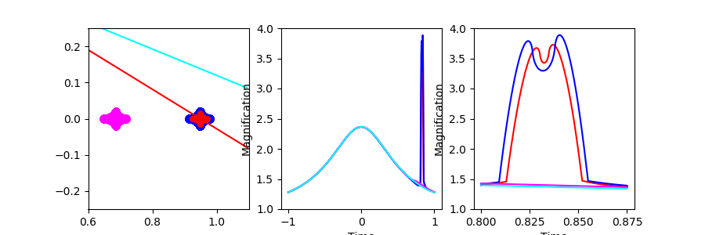
Larger alpha moves source path → no signal

Slide 20
rho = source size → integrated magnification

Slide 21
f_{source}, f_{blend} = The flux parameters
$$f_{\text{observed}}=f_{\text{source}} A\left(t\right)+f_{\text{blend}}$$
$${W149}_{\text{observed}}=18 −2.5 \log_{10}{(f_{\text{observed}}})$$

Slide 22
Other Physics
Parallax = non-inertial observer frame, e.g. the Earth accelerates (pi_E_N, pi_E_E)
Lens motion = two gravitationally bound bodies orbit each other (ds_dt, dalpha_dt)
Multiple source stars
  2 luminous sources
  Orbital motion of the source

Slide 23
Finding the Global Minimum: Multiple Minima
Hwang et al. 2018 arXiv:1802.10246

Slide 24
Given the complexity of the likelihood space, what are the best techniques for finding the global minimum?

Slide 25
Resources
Data Challenge Website: http://microlensing-source.org/data-challenge-guidelines/
Codes for Generating Microlensing Models:
  MulensModel: https://github.com/rpoleski/MulensModel
  pyLIMA: https://github.com/ebachelet/pyLIMA
Background on Microlensing:
  Website: http://microlensing-source.org/
  Review Articles:
    Gaudi 2010 in Exoplanets edited by S. Seager
    Gaudi 2012, ARA&A, 50, 411
    Yee 2014 Section 7 of Exoplanet Detection Techniques in Protostars and Planets VI, ed. Beuther, Klessen, Dullemond, and Henning
  Mathematics:
    Schnieder & Weiss 1986, A&A, 164, 237
    Dominik 1999, A&A, 349, 108

