Slide 1
Three data analysis problems
Andreas Zezas
University of Crete
CfA

Slide 2
Two types of problems:
Fitting
Source Classification

Slide 3
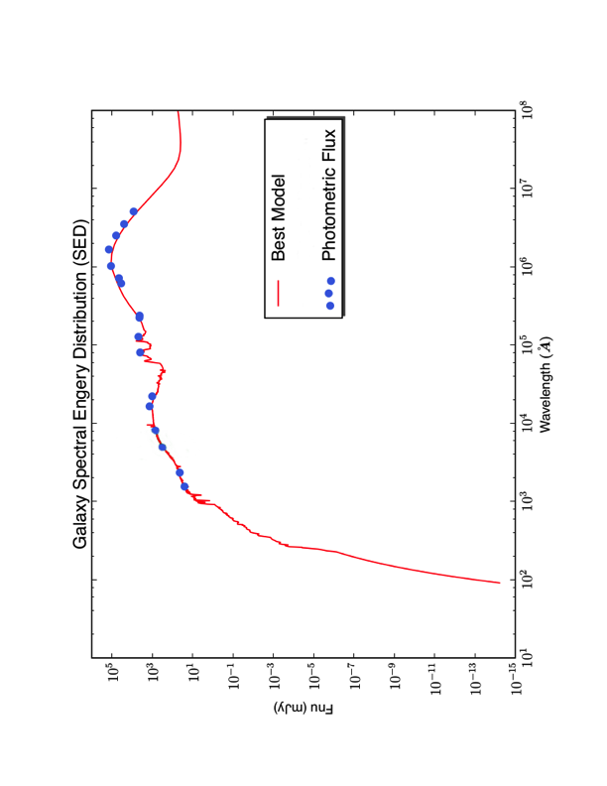
Fitting: complex datasets

Slide 4
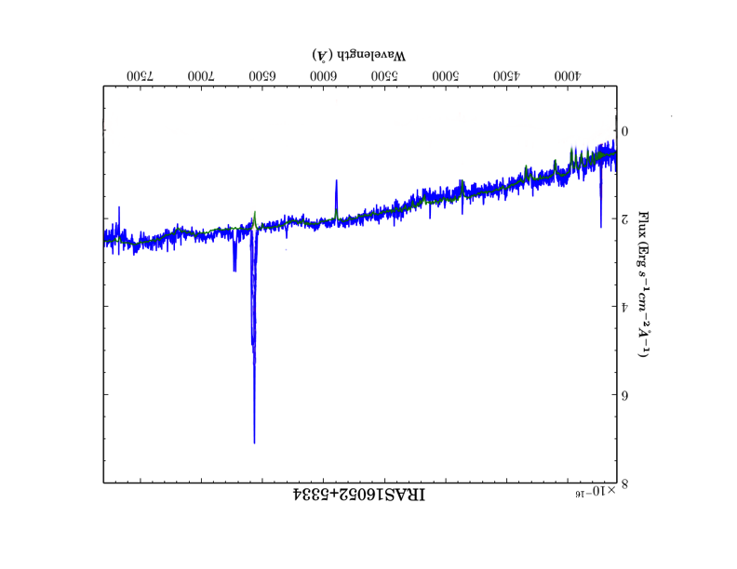
Fitting: complex datasets
Maragoudakis et al. in prep.

Slide 5
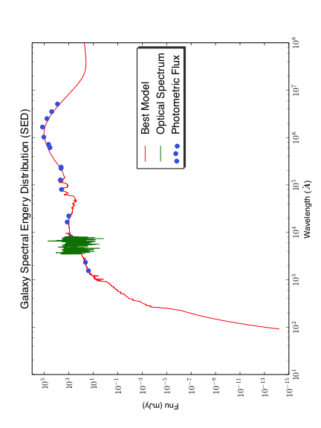
Fitting: complex datasets

Slide 6
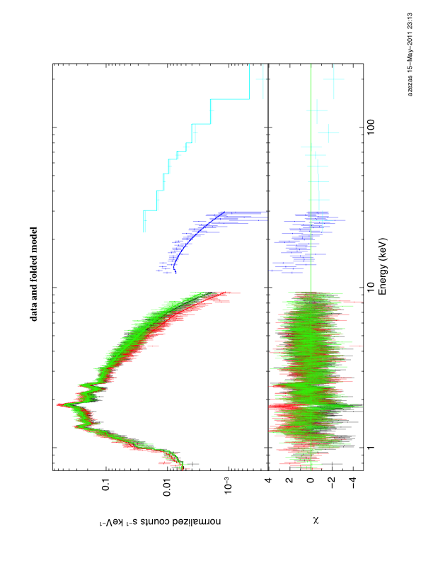
Fitting: complex datasets
Iterative fitting may work, but it is inefficient and confidence intervals on parameters not reliable
How do we fit jointly the two datasets ?
VERY common problem !

Slide 7
Problem 2
Model selection in 2D fits of images

Slide 8
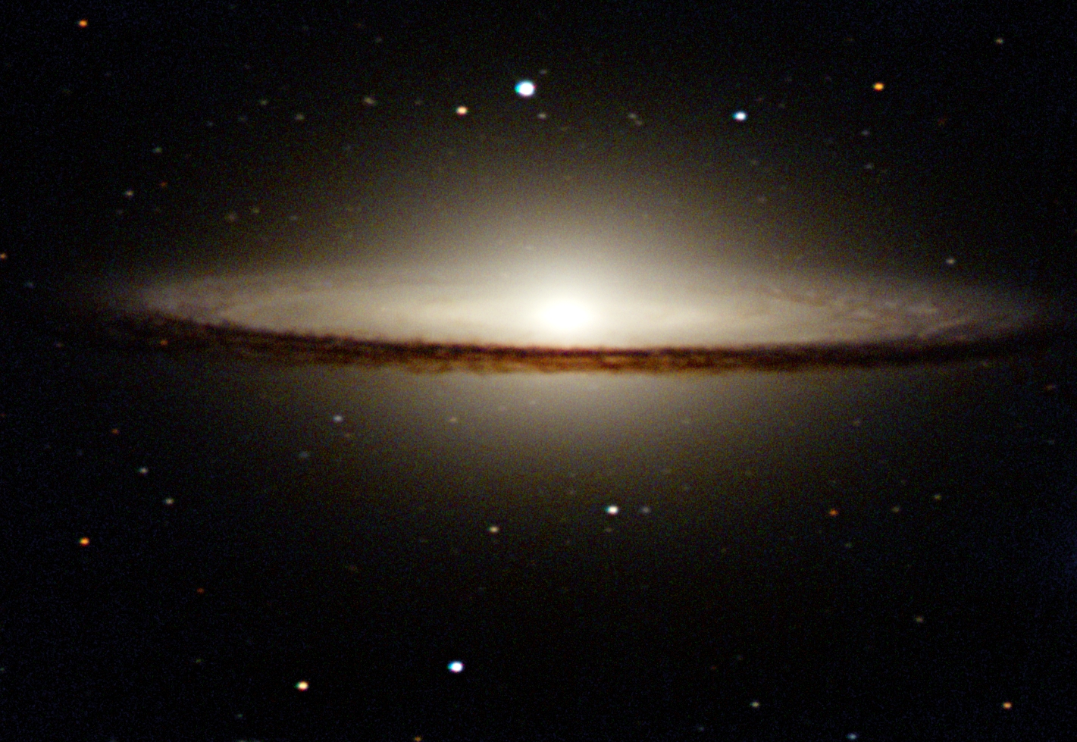
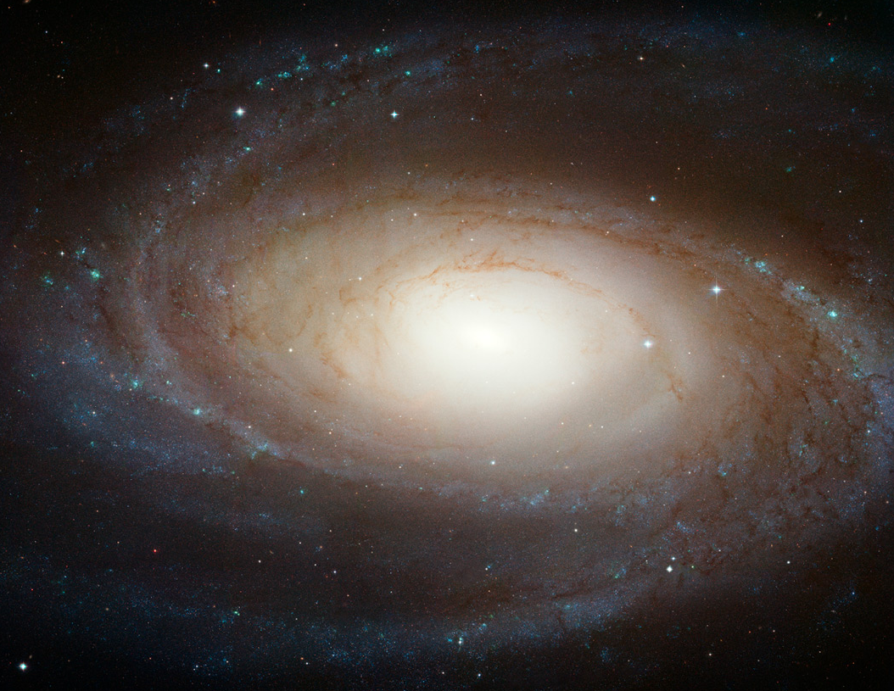
A primer on galaxy morphology
Three components:
spheroidal
exponential disk
and nuclear point source (PSF)

Slide 9


Fitting: The method
Use a generalized model
n=4 : spheroidal
n=1 : disk
Add other (or alternative) models as needed
Add blurring by PSF
Do χ² fit (e.g. Peng et al., 2002)

Slide 10
Fitting: The method
Typical model tree
n=free n=4 n=1
n=4 n=4 n=4
PSF PSF PSF PSF PSF

Slide 11
Fitting: Discriminating between models
Generally χ² works
BUT:
Combinations of different models may give similar χ²
How to select the best model ?
Models not nested: cannot use standard methods
Look at the residuals

Slide 12
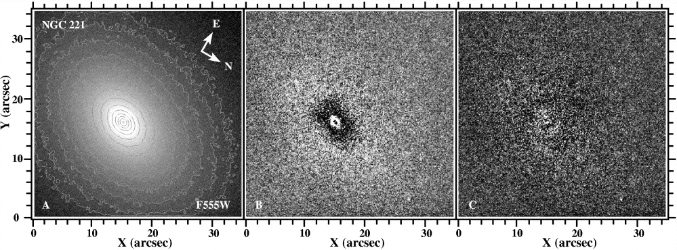
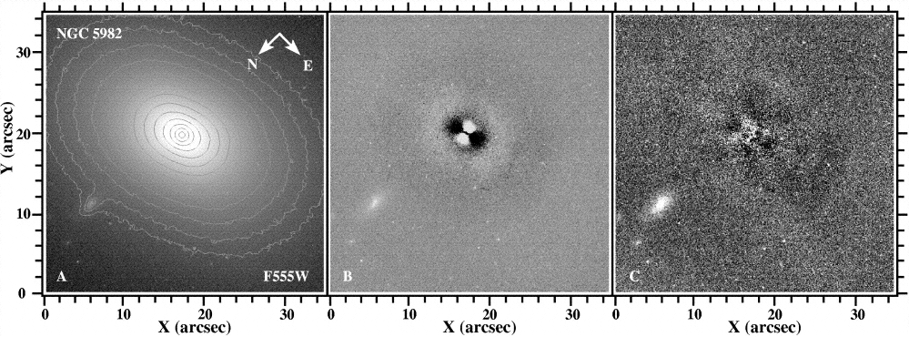
Fitting: Discriminating between models

Slide 13
Fitting: Discriminating between models
Excess variance
Best fitting model among least χ² models
the one that has the lowest exc. variance

Slide 14
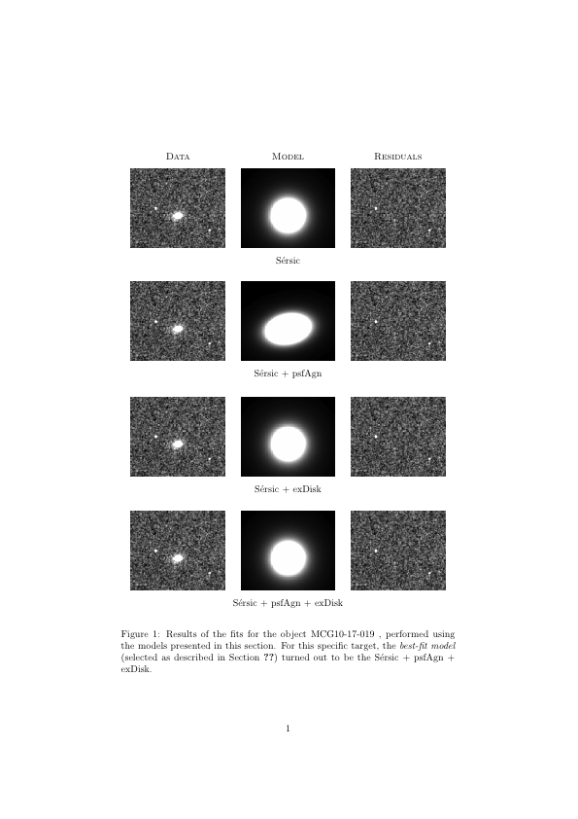
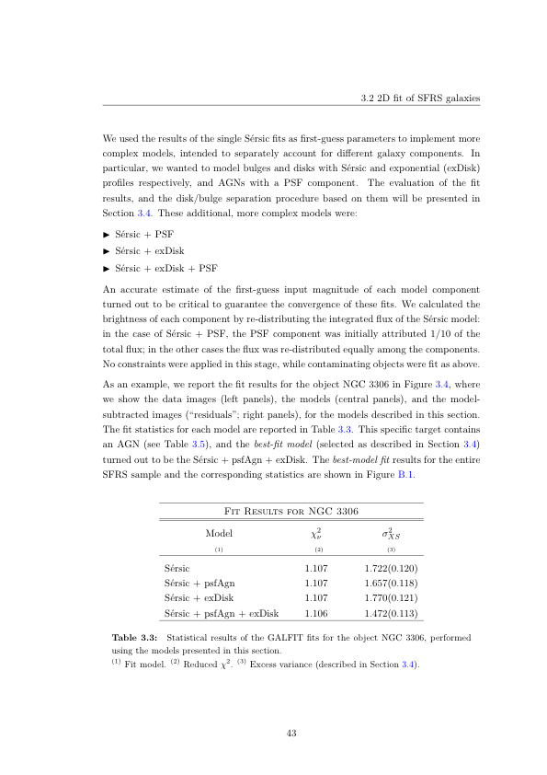
Fitting: Examples
Bonfini et al. in prep.

Slide 15
Fitting: Problems
However, method not ideal:
It is not calibrated
Cannot give significance
Fitting process computationally intensive
Require an alternative, robust, fast, method

Slide 16
Problem 3
Source Classification
(a) Stars

Slide 17
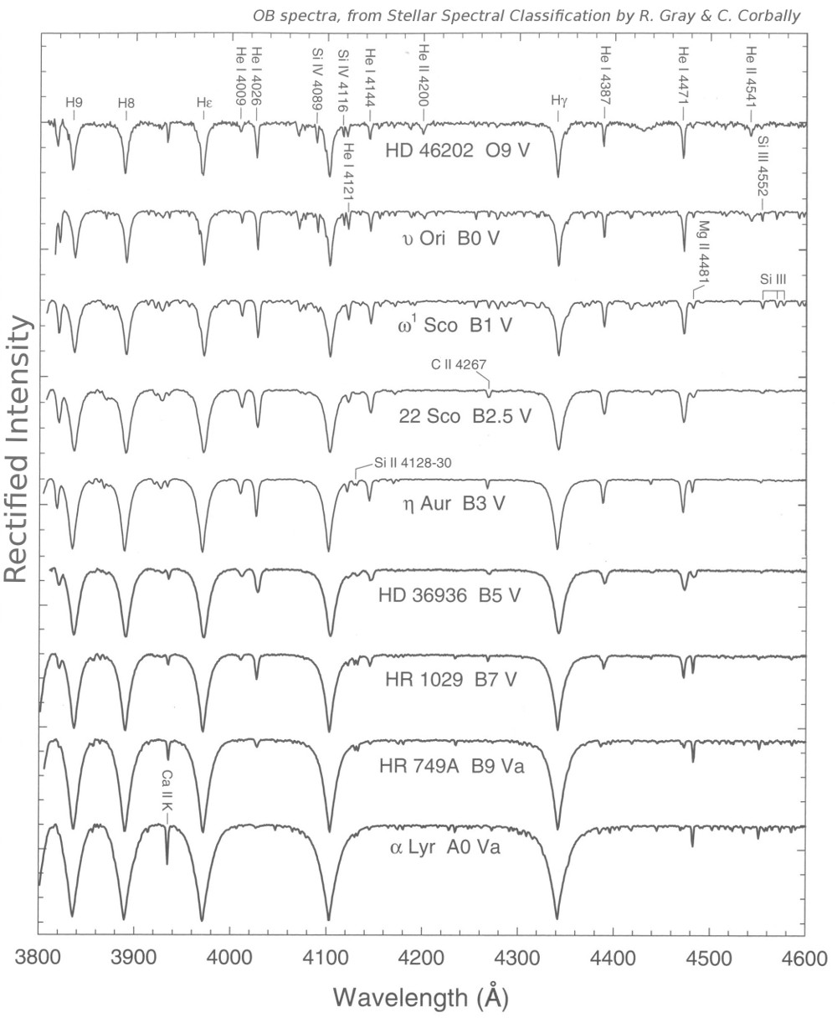
Classifying stars
Relative strength of lines discriminates between different types of stars
Currently done “by eye”
or
by cross-correlation analysis

Slide 18
Classifying stars
Would like to define a quantitative scheme based on strength of different lines.

Slide 19
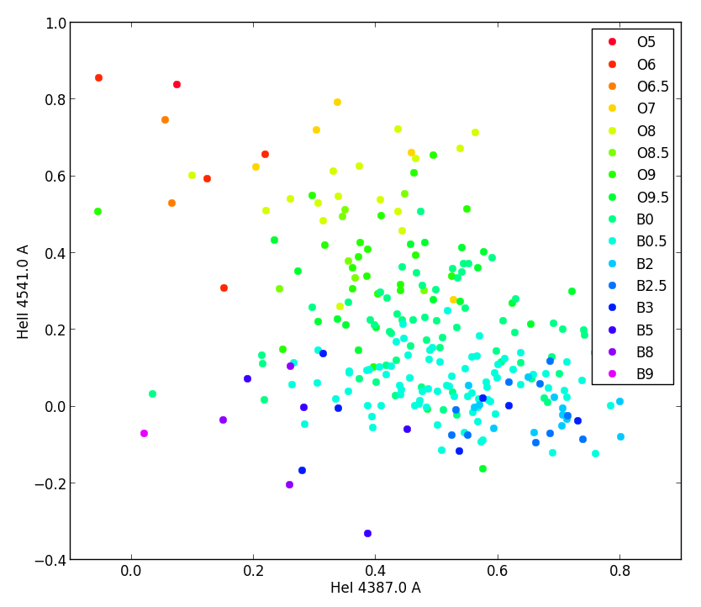
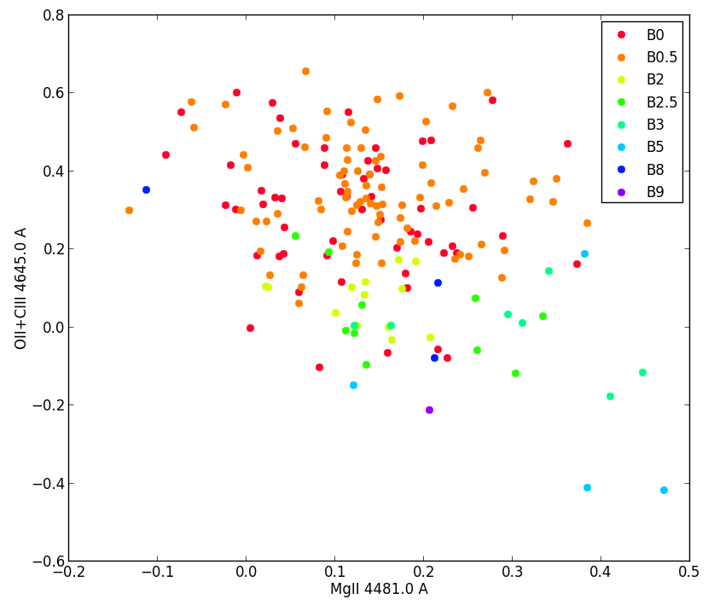
Classifying stars
Maravelias et al. in prep.

Slide 20
Classifying stars
Not simple….
Multi-parameter space
Degeneracies in parts of the parameter space
Sparse sampling
Continuous distribution of parameters in training sample (cannot use clustering)
Uncertainties and intrinsic variance in training sample

Slide 21
Problem 3
Source Classification
(b) Galaxies

Slide 22
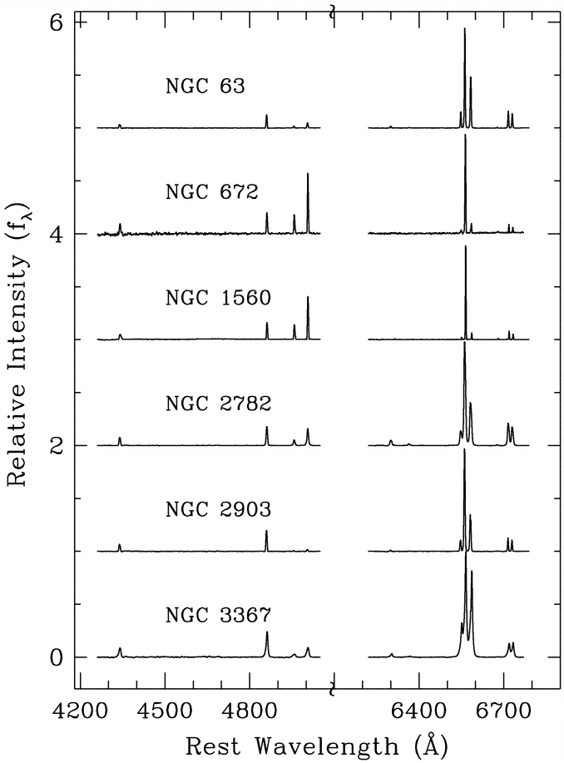
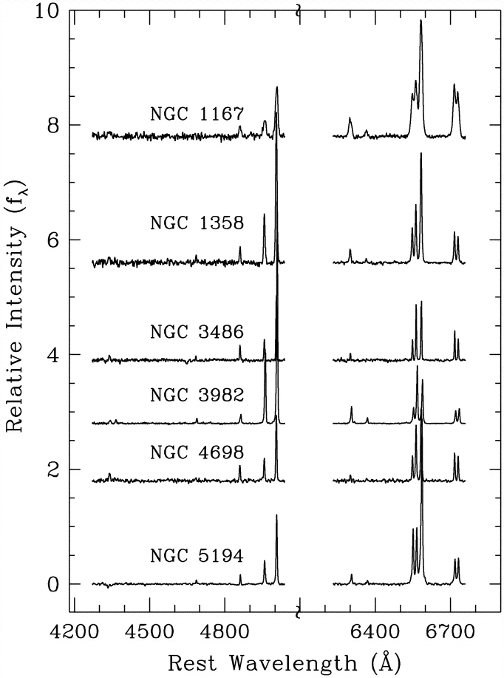
Classifying galaxies
Ho et al. 1999

Slide 23
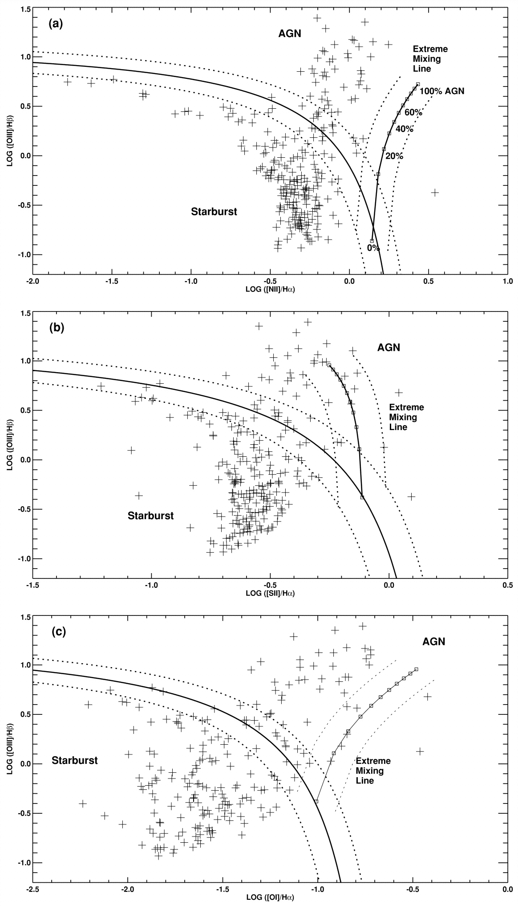
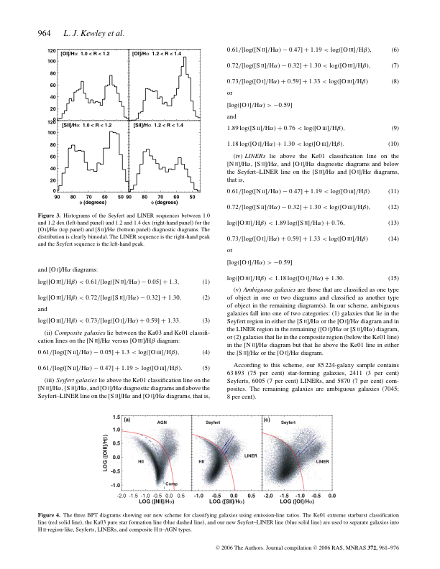
Classifying galaxies
Kewley et al. 2001
Kewley et al. 2006

Slide 24
Classifying galaxies
Basically an empirical scheme
Multi-dimensional parameter space
Sparse sampling - but now large training sample available
Uncertainties and intrinsic variance in training sample
➔ Use observations to define locus of different classes

Slide 25
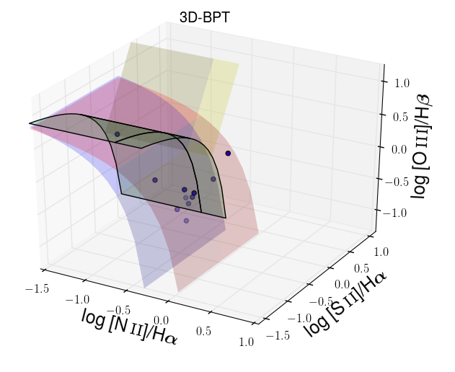
Classifying galaxies
Uncertainties in classification due to
  measurement errors
  uncertainties in diagnostic scheme
Not always consistent results from different diagnostics
Use ALL diagnostics together
Obtain classification with a confidence interval
Maragoudakis et al in prep.

Slide 26
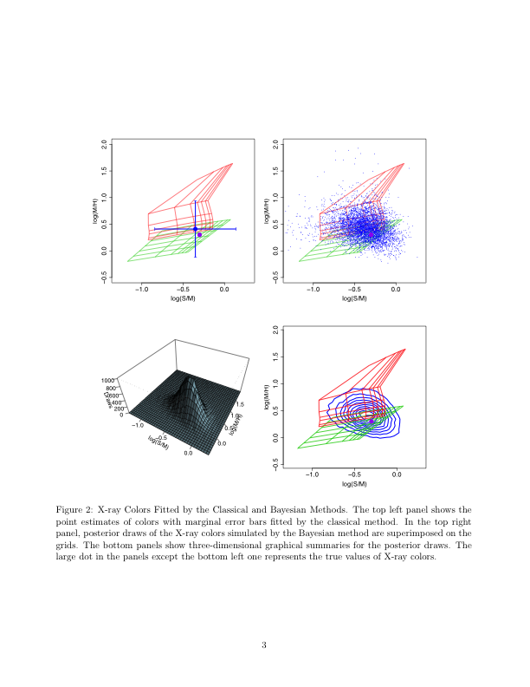
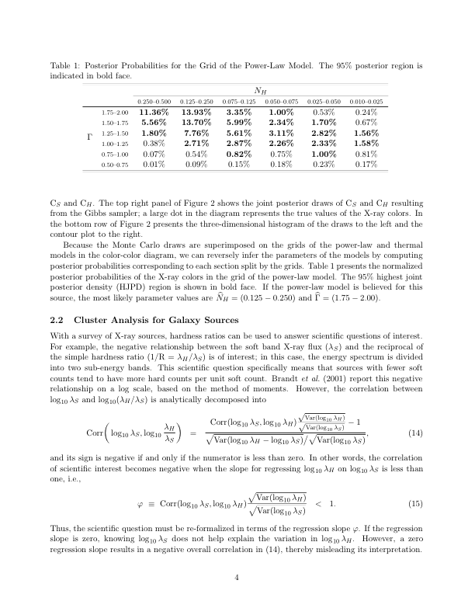
Classification
Problem similar to inverting Hardness ratios to spectral parameters
But more difficult
  We do not have well defined grid
  Grid is not continuous
Γ
N_{H}
Taeyoung Park’s thesis

Slide 27
Summary
Model selection in multi-component 2D image fits
Joint fits of datasets of different sizes
Classification in multi-parameter space
  Definition of the locus of different source types based on sparse data with uncertainties
  Characterization of objects given uncertainties in classification scheme and measurement errors
  All are challenging problems related to very common data analysis tasks.
Any volunteers ?

