Slide 1
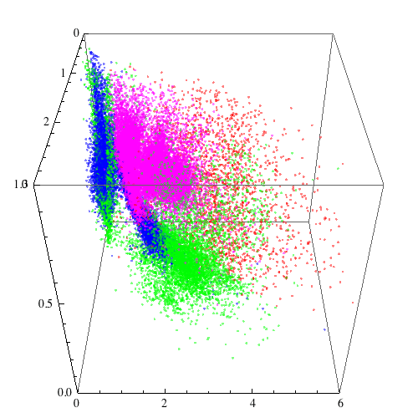
Adding a new dimension:
multivariate studies of X-ray Binaries
Saku Vrtilek (CfA), Luke Bornn (Harvard),
Bram Boroson (CSU), Joey Richards (LLNL)

Slide 2
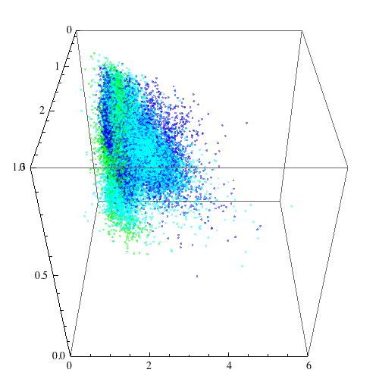
Putting X-ray binaries in their proper place.
Introduction:
X-ray binaries
Data set
CCI description
Physical interpretations
Statistical solutions (Luke)
Future work

Slide 3
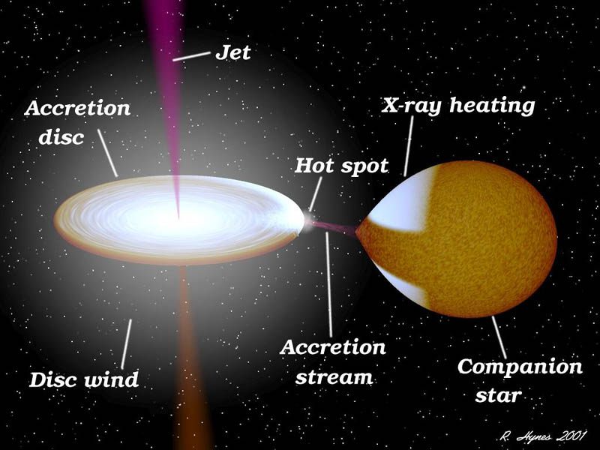
What are X-ray binaries?
Hot corona

Slide 4
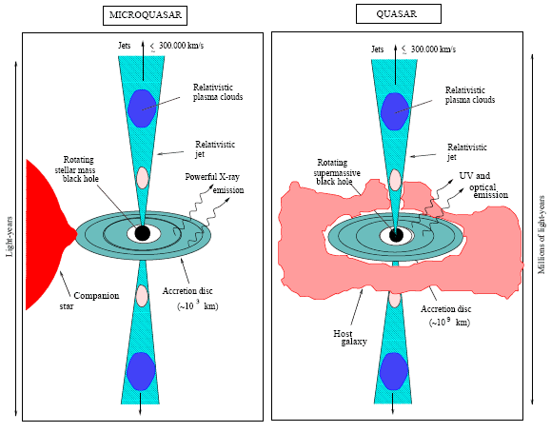
Quasars and microquasars show direct correlation between kinetic power and γ-ray luminosity over 10 orders of magnitude! Nemmen et al. 2012
http://hera.ph1.uni-koeln.de/~heintzma

Slide 5
τ ≈ R_{S}/c ~ M
Minutes Years

Slide 6
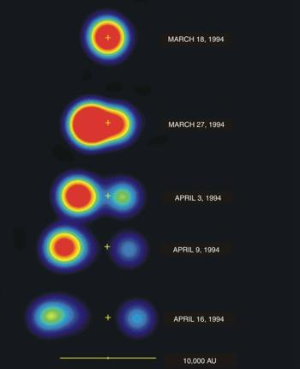
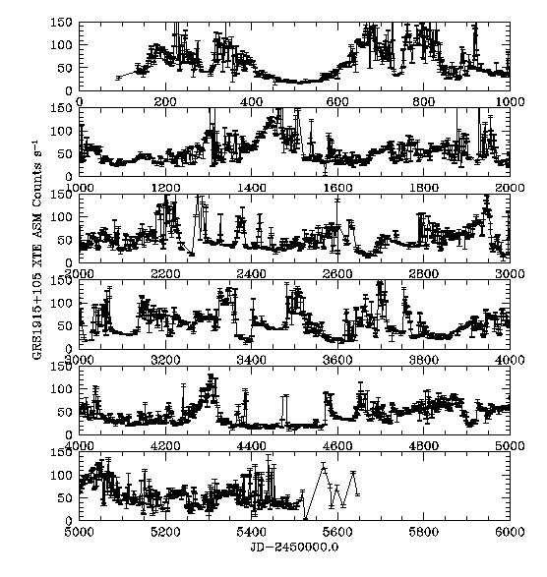
Mirabel et al 1994
Nature front page
GRS1915+105:
First XRB system observed to show prominent relativistic jets

Slide 7
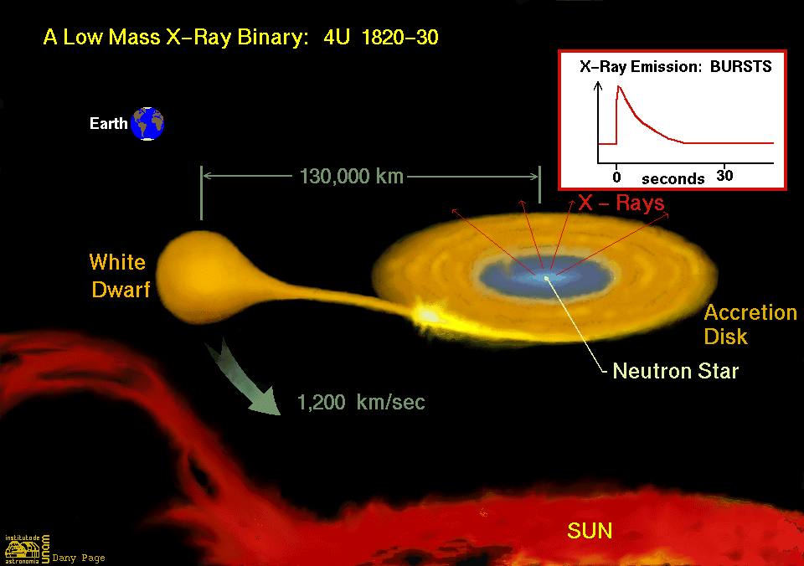
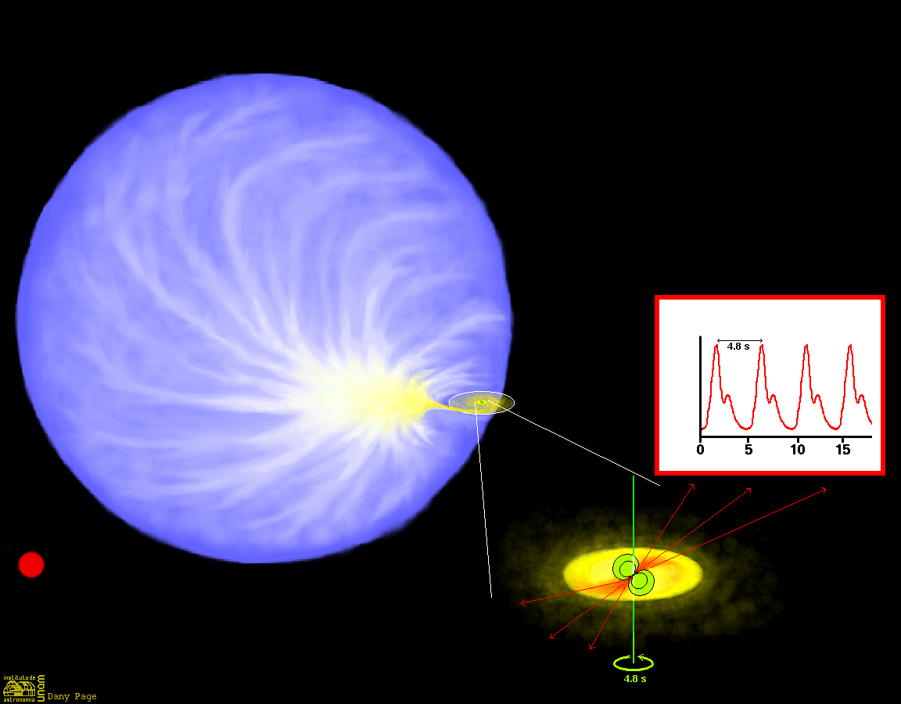
Why Study X-ray Binaries?
Efficient matter to energy converters
Study matter at extreme conditions
Contain endpoints of stellar evolution
Most nearby, easily studied example of accretion processes and disk/jet interaction
HEASARC

Slide 8
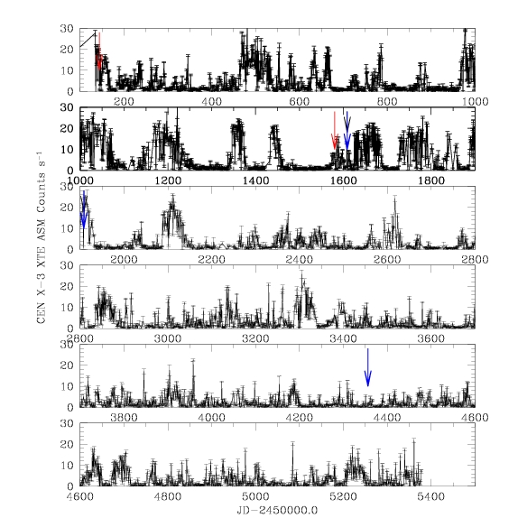
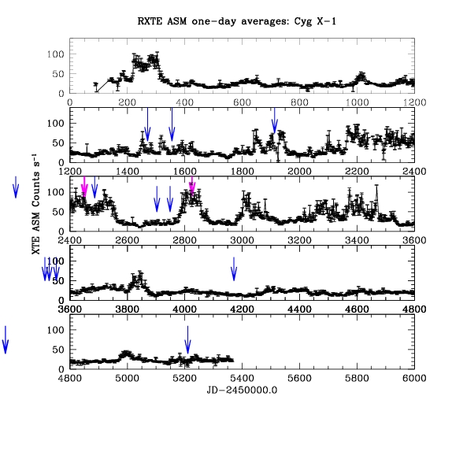
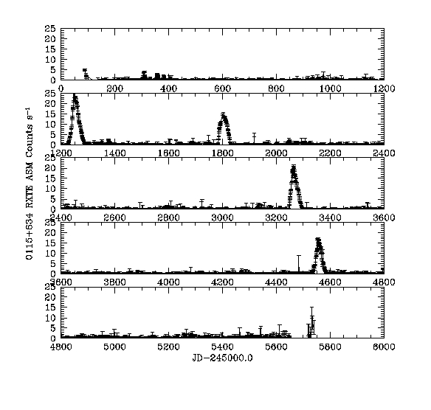
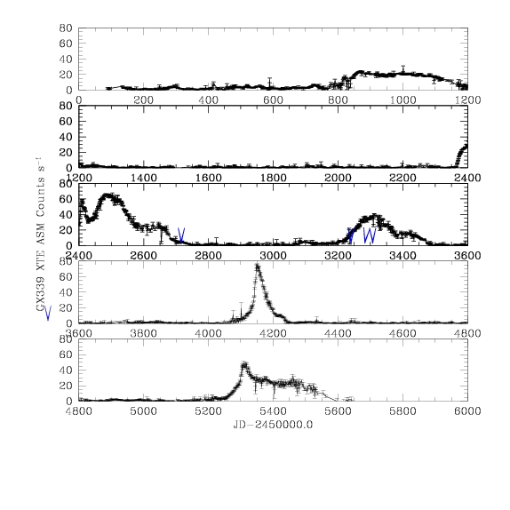
RXTE/ASM: 15 year light curves
Neutron star systems Black hole systems
Cen X-3
Cyg X-1
Intensity
Intensity
Time (days)
Time (days)
0115+634
GX339+4
Intensity
Intensity
Time (days)
Time (days)

Slide 9
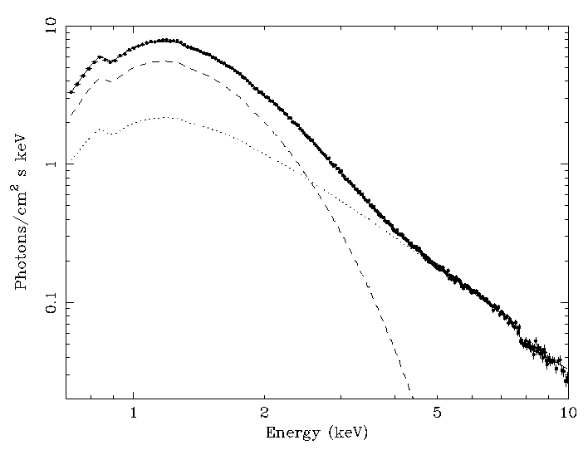
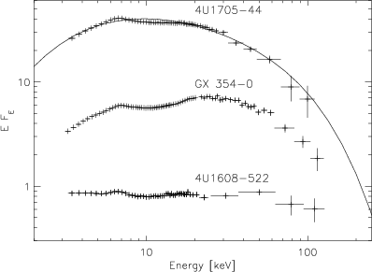
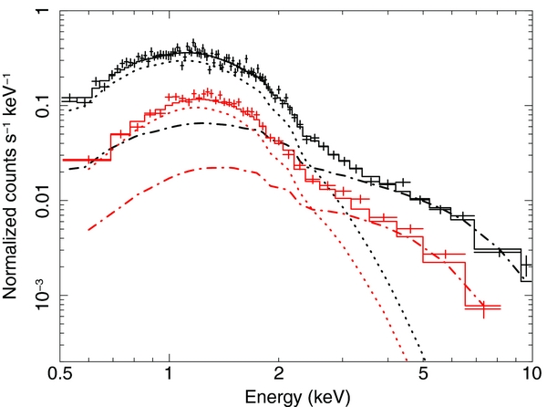
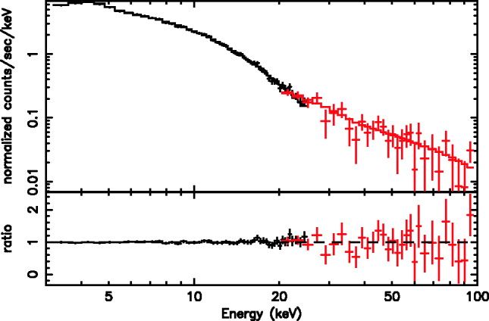
Spectra of X-ray binaries
Neutron star systems Black hole systems
Cyg X-1
Deufel, Dullemond & Spruit 2001
Dotani et al 1997
J1709-267
GX339-4
Dejenaar, Wijnands, & Miller 2013
Miller, Homan, & Miniutti 2006

Slide 10
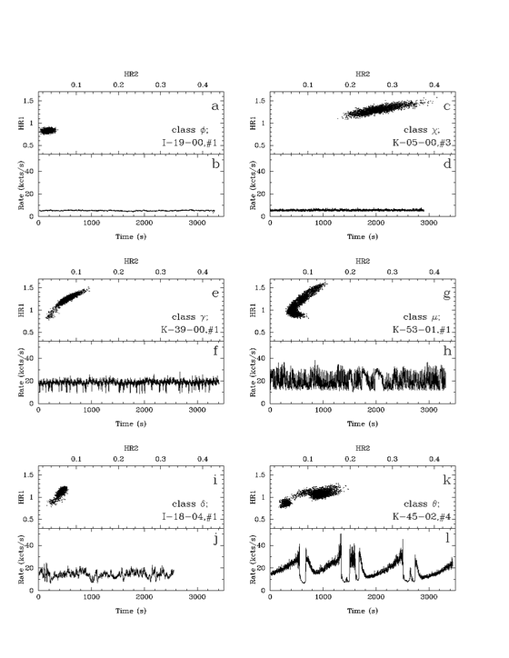
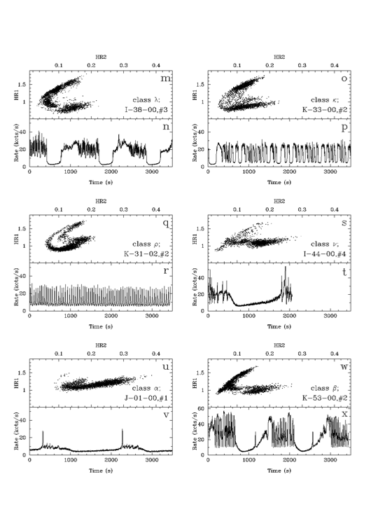
RXTE PCA lightcurves and color-color diagrams of GRS1915+105
1s bins; 1 hour intervals; HR1= (5-13keV)/(2-5keV); HR2=(13-60keV)/(2-5keV)
Belloni et al 2000

Slide 11
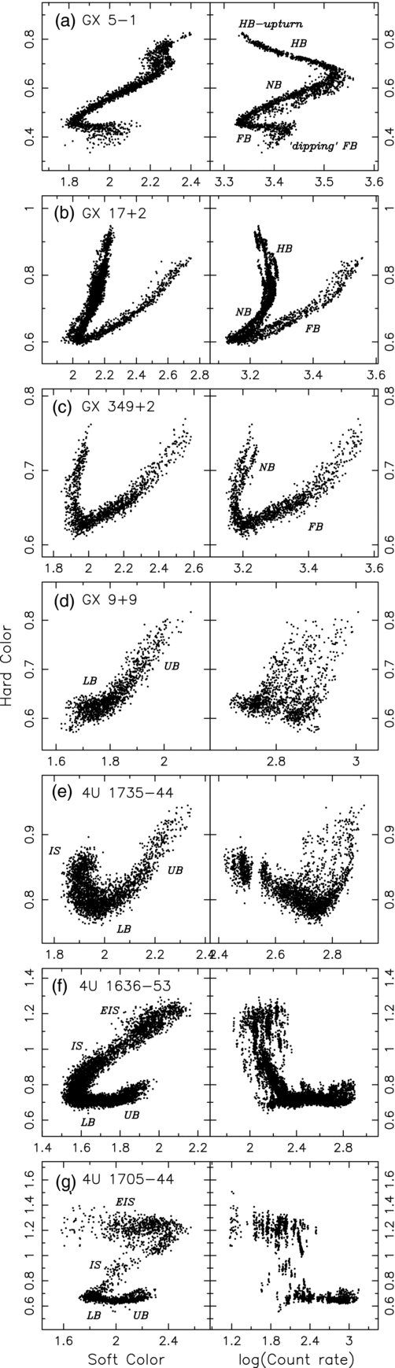
Black hole system GRS 1915+105
Belloni et al 2000
Neutron star “Z” and “Atoll” systems Homan
et al 2010
Hard Color various ranges
Color Intensity Color Intensity Color Intensity
Time (s) Time (s)
Soft Color Intensity

Slide 12
Putting X-ray binaries in their proper place.
Introduction:
X-ray binaries
➔Data set
CCI description
Physical interpretations
Statistical solutions (Luke)
Future work

Slide 13
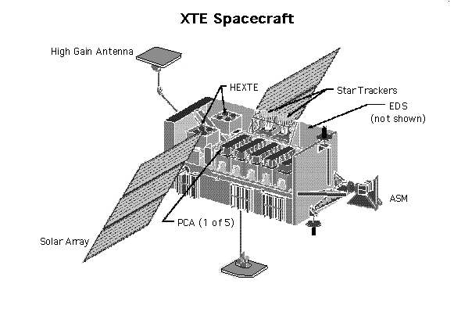
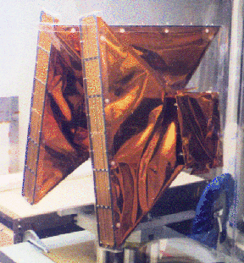
Levine et al 1996
RXTE ASM
3 scanning shadow cameras each with a collecting area of 30 cm²
Covers 80% of sky every 90 minutes
Sensitivity: 30 mCrab
3 energy bands covering 1.3-12 keV
Over 15 years of data available on about 500 sources.

Slide 14
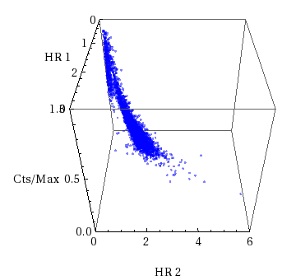
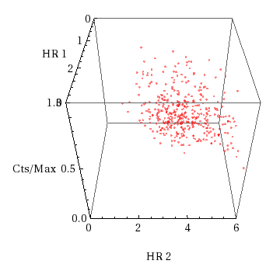
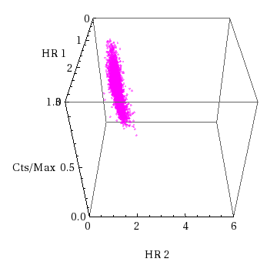
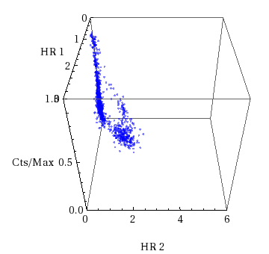
CCI Diagrams
Cyg X-1; black hole; high mass companion
Soft Color HR1 = (3-5keV)/(1.3-3keV)
Hard Color HR2 = (5-12keV)(1.3-3keV)
Intensity = 1.3-12keV counts
(scaled from 0-1)
RXTE/ASM data: One day averages over 13 years
Cyg X-2; non-pulsing Neutron Star “Z” type
Vela X-1; pulsing Neutron Star
GX339-4; Black hole, low-mass companion

Slide 15
Color-Color-Intensity Diagrams
C C I
C HR1 = (3-5keV)/(1.3-3keV)
C HR2 = (5-12keV)(1.3-3keV)
I Intensity = 1.3-12keV counts
(Intensity normalized to top 1%)
(Only ≥ 5σ points plotted)
RXTE/ASM data:
One day averages over 13 years;
Black holes high mass
Black holes low mass
Pulsing neutron stars
Non-pulsing neutron stars
Vrtilek & Boroson 2013

Slide 16
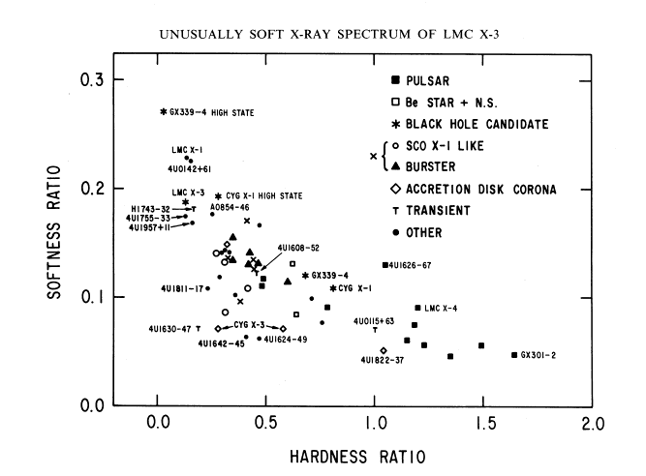
Soft color
Hard color
White & Marshall 1984

Slide 17
Color-Color-Intensity Diagrams
C C I
C HR1 = (3-5keV)/(1.3-3keV)
C HR2 = (5-12keV)(1.3-3keV)
I Intensity = 1.3-12keV counts
(Intensity normalized to top 1%)
(Only ≥ 5σ points plotted)
RXTE/ASM data:
One day averages over 13 years;
Black holes high mass
Black holes low mass
Pulsing neutron stars
Non-pulsing neutron stars
Vrtilek & Boroson 2013

Slide 18
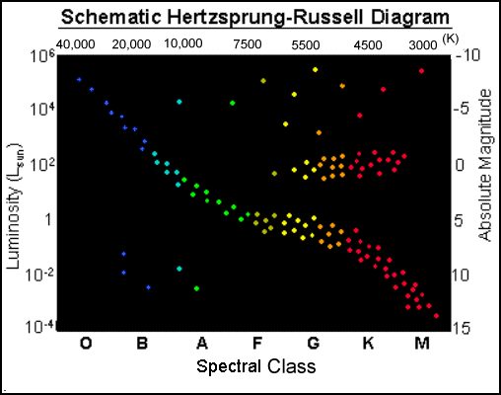
Optical Color (V-B)

Slide 19
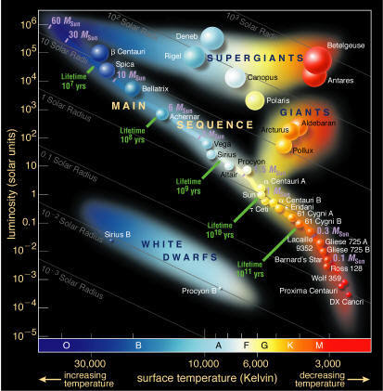

Slide 20
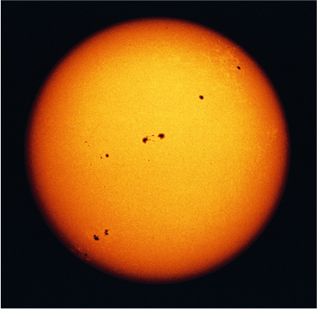
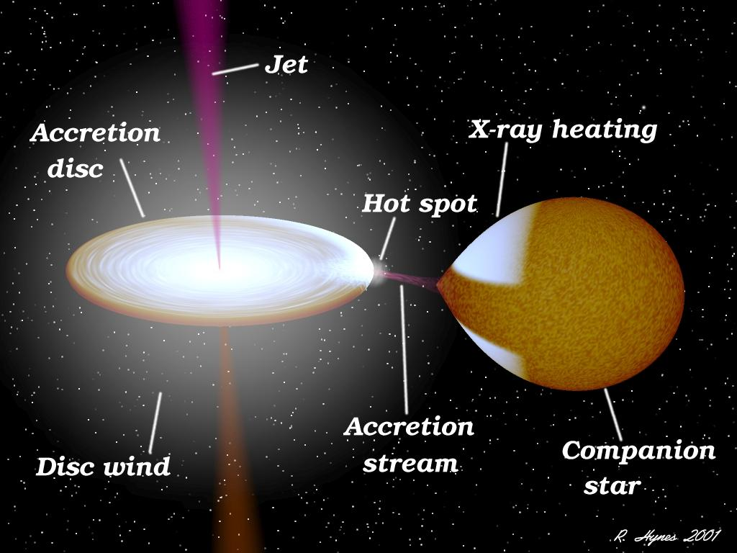
Optical Color + Optical Luminosity X-ray color + X-ray luminosity

Slide 21
A Hertsprung-Russell diagram for accreting binaries?
;
Black holes high mass
Black holes low mass
Pulsing neutron stars
Non-pulsing neutron stars
Vrtilek & Boroson 2013

Slide 22
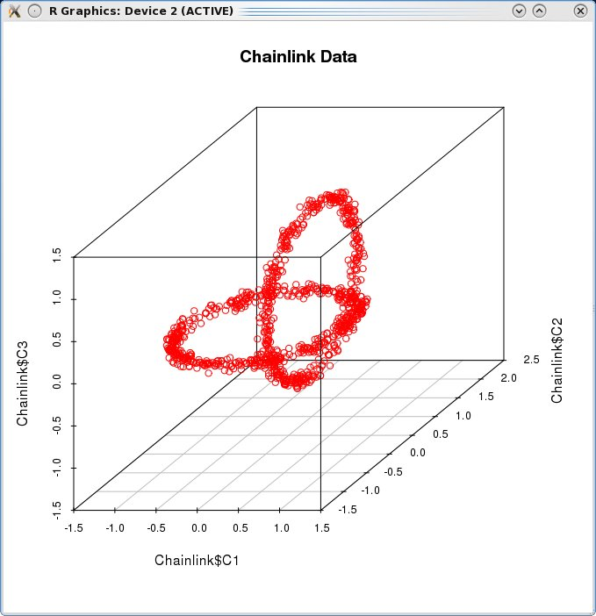
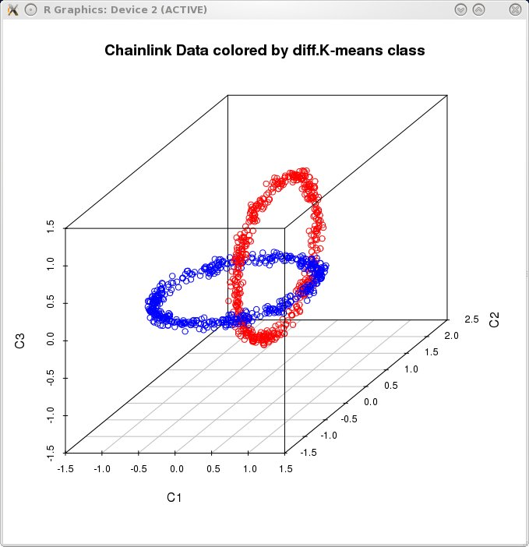
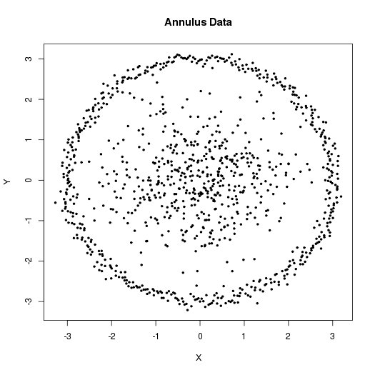
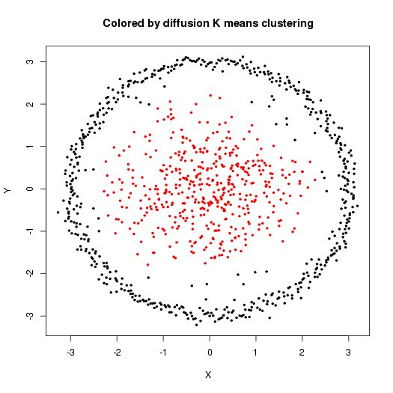
Spectral Connectivity Analysis
Richards et al (2008; 2009)
Freeman et al (2009)
Lee & Waterman (2010)
Input data Data clustered by diffusionMap
diffusionMap:
http://cran.r-project.org/web/packages/diffusionMap/index.html

Slide 23
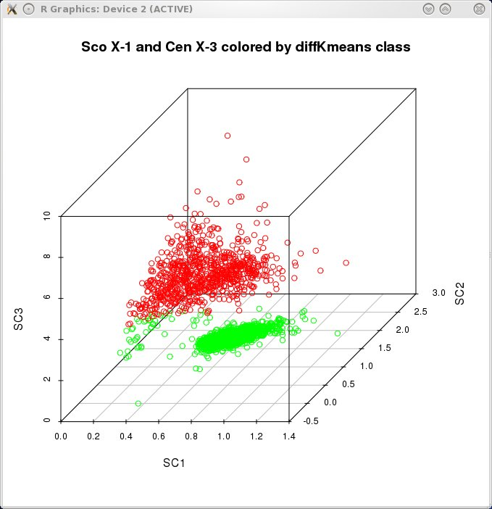
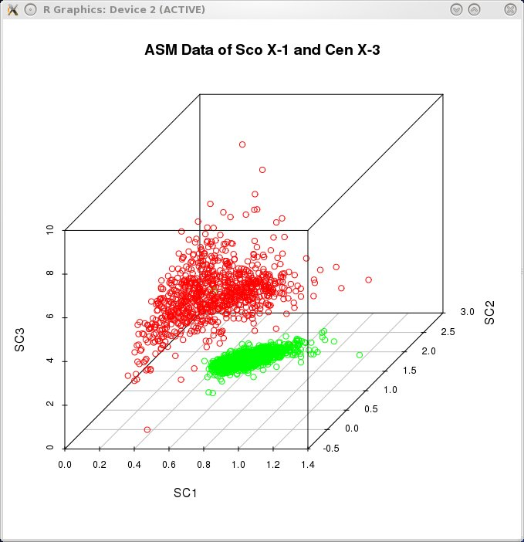
Pulsars vs Z-sources
Input data colored by Data colored by prior knowledge diffusionMap clusters
Sco X-1, Cen X-3

Slide 24
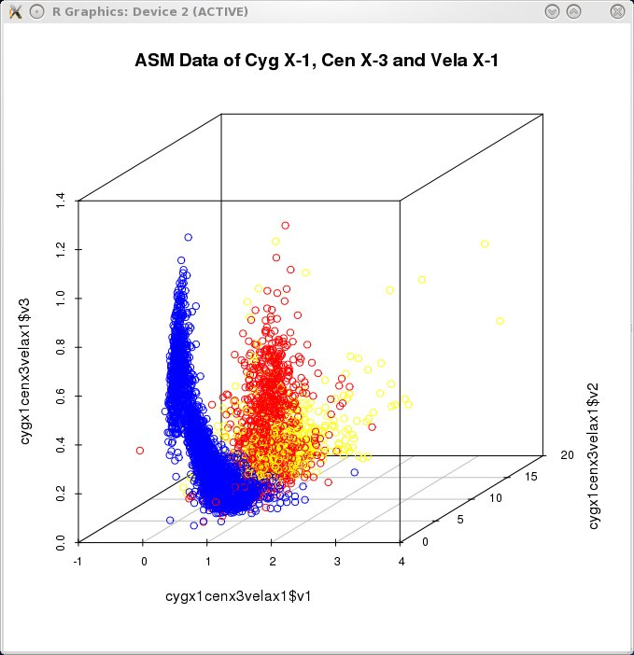
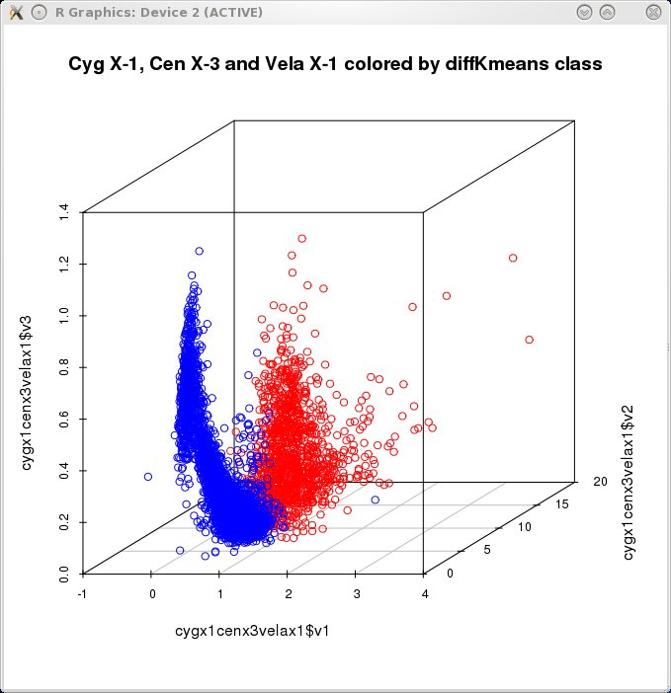
Pulsars vs Black Holes
Input data colored by Data colored by prior knowledge diffusionMap clusters
Cyg X-1, Cen X-3,
Vela X-1

Slide 25
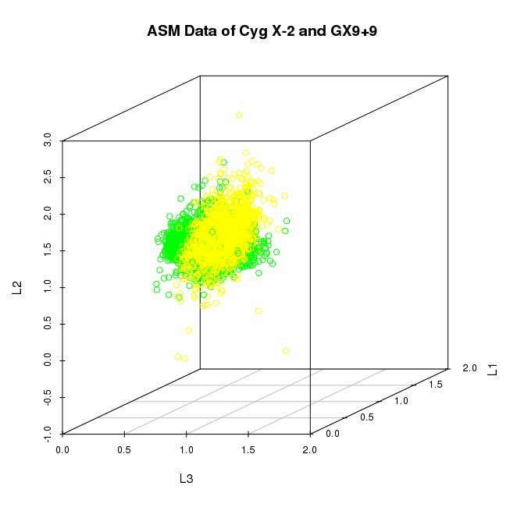
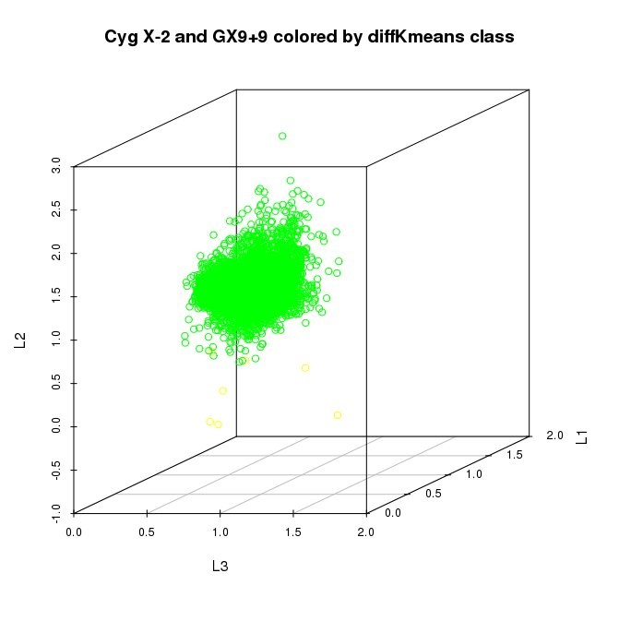
Z sources vs Atoll sources
Input data colored by Data colored by prior knowledge diffusionMap clusters
Cyg X-2,
GX9+9

Slide 26
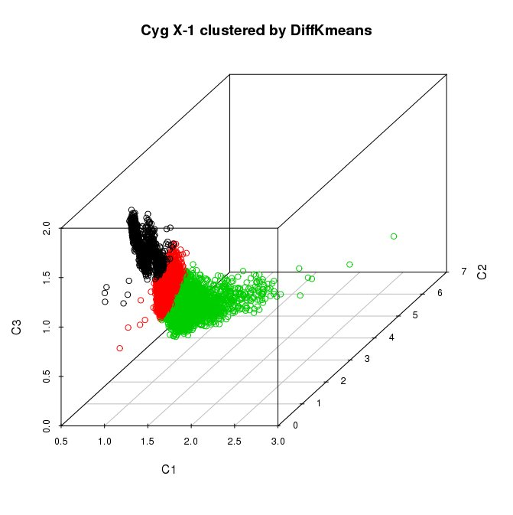
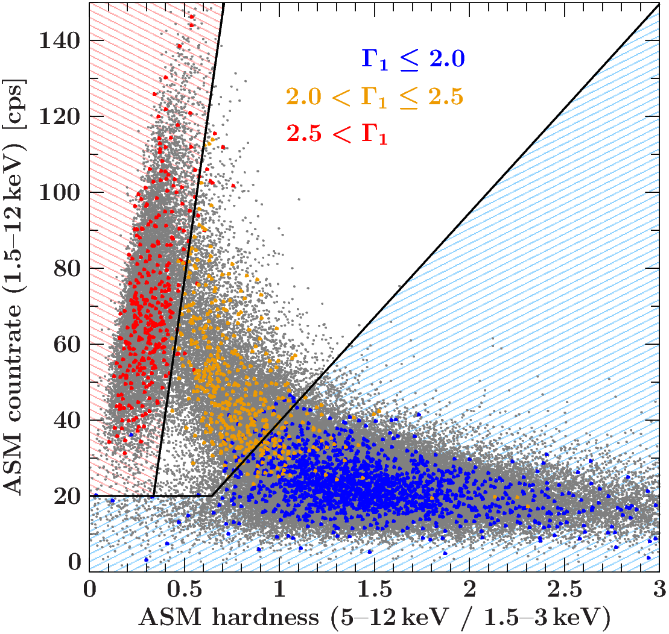
Different states of a single source: Cygnus X-1
(Hard state, intermediate state, and soft state of Cyg X-1 in ASM determined using 2741 spectral fits to PCA data)
PCA data of Cyg X-1 clustered by diffusionMap
Buchan et al 2013
Grinberg et al. 2013

Slide 27
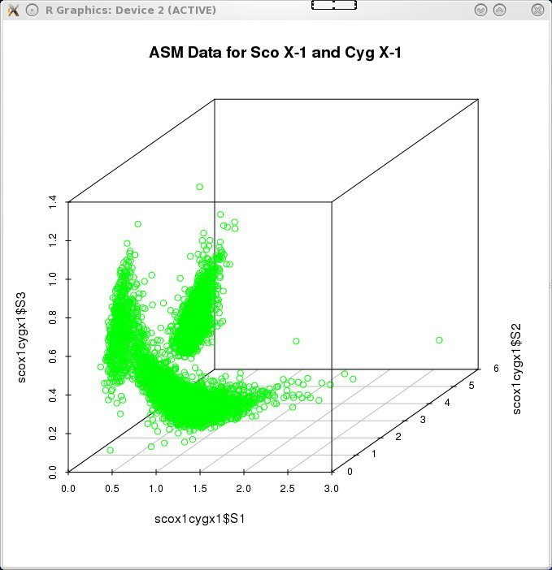
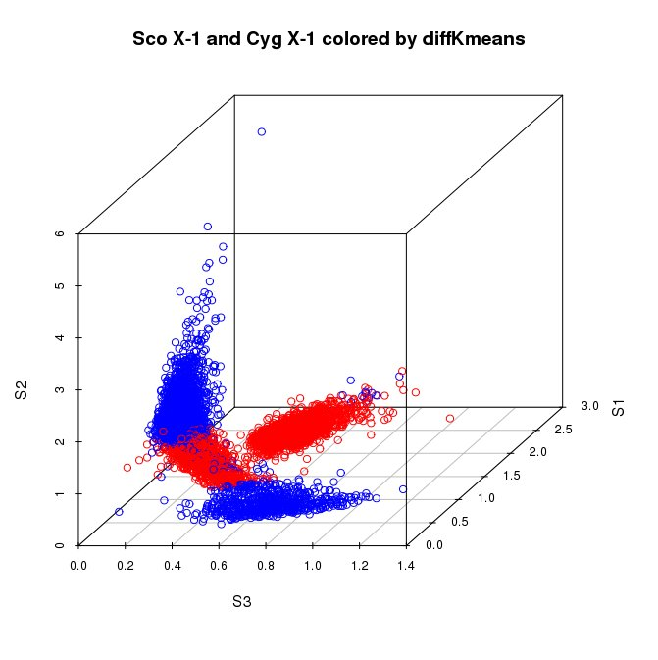
Separating Black holes and Z sources?
Sco X-1
Cyg X-1

Slide 28
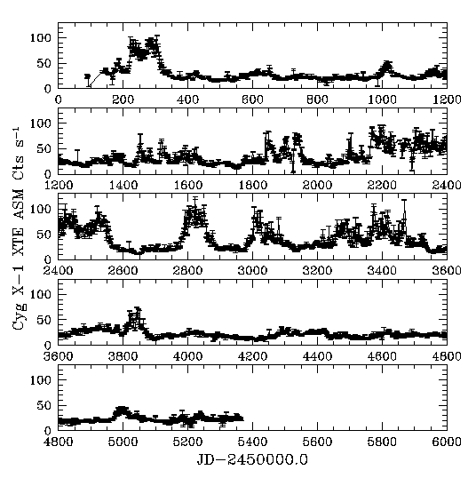
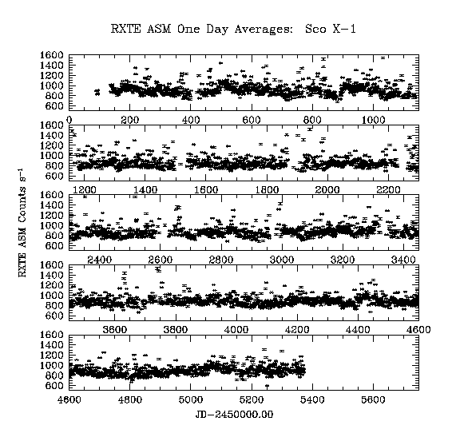
Is Sco X-1 equivalent to the intermediate state of Cyg X-1?

Slide 29
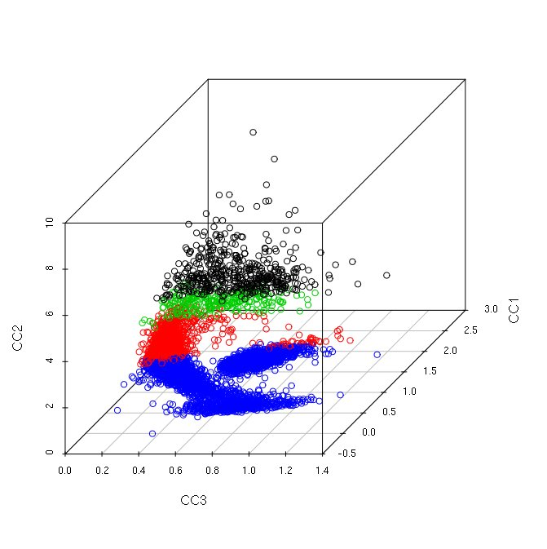
Different approach: see Luke’s presentation!

Slide 30
Different states of a single source: Cygnus X-1
(Hard state, intermediate state, and soft state of Cyg X-1 in ASM determined using 2741 spectral fits to PCA data)
Grinberg et al. 2013

Slide 31
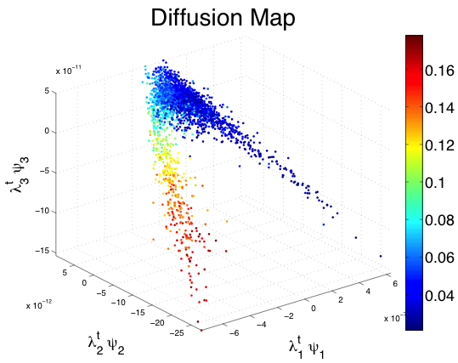
Problems with diffusionMap code:
optimized for selection by redshift;
2) critically dependent on
number of groups and spacing between groups.
Different approach: see Luke’s presentation!

Slide 32
Putting X-ray binaries in their proper place.
Introduction:
✔X-ray binaries
✔Data set
✔CCI description
➔Physical interpretations
Statistical solutions (Luke)
Future work

Slide 33
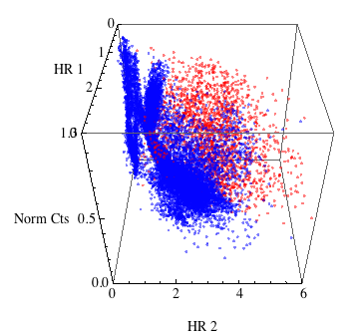
Incorporating the Physics
Cyg X-1
Cyg X-3
Circinus X-1
XTE J1550-564
Sco X-1
GROJ1655-40
GRS 1915+105
GX339-4
Resolved jet sources
X-ray pulsars

Slide 34
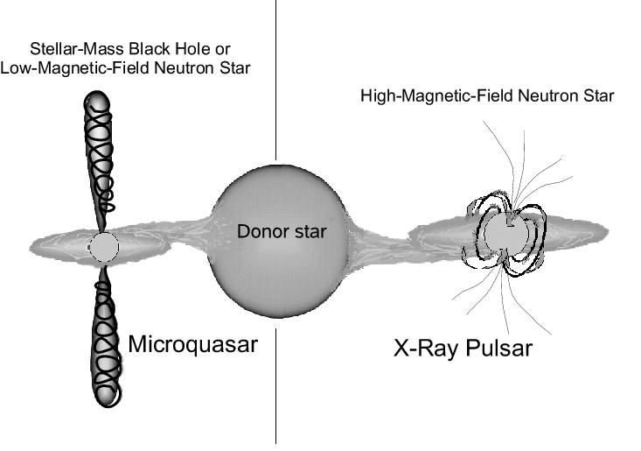
Incorporating the Physics
Massi & Bernado (2008)
Resolved jet sources
X-ray pulsars

Slide 35


If P_{B} < P_{p} field lines spiral
P_{B} = B²/8π
P_{p} = ρv²
P_{B} = P_{P} at the Alfven radius
Condition for jet formation
is that
R_{A}/R* = 1 for NS
R_{A}/R_{LSO} = 1 for BH

Slide 36

R_{Alfven}/R *
P_{B} = B²/8π
P_{p} = ρv²
So for the jet criterion
P_{B}=P_{p} ➔ B²/8π = ρv²
⬅ Mass accretion rate
Magnetic field strength ➔
Massi & Bernado 2008:
M_{dot} = 4πR²ρv (Longair 1994)
v = ( 2GM*/R)^{1/2}
For a dipole magnetic field: B/B* = (R*/R)³
R_{A}/R* ≅ 0.87 (B*/10⁸G)^{4/7}(M_{dot}10⁻⁸ M_{sun}/year)^{-2/7}
^{For a NS with a mass 1.44M}_{sun} and radius of 9km (Titarchuk & Shaposhnikov 2002)

Slide 37
Massi & Bernado 2008 quantified this progression using known values:
R_{Alfven}/R_{NS surface} = 1 for neutron star systems
R_{Alfven} /R_{ISO} = 1 for black hole systems.
B ≤ 1.35 X 10⁸ G
Schwarszchild blackhole
B ≤ 5 X 10⁸ G
Kerr blackhole
B ≤ 10^{8.2} G Z-sources
B ≤ 10^{7.7} G Atoll sources
B ≤ 10^{7.5} G
Millisecond pulsars
B ≤ 10^{5.9} G AGN
Pulsars
B ~ 10¹² G
No jets at any accretion rate

Slide 38

Fender et al model for jet production in XRBs
From most likely to least likely to produce jets:
Black hole systems with no intrinsic magnetic field.
Low-mass neutron star systems with weak magnetic fields at high accretion (Z-type)
Low-mass neutron star systems with weak magnetic fields at low accretion (Atoll)
High-mass neutron star systems with high magnetic fields (Pulsars)

Slide 39

R_{Alfven}/R *
⬅ Mass accretion rate
Magnetic field strength ➔
Massi & Bernado 2008
Sco X-1

Slide 40


R_{A}/R_{LSO} = 1
Schwarzschild-BH XRBs
Kerr-BH XRBs

Slide 41
R_{Alfven}/R *
⬅ Mass accretion rate
Magnetic field strength ➔
Massi & Bernado 2008
Homan et al 2010 claim M_{dot} increases from Atoll to Z sources. And bursters are thought to be at very low Mdot.

Slide 42

CCI diagram incorporate ALL key elements that determine interplay between jet power and disk radiation:
Mass accretion rate which determines available energy
Strong magnetic fields which inhibit jet formation
Basic condition for jet formation (R_{A}/R_{lso} = 1)
Lum
Magnetic field strength ➔
Mass accretion rate ➔
HR2
R_{Alfven}/R_{Isco}
HR1

Slide 43


Mass accretion rate determines available energy
Strong magnetic fields inhibit jet formation
ISCO is related to jet power
McClintock, Narayan, & Steiner 2013
Lum
Magnetic field strength ➔
Mass accretion rate ➔
HR2
R_{Alfven}/R_{Isco}
Fender, Belloni, & Gallo (2004)
HR1

Slide 44
Putting X-ray binaries in their proper place.
Introduction:
X-ray binaries
Data set
CCI description
Physical interpretations
Statistical solutions (Luke)
➔Future work

Slide 45

Template from known sources

Slide 46

GRS 1915+105 Belloni states
Putting in the numbers.
Lum
Belloni Jet Line
HR2
HR1
Lum
Magnetic field strength ➔
Mass accretion rate ➔
HR2
R_{Alfven}/R_{Isco}
Fender, Belloni, & Gallo (2004)
HR1

Slide 47











Individual sources with better resolution
α
β
χ
θ
δ
γ
κ
ρ
λ
μ
ν
Peris 2013
PCA Data of GRS1915+105 Belloni states

Slide 48


X-ray binaries in external galaxies: NGC4649
Cyg X-3 Kalkonen states
Chandra grating data from Mike McCollough
Chandra ACIS data from Dong-Woo Kim and Pepi Fabbiano

Slide 49





MAXI data
Freshwater et al 2013
LMC X-1
Cyg X-1
LMC X-3
Slit camera with a collecting area of 5000 cm².
90-98% of sky every 96 minutes.
Sensitivity: 3 mCrab
Energy range: 0.5-30 keV
Resolution: 18% at 6 keV)
Monitoring over 1000 sources.
Cyg X-1, LMC X-1, LMC X-3

Slide 50

What we are working on. . .
Defining geometric loci for classification of unknown objects.
Identifying the physics that drives objects to specific locations in CCI
Quantifying the disk-jet connection:
When will an accreting neutron star become a microquasar rather than a pulsar?
When will a black hole X-ray binary evolve into a microquasar phase?
Studying states within a given object (need better resolution data)
Studying populations in other galaxies.
Expanding to other databases, instruments, and object classes.
http://hera.ph1.uni-koeln.de/~heintzma/U1/MIV_microq.htm

Slide 51
XRB classification scheme
Binary systems containing black holes:*
Dynamically well determined with massive companions
Dynamically well determined with low-mass companions
Black hole candidates
Binary systems containing neutron stars:**
Systems with high mass companions
Pulsars
Non-pulsing
Systems with low mass companions
Pulsars
Non-pulsing
Z-sources
Atolls
Bursters
*From Remillard & McClintock 2006
**Liu, van Paradijs, & van den Heuvel 2000,2001

Slide 52

Sample heirarchical clustering schemes.

Slide 53



z
Capturing geometries
Richards et al (2008)
Principal Components Analysis Spectral Connectivity Analysis

