Slide 1


On atomic data uncertainties
Stuart Loch¹, Kyle Stewart¹, Hans Verner Van Wyk¹,
Connor Ballance², Adam Foster³, Martin O’Mullane⁴
¹Auburn University, Auburn, AL
²Queen’s University of Belfast, Belfast
³The Center for Astrophysics Harvard & Smithsonian, Boston, MA
⁴The University of Strathclyde, Glasgow, UK
7th June 2021

Slide 2
Overview
Motivation and examples
Top priorities for atomic data uncertainties
Focus on uncertainties on calculated atomic collision data
Propagation of atomic data uncertainties
Description of our method
  Results for Dielectronic Recombination.
  Preliminary results for A-values and electron-impact excitation
Future directions and discussion points
Work supported by funding from NASA Laboratory Astrophysics program

Slide 3
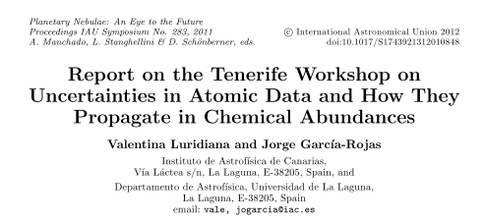
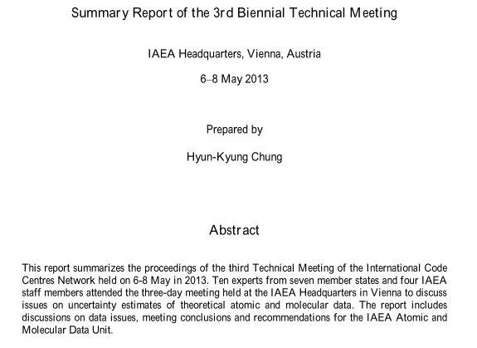
There has been a growing interest in and demand for atomic data uncertainties
Interest in uncertainties has been growing
  NIST has a long history of assigning A-value uncertainties
There have been conferences
  Proc. of Int. Astr. Union, IAU Symp., 283 : 139 (2011)
  IAEA conf. series: https://www-amdis.iaea.org/meetings/UQ2016/
Papers are starting to include uncertainty estimates and their impact
  Foster et al., Space Science Review 157 : 135 (2010)
  Loch et al., AIP conference proceedings 1545 242 (2013)
  Bautista et al., ApJ 770 : 11 (2013)
  Xixi et al., ApJ, 866 : 146 (2018)
  Dere, MNRAS, 496, 2334 (2020)
  Del Zanna et al., MNRAS, 484, 4754 (2019)
Kallman et al. Astro2020: Laboratory Astrophysics Needs for X-ray Calorimeter Observatories, Bulletin of the American Astronomical Society, Vol. 51, 156 (2019)

Slide 4
Much progress has been made on developing methods of assigning uncertainties on atomic data
There are now several methods that have been explored to put uncertainties on atomic and molecular data.
  Analytic approaches : Bautista et al., ApJ 770, 11 (2013)
  Comparing multiple codes/methods to calculate the same process:
    Del Zanna et al., MNRAS, 484, 4754 (2019)
    Xixi et al., ApJ, 866, 146 (2018)
  Very approximate estimates (baseline uncertainties) :
    Loch et al., AIP conference proceedings 1545, 242 (2013)
There are multiple working groups looking at this, including an IAEA project.
Given how new this area is, and how challenging it can be, a range of approaches is needed here.
  It would be good to compare the different methods. This could be a useful topic to coordinate on during the discussion time.

Slide 5
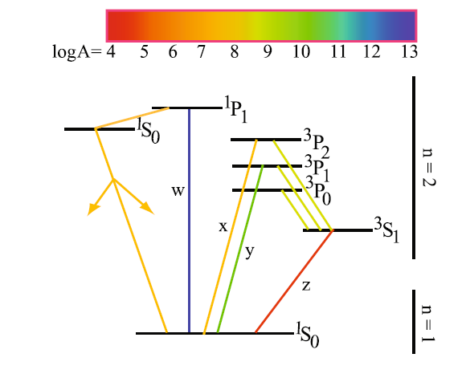
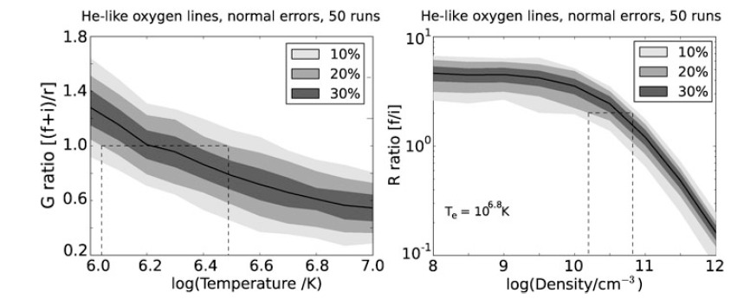
Example : The G- and R-ratios in He-like O
30%
20%
10%
30%
20%
10%
Uniform uncertainties not ideal for collision data (Foster et al. Space Science Rev. 157 : 135 (2010))
Loch et al. (AIP conf. proc., 1541, 242 (2013)) assigned baseline uncertainties that scaled with T_{e}.
  Correlation was not included but is likely to be important in uncertainty data

Slide 6
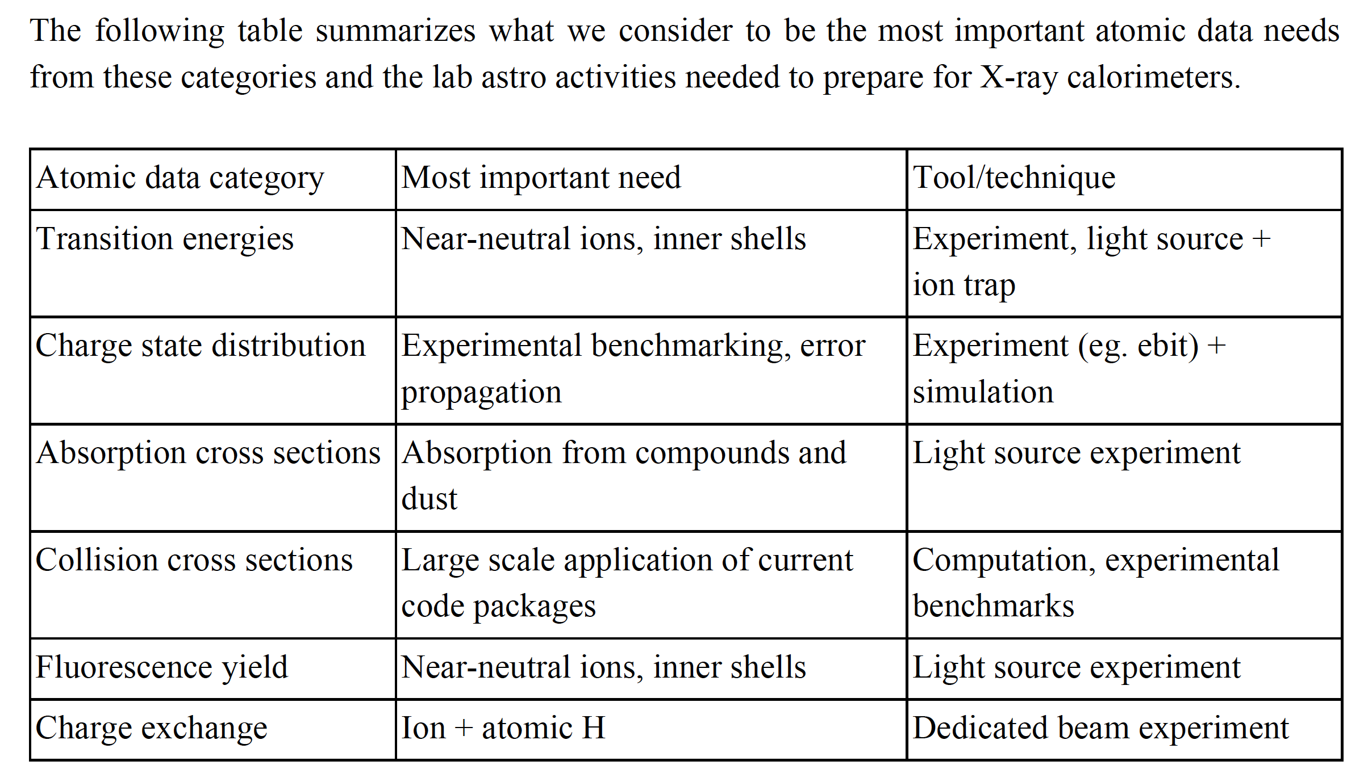
Astro2020 white paper: Laboratory Astrophysics Needs for X-ray Calorimeter Observatories
There have been significant efforts to identify atomic data needs and the accuracy to which the data is required.
One example is the XRISM working group (see next slide).
“Knowledge of the uncertainties in the atomic data (and a framework to incorporate them into modeling software) is also important to prevent misinterpretation of discrepancies between models and measured spectra, since X-ray spectral models are calculated from first principles and atomic data.”
From Kallman et al. Bulletin of the American Astronomical
Society, Vol. 51, 156 (2019)

Slide 8
Schematic for Uncertainties
Atomic
structure
Plasma
Parameters
Plasma
diagnostics
Rate
Coeff. (T_{e})
Collision
calculation
Modeling
code
Cross
sections
Emissivities,
power loss,
effective rates
Fundamental
Data Generation
Modeling
Codes

Slide 9

Schematic for Uncertainties
Atomic
structure
Plasma
Parameters
Plasma
diagnostics
Rate
Coeff. (T_{e})
$$ψ_{nl}(\vec{r})$$
Collision
calculation
Modeling
code
Rate coeff.
Uncertainties
Cross
sections
Emissivities,
power loss,
effective rates
Fundamental
Data Generation
Monte-Carlo
Uncertainties
Modeling
Codes

Slide 10
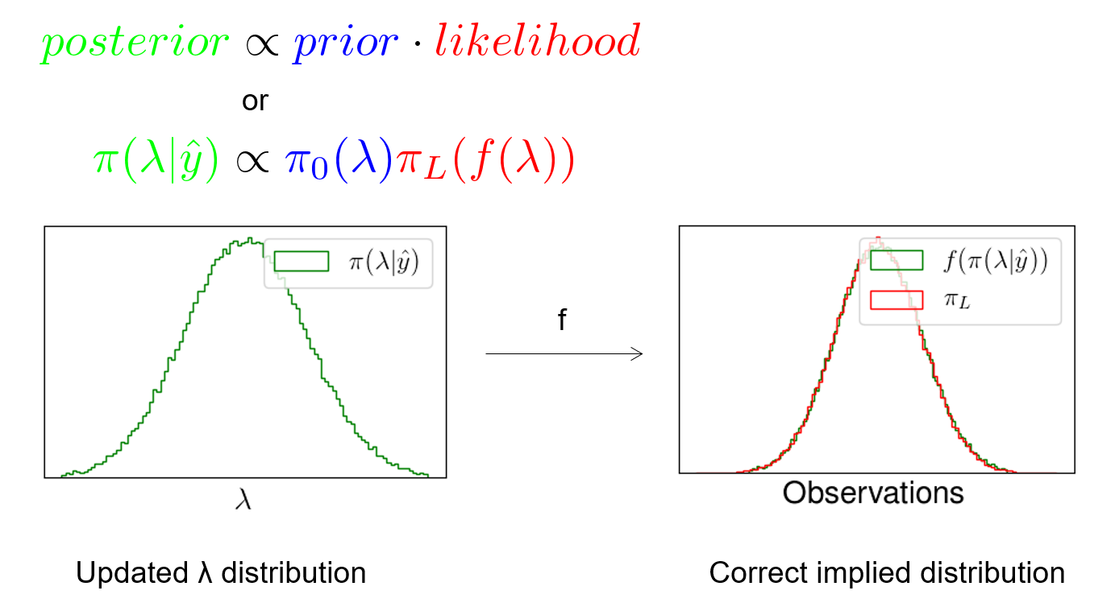
An approach for collision data uncertainties
We consider methods that are appropriate for the process being considered (i.e., no missing physics such as relativistic effects).
  Missing physics would become apparent when the results are compared to other theory/experiments.
The uncertainties reflect the range of values the method would give, based upon reasonable variation in the input parameters.
We use a Bayesian analysis method to determine how much to vary the input parameters.
  Gives a distribution function on the input parameters.
  This is then carried through the whole collision calculation.
Bayes’ rule allows us to update our assumed prior distribution of input parameters in light of the experimental measurement and its error distribution, yielding a posterior distribution of input parameters.

Slide 11
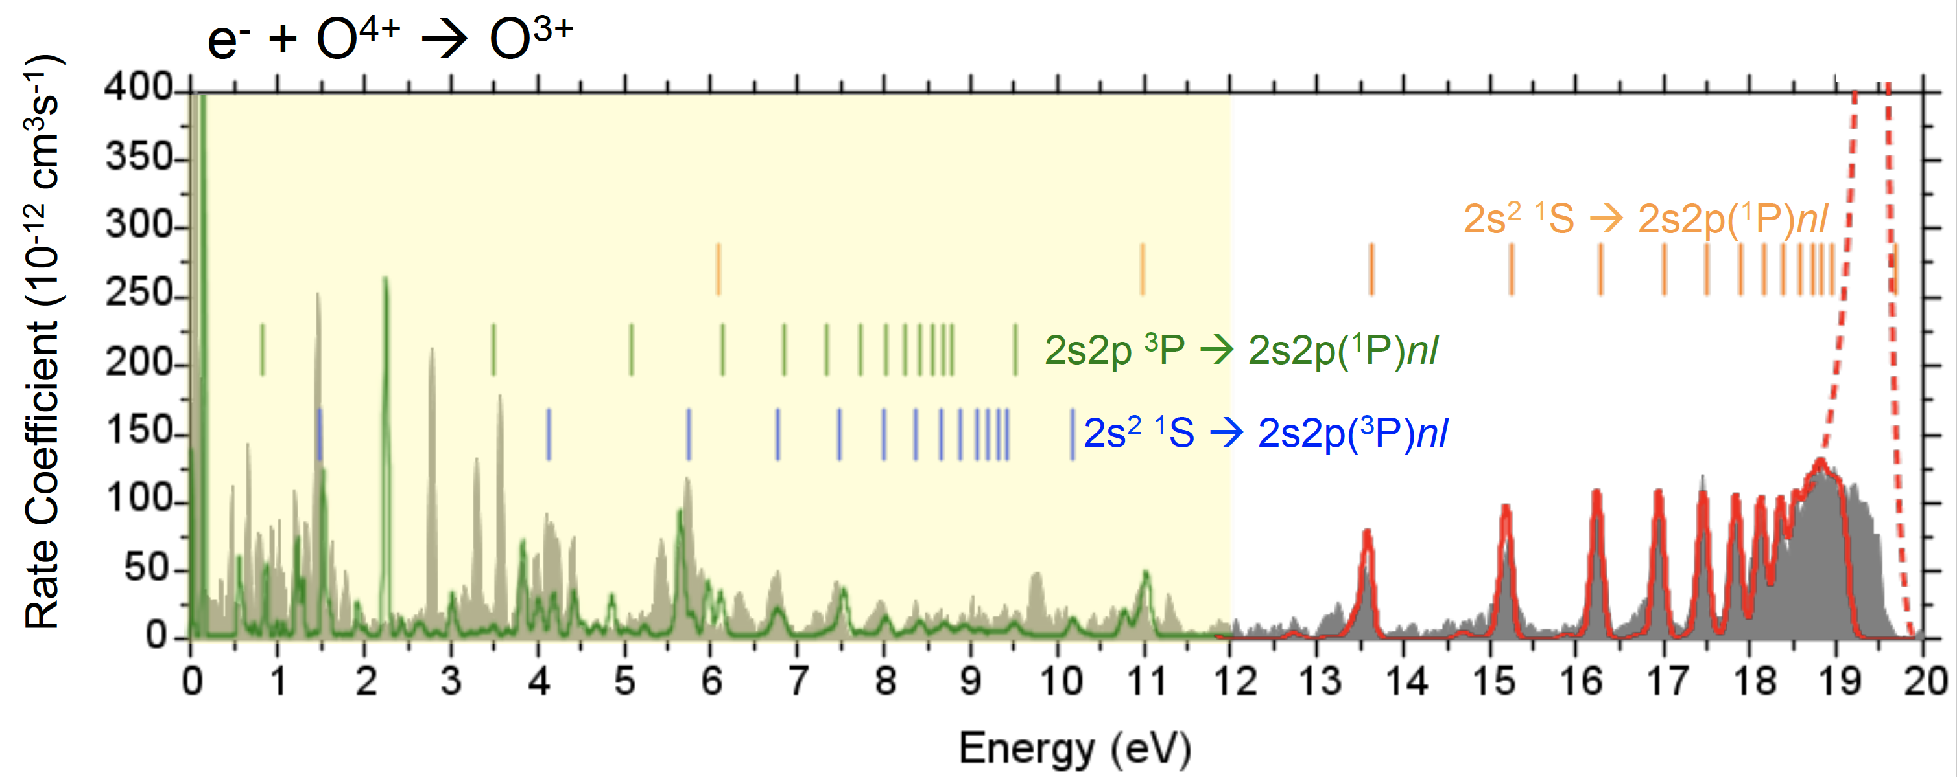
Dielectronic recombination
Much of current databases use total DR rate coefficients based upon Distorted-wave calculations using perturbation theory.
  The DR project (Badnell et al. A&A, 406, 1151 (2003))
  FAC (Gu ApJ, 590, 1131 (2003))
These methods work well for collisional-ionization temperatures, but not for low temperature photo-ionized regime.
We will focus on uncertainties in the collisional-radiative regime
Measurements from Fogle et al. A&A, 442, 757 (2005)

Slide 12
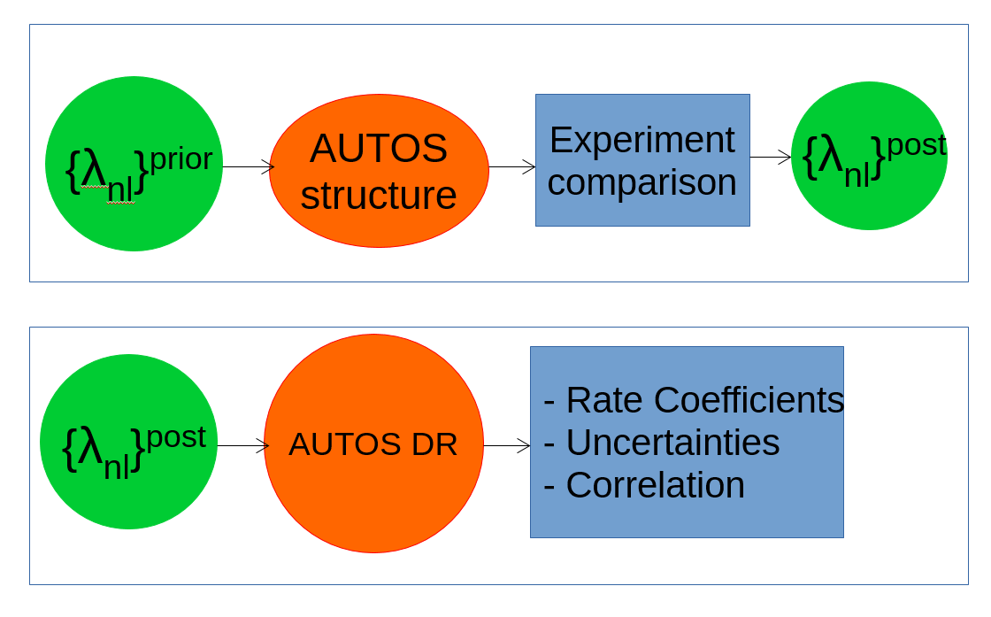
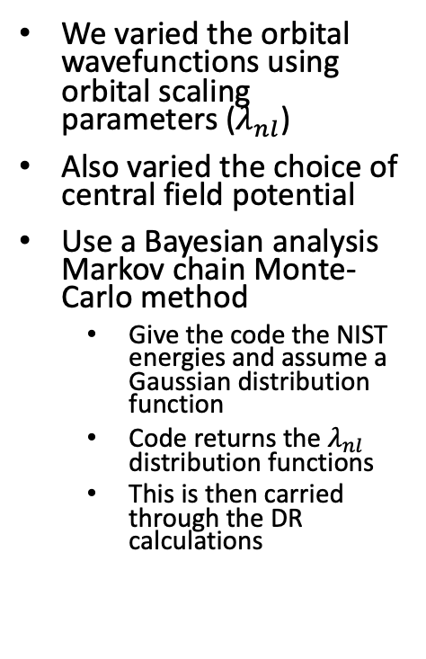
Illustration for dielectronic recombination
We varied the orbital wavefunctions using orbital scaling parameters ($λ_{nl}$)
Also varied the choice of central field potential
Use a Bayesian analysis Markov chain Monte-Carlo method
  Give the code the NIST energies and assume a Gaussian distribution function
  Code returns the $λ_{nl}$ distribution functions
  This is then carried through the DR calculations
NIST ENERGIES

Slide 13
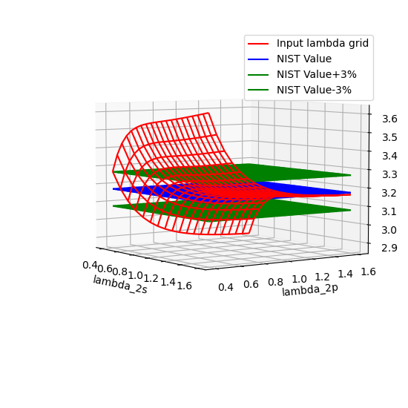
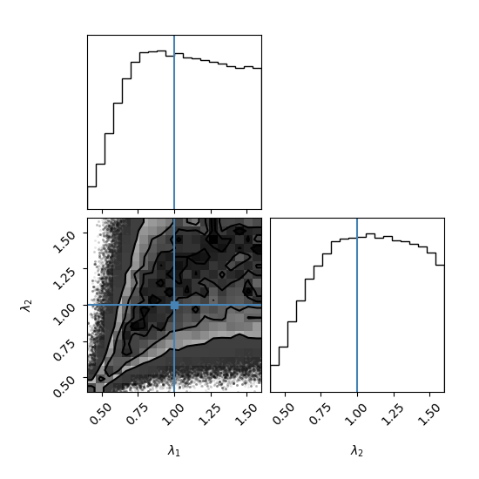

Fe²²⁺ results showing $λ$ distribution function
Atomic structure for Fe²²⁺, showing variation with orbital scaling parameter
Resulting lambda distribution distributions and contours.

Slide 14
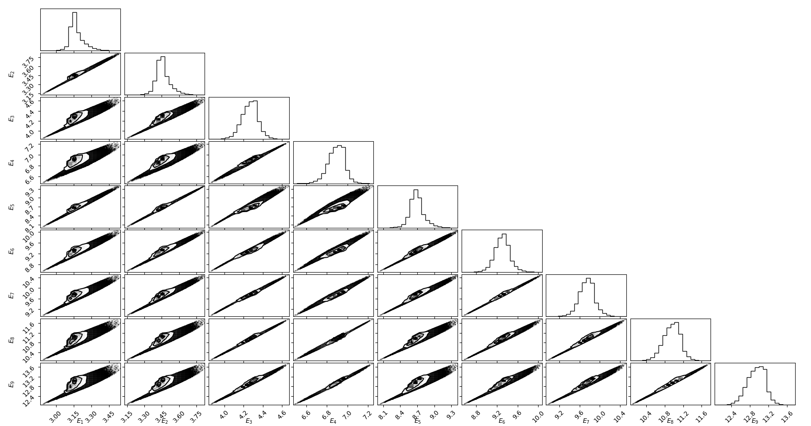
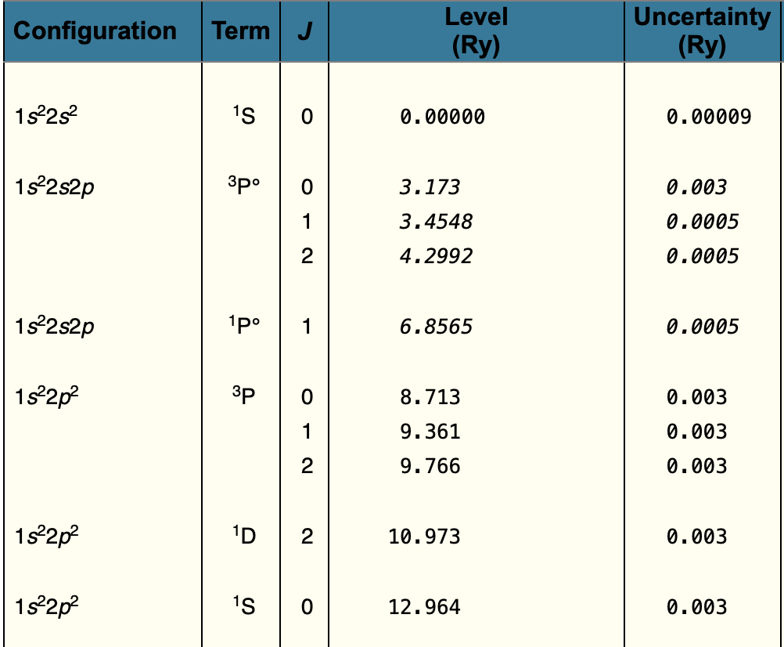

The code reproduces the NIST energies with a reasonable Gaussian distribution
$λ_{nl}$ distributions
NIST energies
Energies

Slide 15
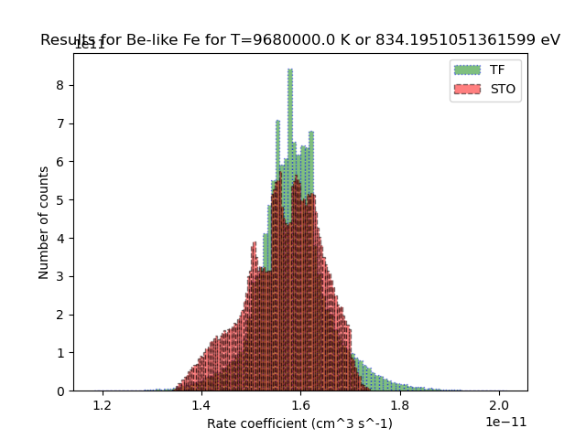
Fe²²⁺ DR rate coefficient distribution functions
Central field potential #1 (Thomas-Fermi-Amaldi-Dira)
Average = ﻿1.583x10⁻¹¹ cm³ s⁻¹
Std Dev = ﻿7.333x10⁻¹³ cm³ s⁻¹
Std Dev / Avg = ﻿﻿ ﻿4.631 %
Central field potential #2 (Hartree with Slater-Type Orbitals)
Average = ﻿﻿1.566x10⁻¹¹ cm³ s⁻¹
Std Dev = ﻿﻿7.655x10⁻¹³ cm³ s⁻¹
Std Dev / Avg = ﻿4.888 %
Equally weighted distributions
Avg = ﻿1.574x10⁻¹¹ cm³ s⁻¹
Std Dev = 7.545x10⁻¹³ cm³ s⁻¹
Std Dev / Avg = ﻿ 4.79%

Slide 16
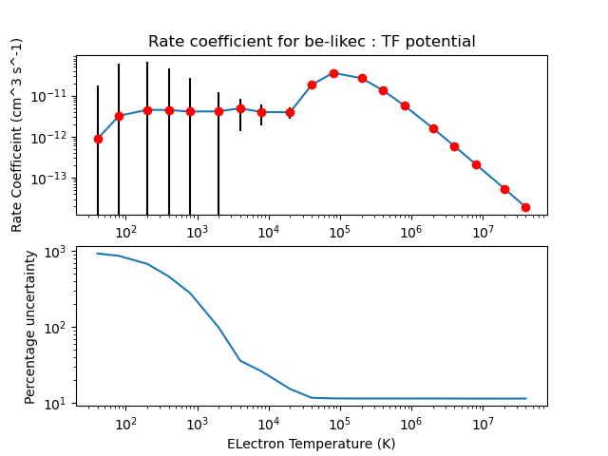
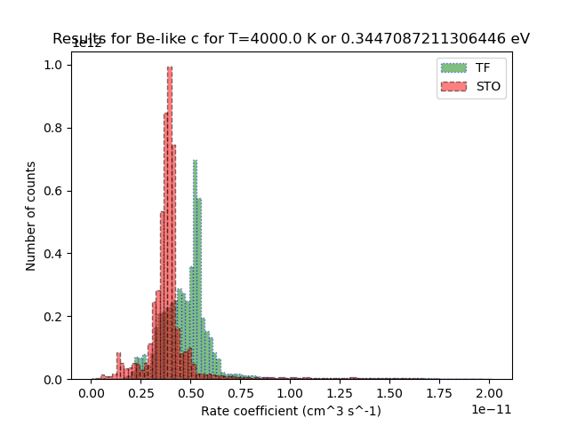
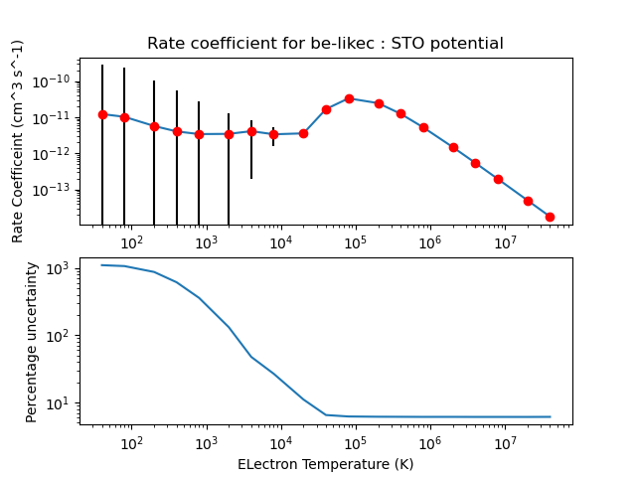
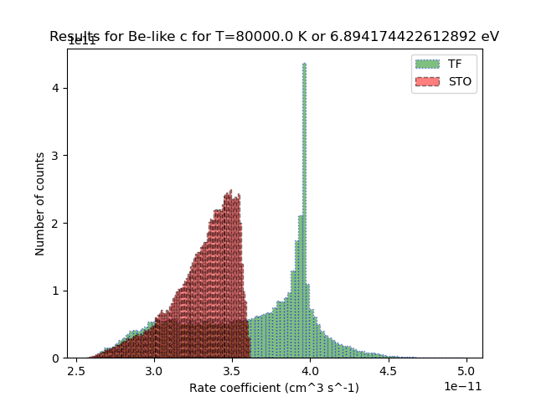
Be-like C
﻿Results for T(K)= 80000.0 K : T(eV)= 6.89 eV
Average: TF = 3.599x10⁻¹¹ cm³ s⁻¹
Average: STO = 3.309x10⁻¹¹ cm³ s⁻¹
Average: TF + STO = 3.454x10⁻¹¹ cm³ s⁻¹
Standard Deviation: TF = 4.147x10⁻¹² cm³ s⁻¹
Standard Deviation: STO = 2.053x10⁻¹² cm³ s⁻¹
Standard Deviation: TF + STO = 3.580x10⁻¹² cm³ s⁻¹
Percent uncertainty: TF = 11.5 %
Percent uncertainty: STO = 6.2 v%
Percent uncertainty: TF + STO = 10.4 %

Slide 17
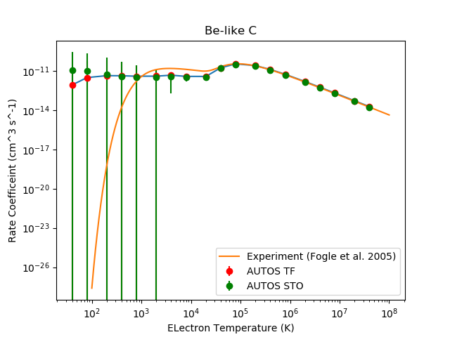
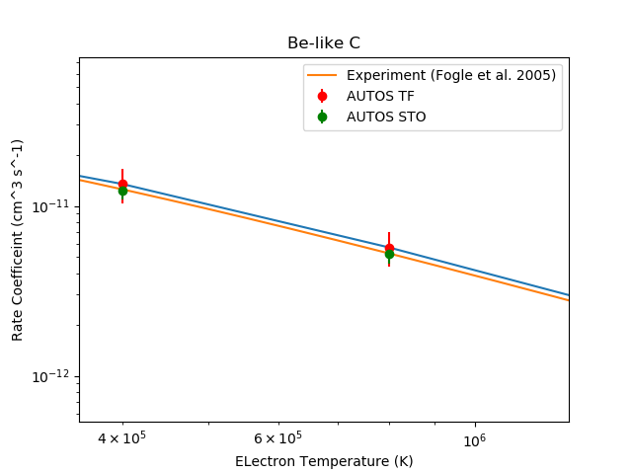
Comparison with Experiment : Be-like C
Measurements from hybrid rates generated in Fogle et al. A&A, 442, 757 (2005)

Slide 18
He-like O
Preliminary Electron-impact excitation results
We applied the same method to electron-impact excitation using the R-matrix codes. It looks promising.
In this case the role of correlation is much more important.
Line ratios based upon atomic data with
  a positive correlation have uncertainties smaller then either uncertainty [He-like O]
  A negative correlation have uncertainties larger than either uncertainty [Ne-like Fe]
Ne-like Fe

Slide 19
Lessons learned
In the Bayesian analysis method, many points are required for the Markov chain Monte-Carlo steps through the parameter space
  It is important to give the method a wide range for the input parameters, so that it can determine what to keep or throw out.
  The use of interpolators makes the code much quicker
  It is important to check the acceptance fraction and autocorrelation time (number of steps) for efficiency and appropriateness of the method.

Slide 20
Conclusions
We have shown results for a method to put uncertainties on dielectronic recombination rate coefficients as a function of electron temperature
  The same approach could be used for other atomic collision processes
The uncertainty data will be archived in ATOMDB and ADAS. We note that a lot of other information would be available for people who would want to use it (e.g., correlation on the uncertainties)
  We will archive the rate coefficient uncertainties and derived coefficients (e.g., photon emissivities)
Getting some feedback from people who can use the data for their research would be very useful
It would also be useful to compare with other methods of assigning uncertainties

Slide 21
Many thanks for your attention!
Any questions?
Contact information
  Stuart Loch: loch@physics.auburn.edu

Slide 22
Extra slides

Slide 23
Discussion points
Uncertainties propagated through modeling codes can provide information on what atomic processes are required to high accuracy for diagnostic and modeling purposes.
It would be useful to have some case studies where there is currently a difference between modeling and observation and see if the differences are within the uncertainties (of observation and theory), or if there are physics differences causing the discrepancies.
We will produce uncertainties on ‘derived coefficients’ such as photon emissivities. We have a range of such coefficients we will generate. A list of other derived coefficients commonly used would be useful.
There are now a few methods that have been explored to put uncertainties on atomic and molecular data. It would be good to get together and pick a common process and range of ions and do a comparison.

