Slide 1
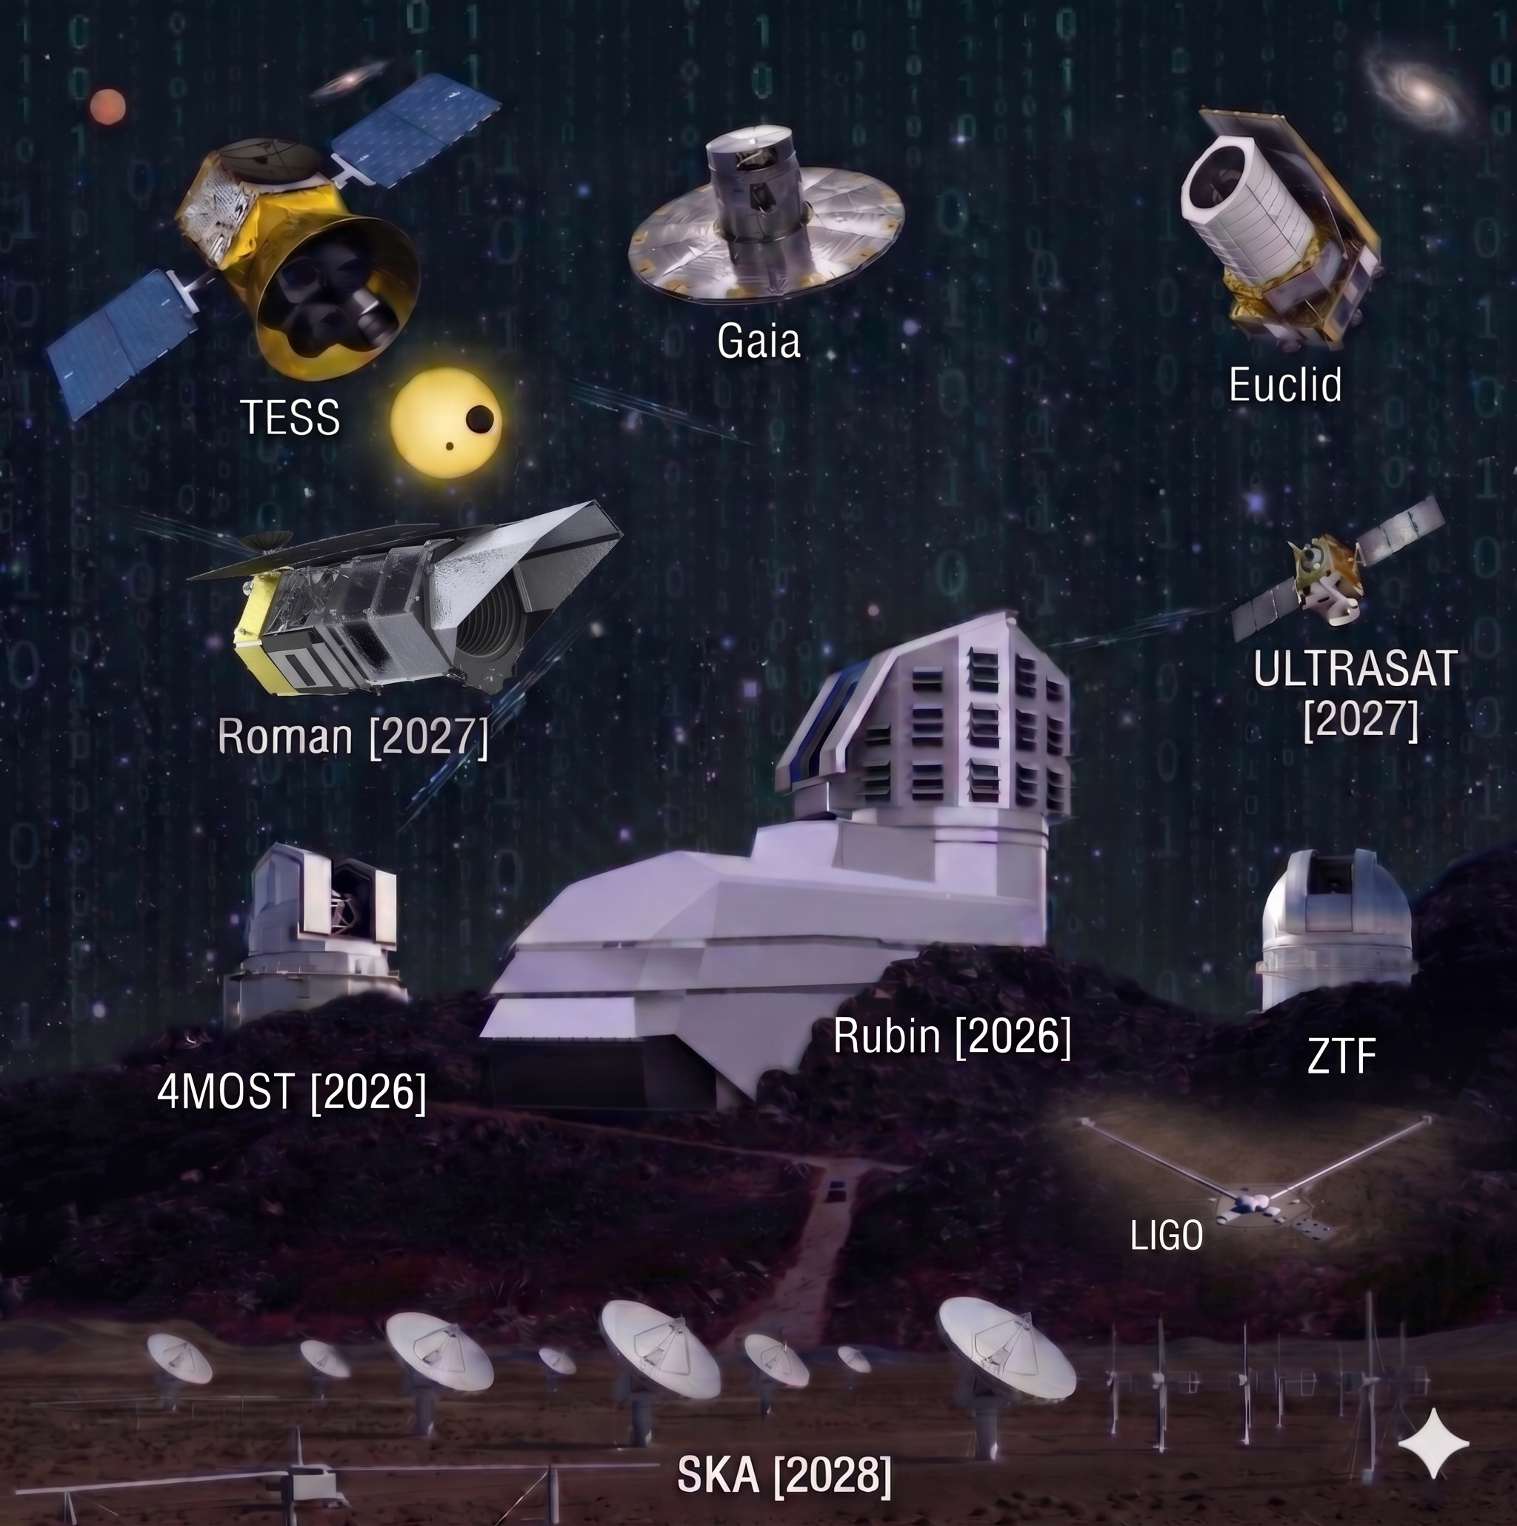
DEEP SPACE · JSM BOSTON
Causally-Motivated Foundation Models
Disentangling Physics from Instruments
Daniel Muthukrishna
Research Scientist — MIT Kavli Institute for Astrophysics
AstroAI Fellow — Harvard & Smithsonian CfA
Coauthors:
Pablo Mercader-Perez, Carolina Cuesta-Lazaro, Jeroen Audenaert,
David Hogg, Ashley Villar
Augst 3rd, 2026 ·
danmuth@mit.edu · danielmuthukrishna.com

Slide 2
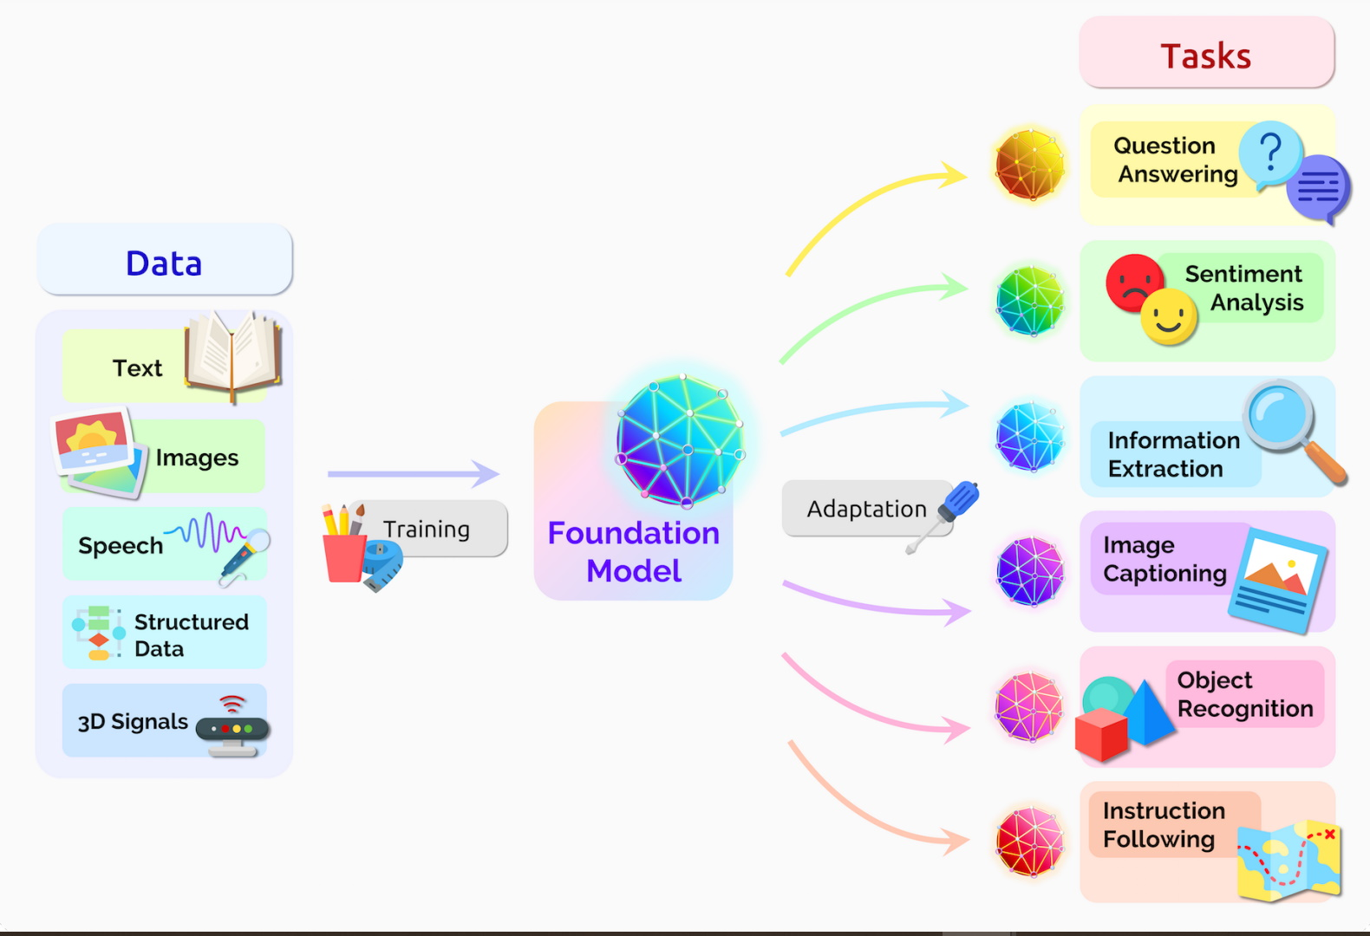
What is a Foundation Model?
Foundation models are the base pre-trained networks for LLMs like ChatGPT or Claude, vision models like DALL-E, and appear to have emergent capabilities
The goal is to find general representations that are useful for many (any?) downstream task.
They’re not trained in the usual supervised fashion
  Instead, FMs typically undergo self-supervised learning by optimizing a contrastive or generative objective.
Bossmani et al. 2021

Slide 3
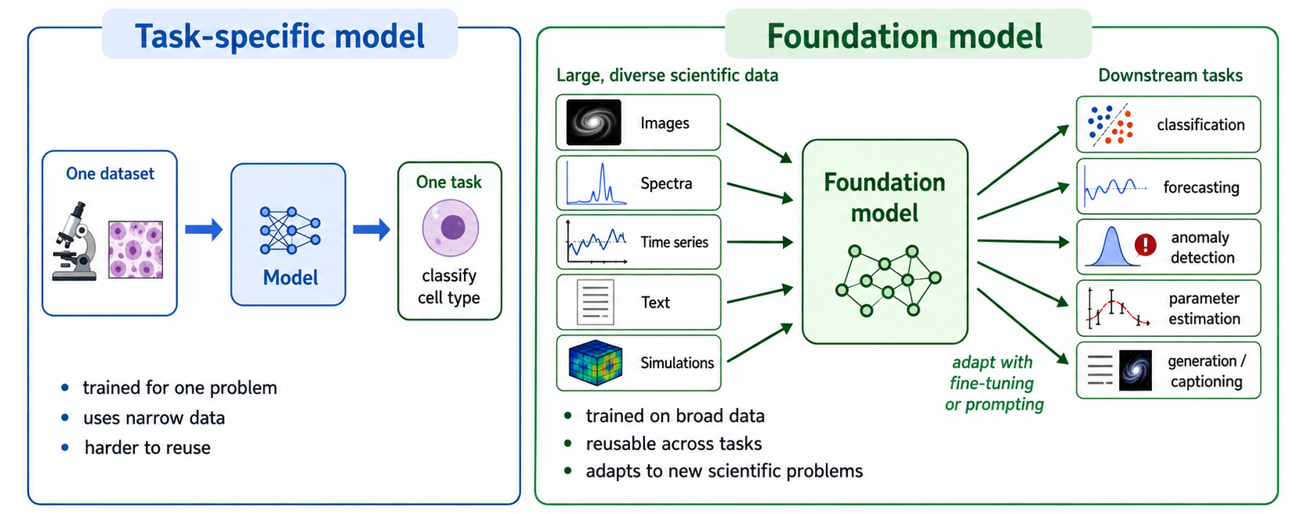
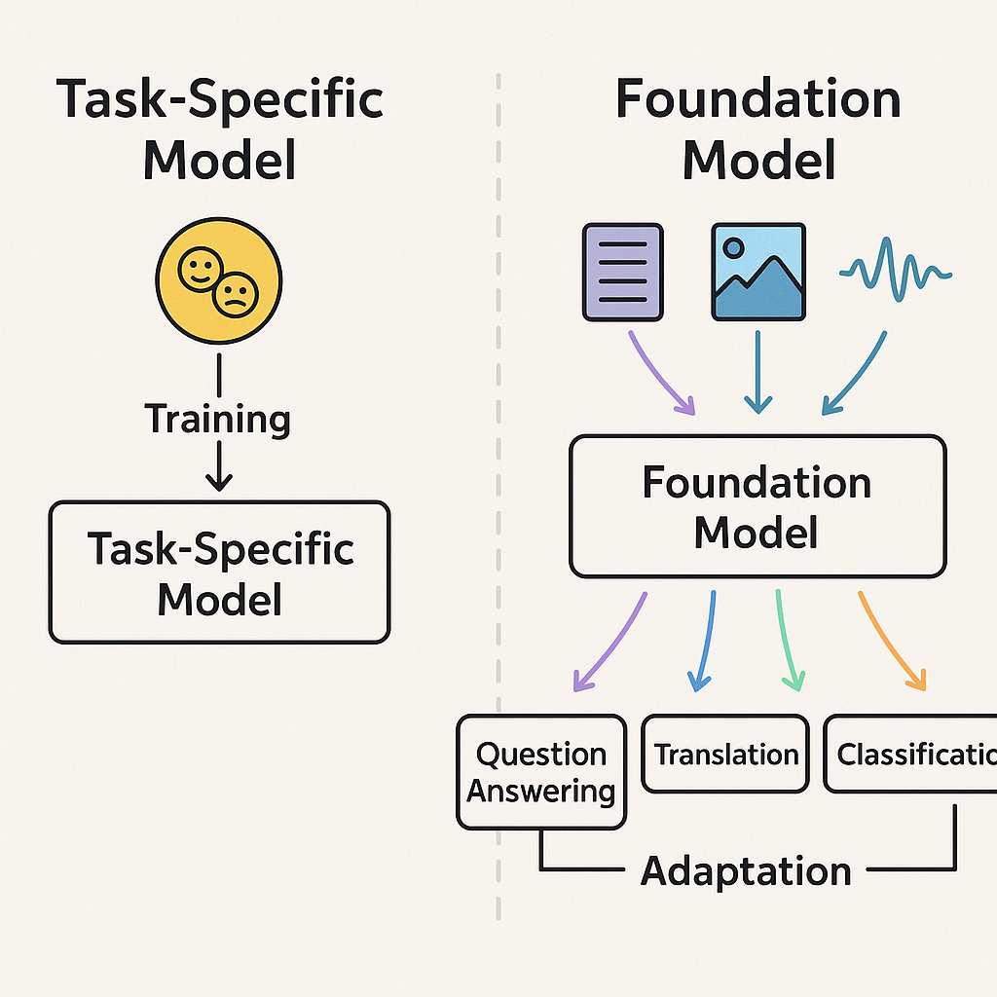
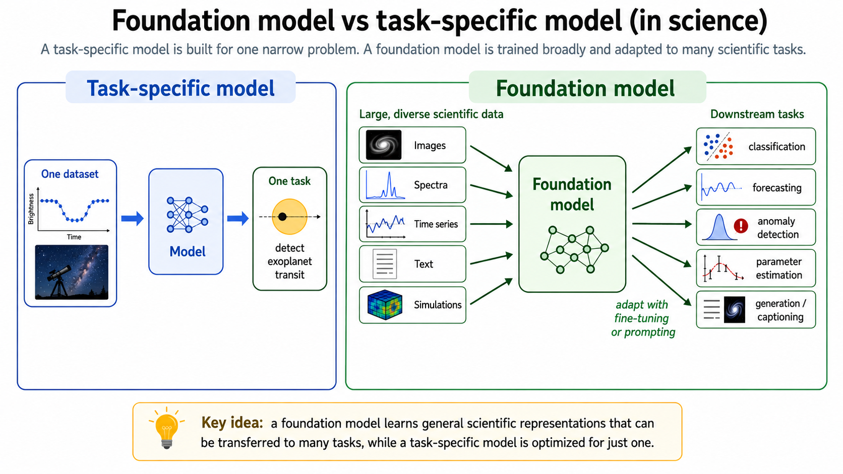
What is a Foundation Model?
FMs learn general representations that are useful for many (any?) downstream task.
They’re not trained in the usual supervised fashion
  Instead, they undergo self-supervised learning by optimizing a contrastive or generative objective.
I prompted ChatGPT for an illustration…

Slide 4
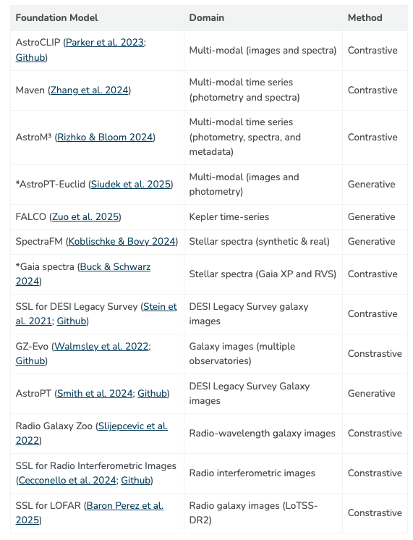
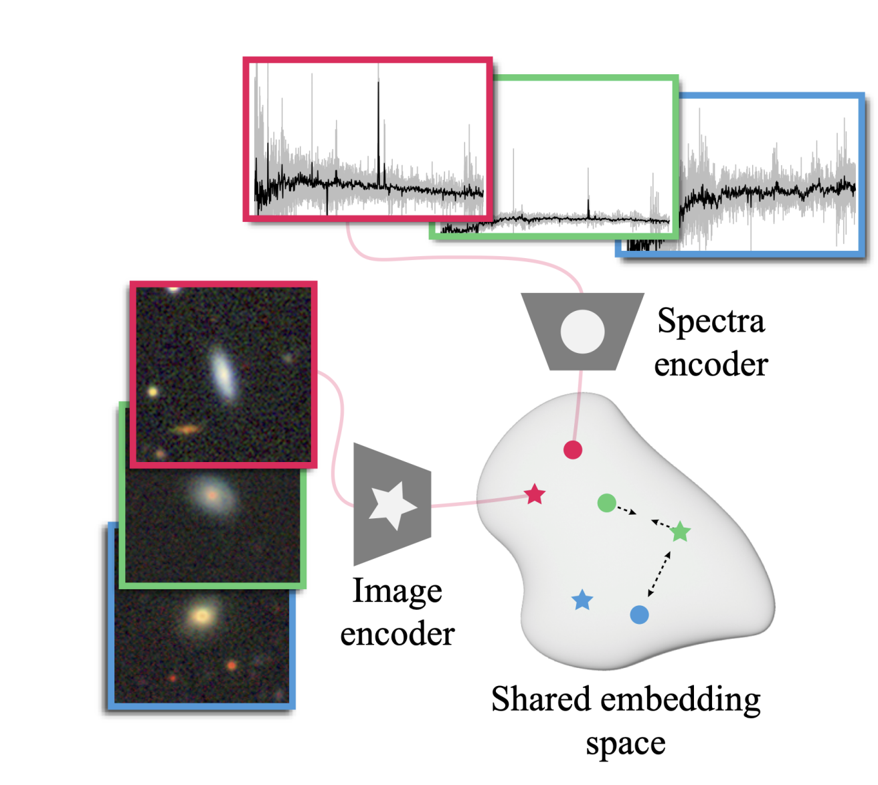
Foundation Models in Astronomy
AstroCLIP, Parker et al. 2024
Blog by John Wu about Foundation Models: https://jwuphysics.github.io/blog/2025/05/foundation-models-in-astronomy/

Slide 5
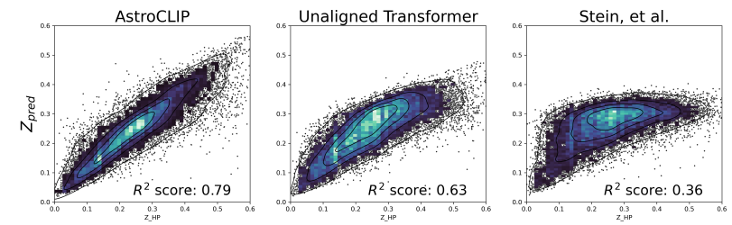
Foundation Models in Astronomy: AstroCLIP
Downstream Task: Redshift Prediction
AstroCLIP had better redshift prediction
Without ever knowing about redshift! (zero-shot)
AstroCLIP, Parker et al. 2024

Slide 6
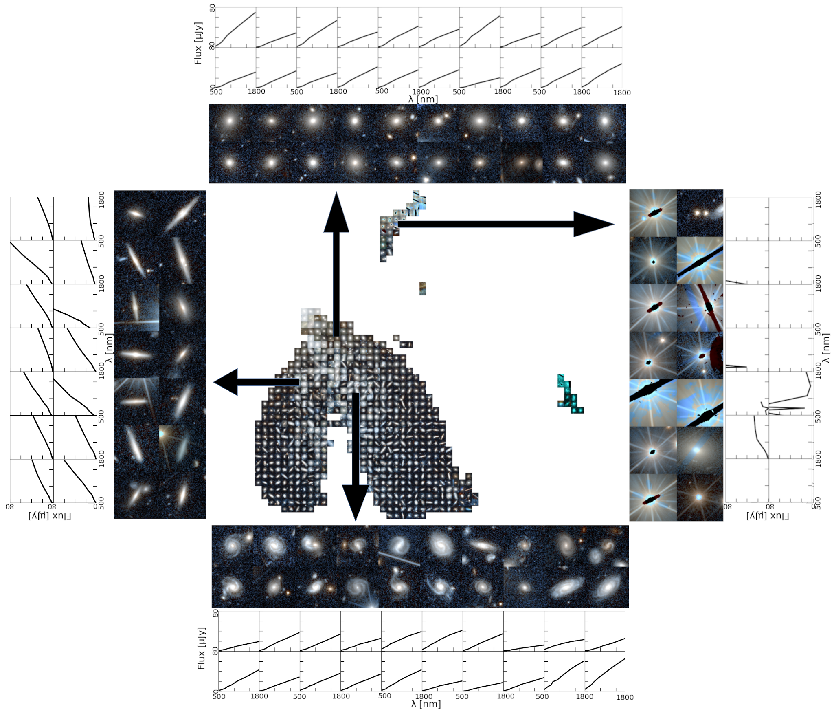
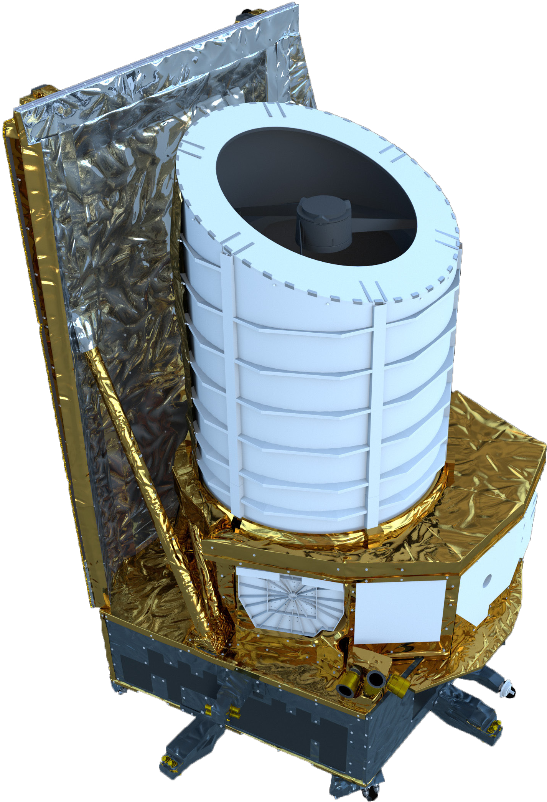
The anomalies from standard FMs are
often instrument systematics – not discoveries
Euclid Collaboration, Siudek et al. 2025

Slide 7

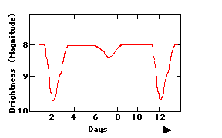
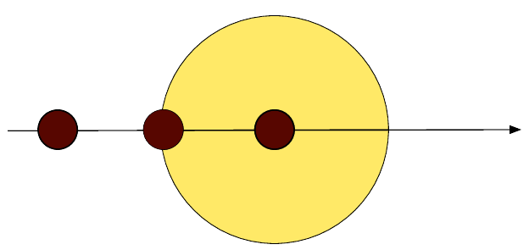
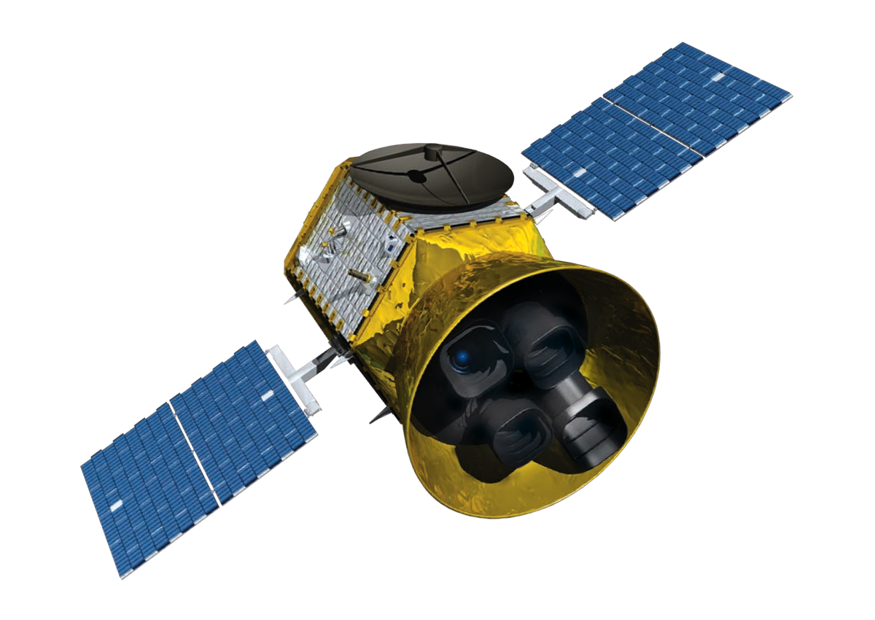



Instrument systematics distort our signal
An observation is the downstream result of a combined causal process:
Physical Process
Light
Instrumental Response
Observation
Star
Planet
Observation = f(Physics, Instrument Systematics)
Originates somewhere in the universe and is independent of the measurement
Science variables
Distortions introduced by the measurement
Confounding variables
Slide credit: Pablo Mercader-Perez
Notes:
Let me start by explaining one way we can interpret an observation

Slide 8
Typical Foundation Model

Slide 9
Typical Foundation Model

Slide 10
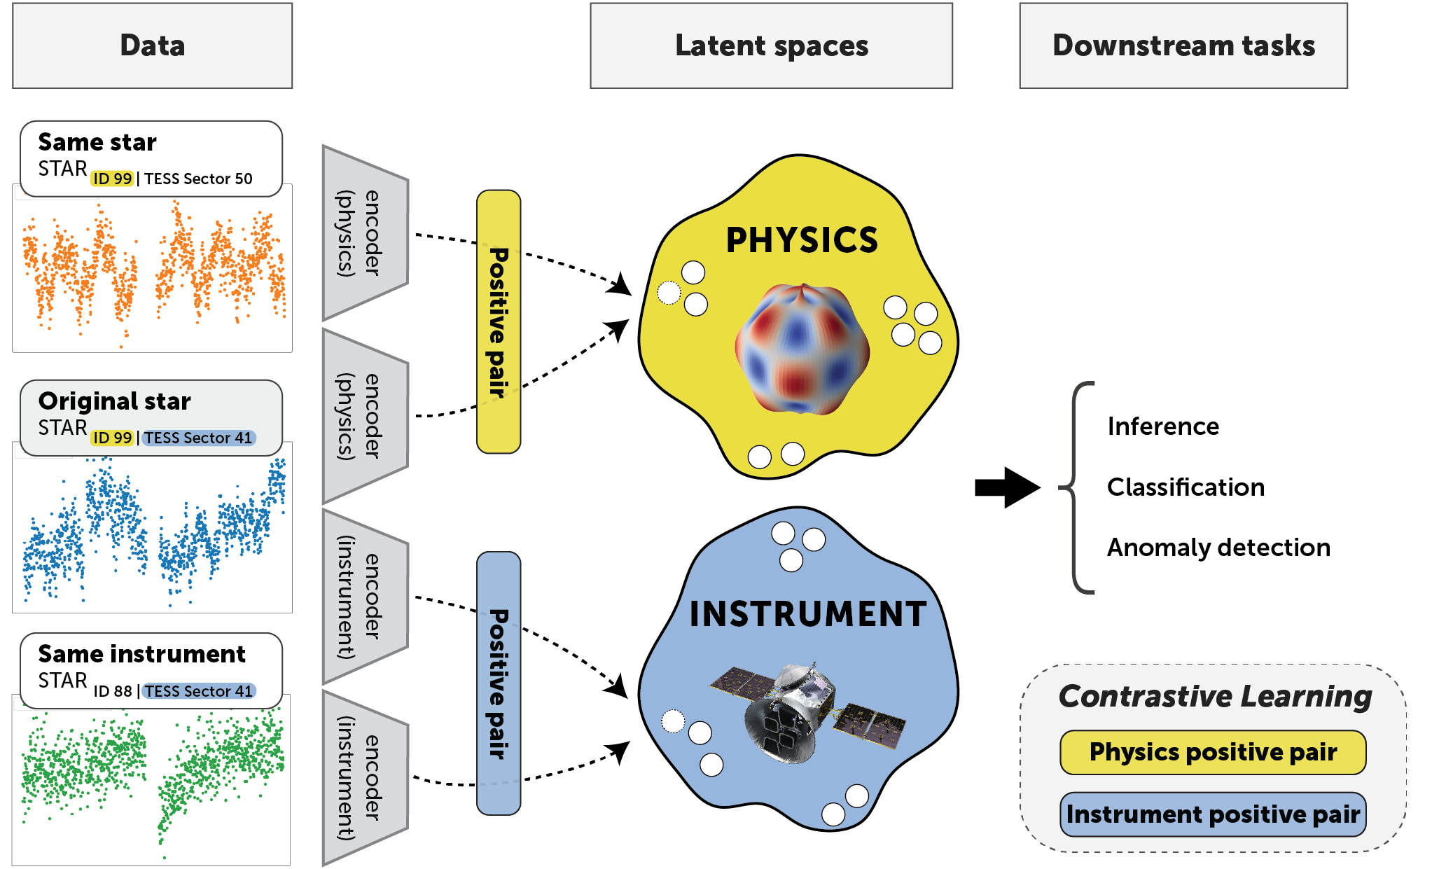
Causal Foundation Model

Slide 11
Making Data “Triplets”

Slide 12
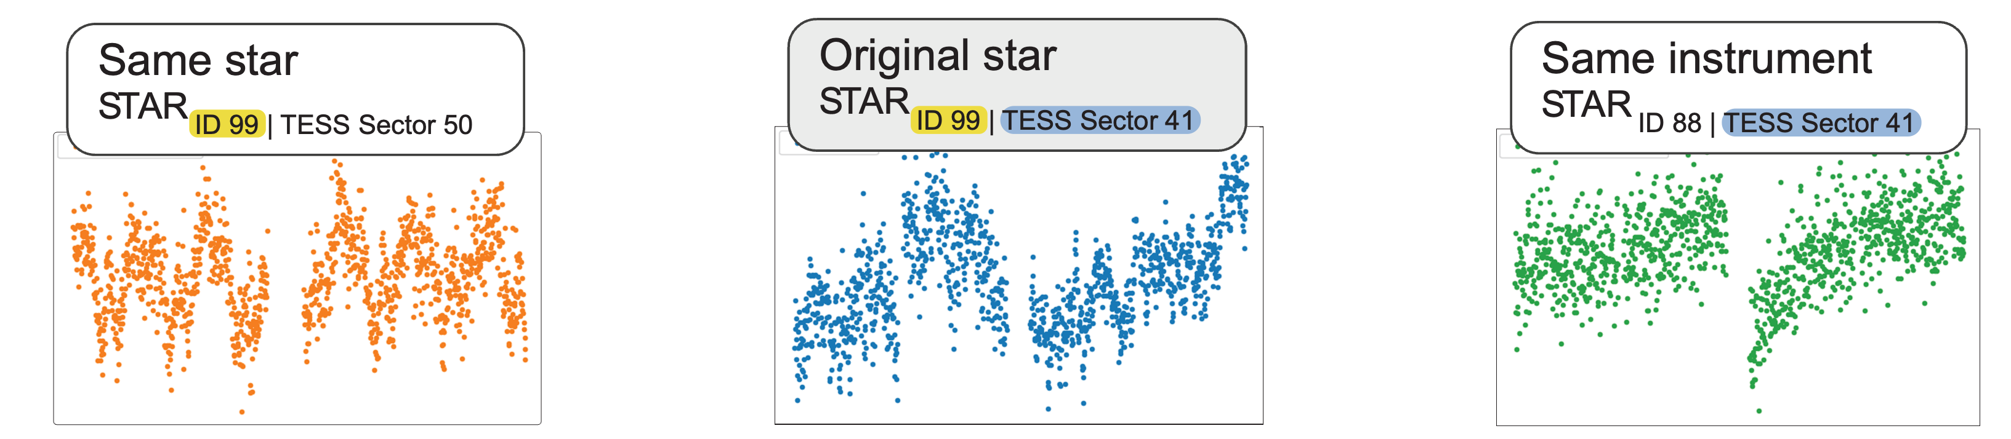
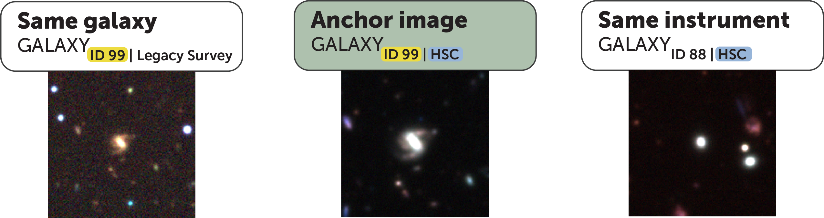
Making Data “Triplets”

Slide 13
Causal foundation model
Audenaert, Muthukrishna, Gregory, Hogg, Villar (2025)
Notes:
One instrument
Given it’s constituent parts, way cooler things
Accelerometers, audio recorders, different systematics and any other sensor in genera;

Slide 14
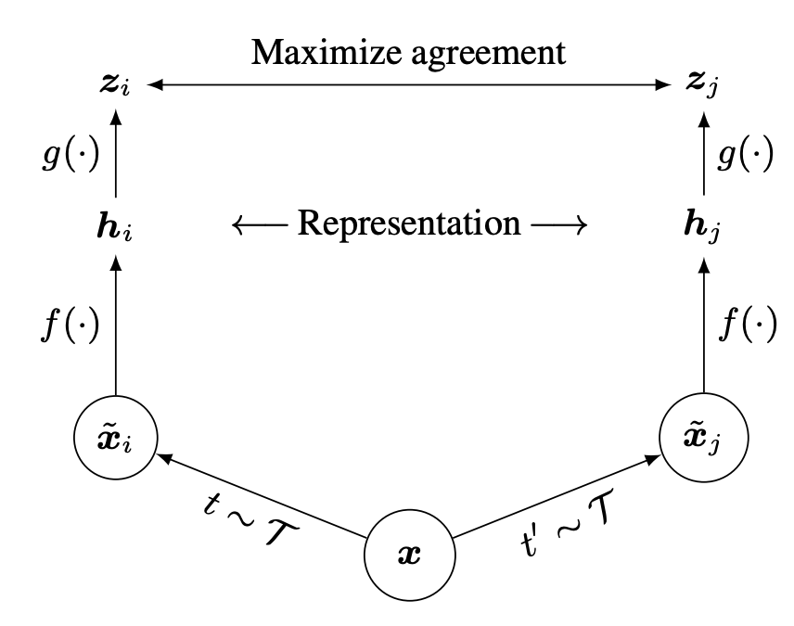
Contrastive vs Generative objective

Slide 15
SimCLR – Contrastive Learning
Chen et al. (2020)

Slide 16
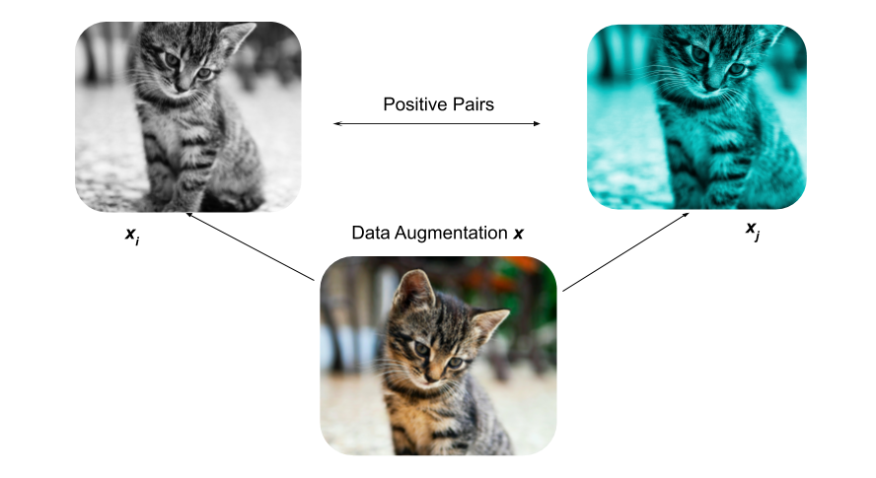
SimCLR – Contrastive Learning
Chen et al. (2020)

Slide 17
SimCLR – Contrastive Learning
Chen et al. (2020)

Slide 18
SimCLR – Contrastive Learning
Chen et al. (2020)

Slide 19
SimCLR – Contrastive Learning
Chen et al. (2020)

Slide 20
SimCLR – Contrastive Learning
Physics Space
Instrument Space

Slide 21
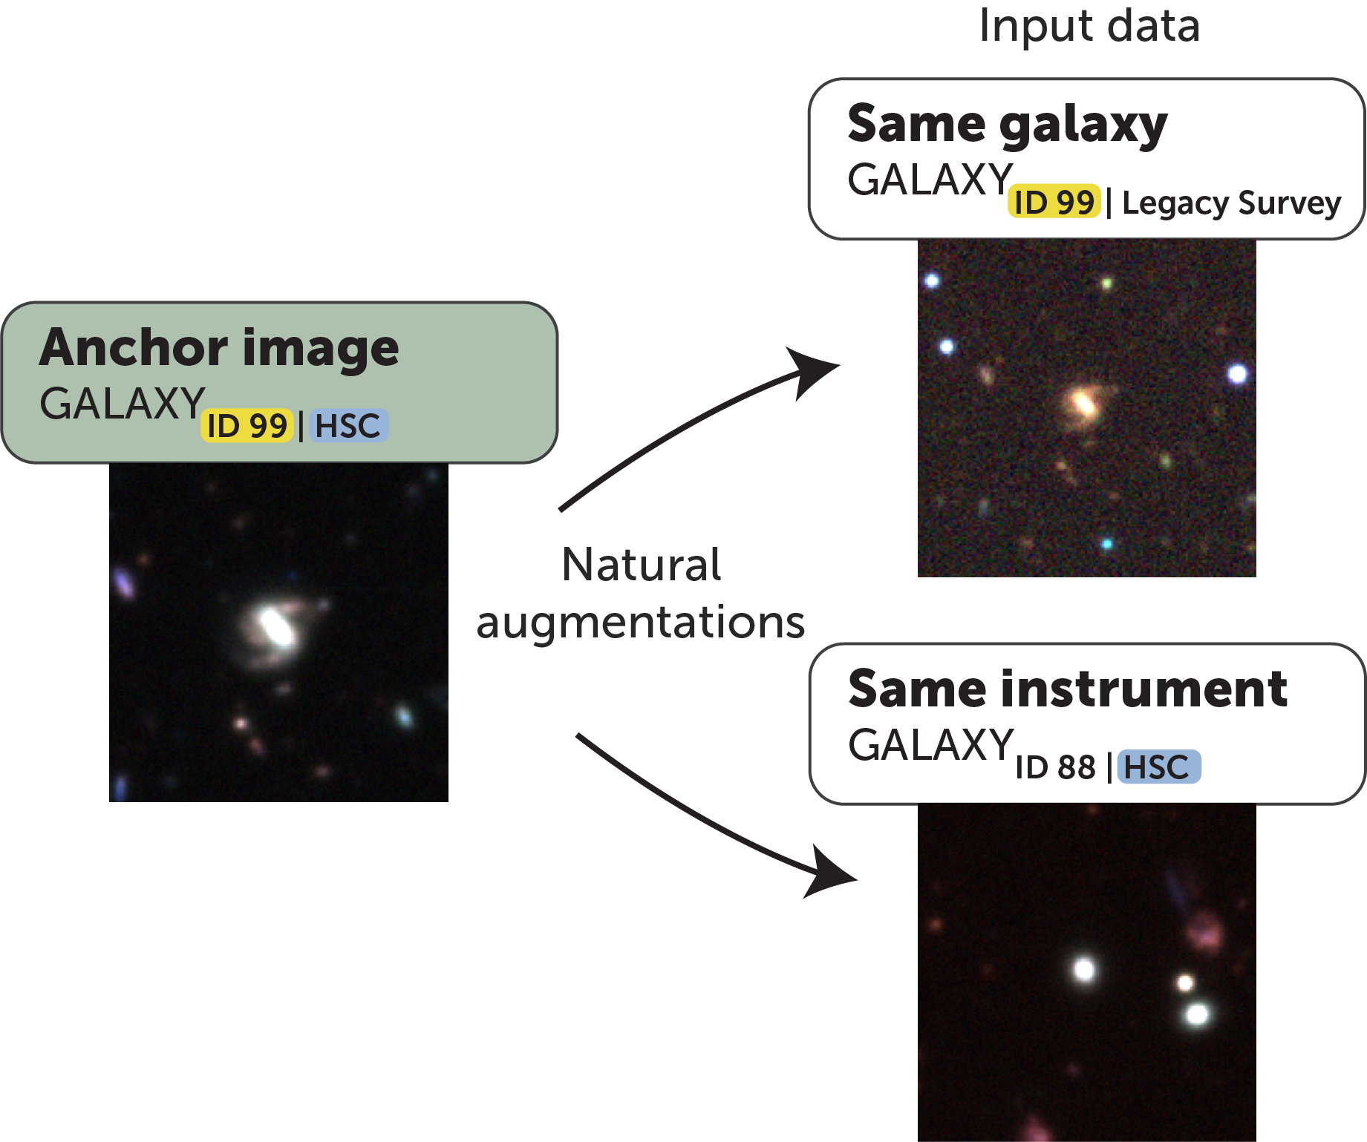
Making Triplets

Slide 22
SimCLR – Contrastive Learning
Physics Space
Instrument Space

Slide 23
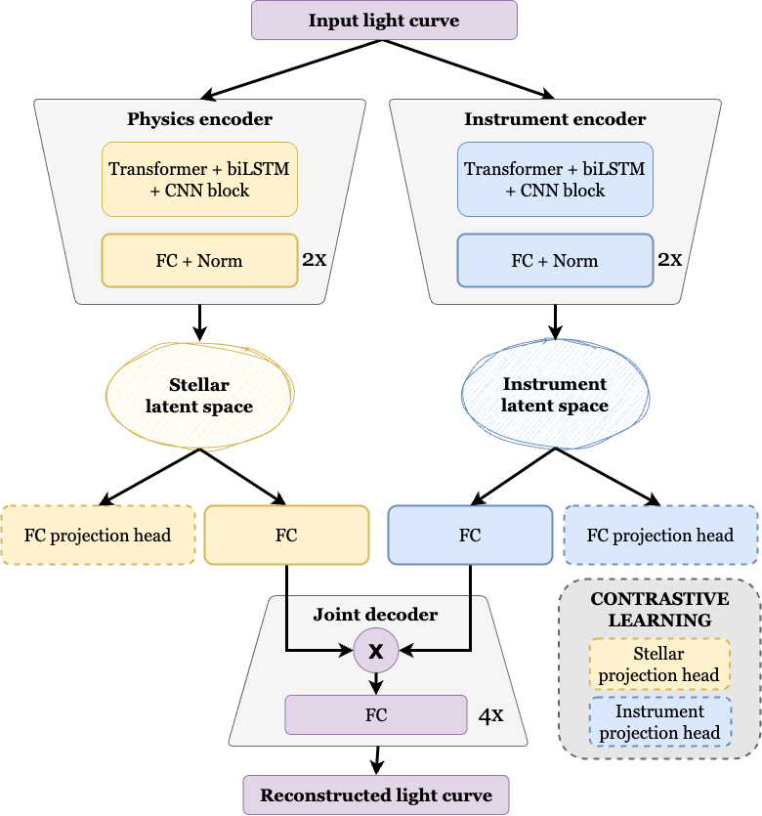
Muthukrishna*, Audenaert*, Gregory, Villar, Hogg (2025)
Notes:
One instrument
Given it’s constituent parts, way cooler things
Accelerometers, audio recorders, different systematics and any other sensor in genera;

Slide 24
Muthukrishna*, Audenaert*, Gregory, Villar, Hogg (2025)
Notes:
One instrument
Given it’s constituent parts, way cooler things
Accelerometers, audio recorders, different systematics and any other sensor in genera;

Slide 25
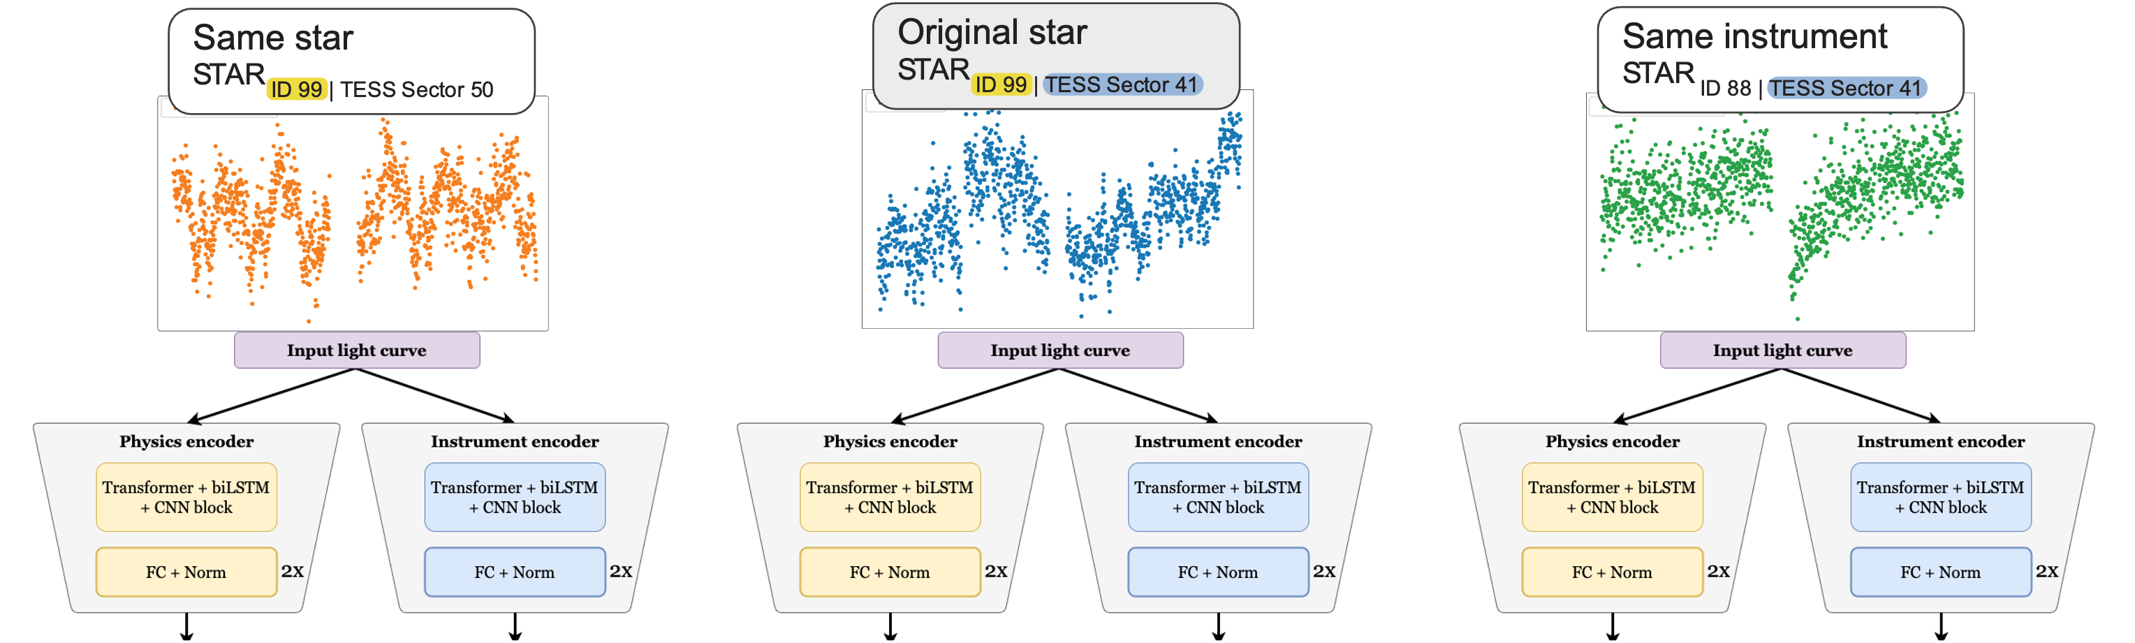
Muthukrishna*, Audenaert*, Gregory, Villar, Hogg (2025)
Notes:
One instrument
Given it’s constituent parts, way cooler things
Accelerometers, audio recorders, different systematics and any other sensor in genera;

Slide 26

Causal Foundation Model
arXiv:2507.05333
Muthukrishna*, Audenaert*, Gregory, Villar, Hogg (2025)

Slide 27
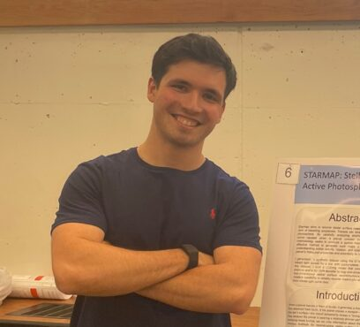
CausalFM — disentangling physics from instrument
Preliminary work on real data
Pablo Mercader-Perez
MIT PhD Student
Muthukrishna, Audenaert et al. 2025 · https://arxiv.org/abs/2507.05333
Mercader-Perez, Cuesta, Muthukrishna et al. 2026 · https://arxiv.org/abs/2604.09787
Notes:
Doing this for time-series data is a much harder problem, and so in preliminary work, my PhD student,
-has just had a paper accepted last week applying this to galaxy images from legacy and hyper-suprime cam
And it really demonstrates the success of my novel method. Probing just the physics space, we can get better morphology classifications, and physical parameter estimations than standard methods.
And what’s really cool is what happens with anomaly detection!

Slide 28
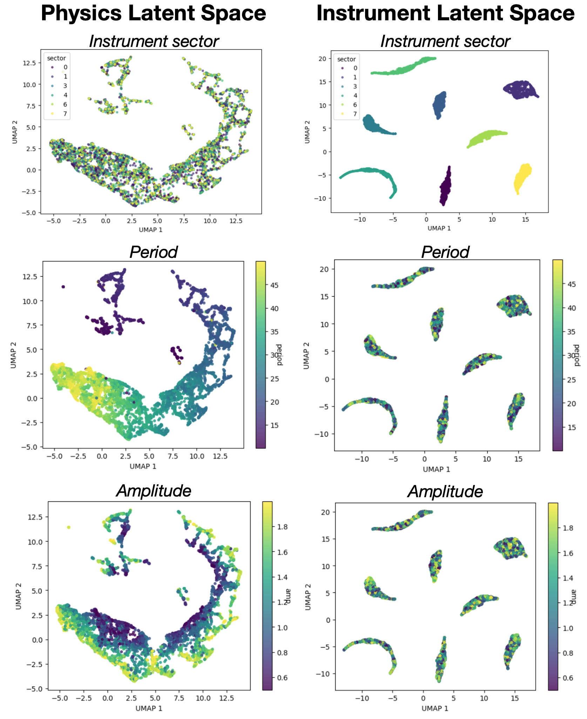
Simple simulations
Sine + linear trends + noise

Slide 29
Latent Space

Slide 30
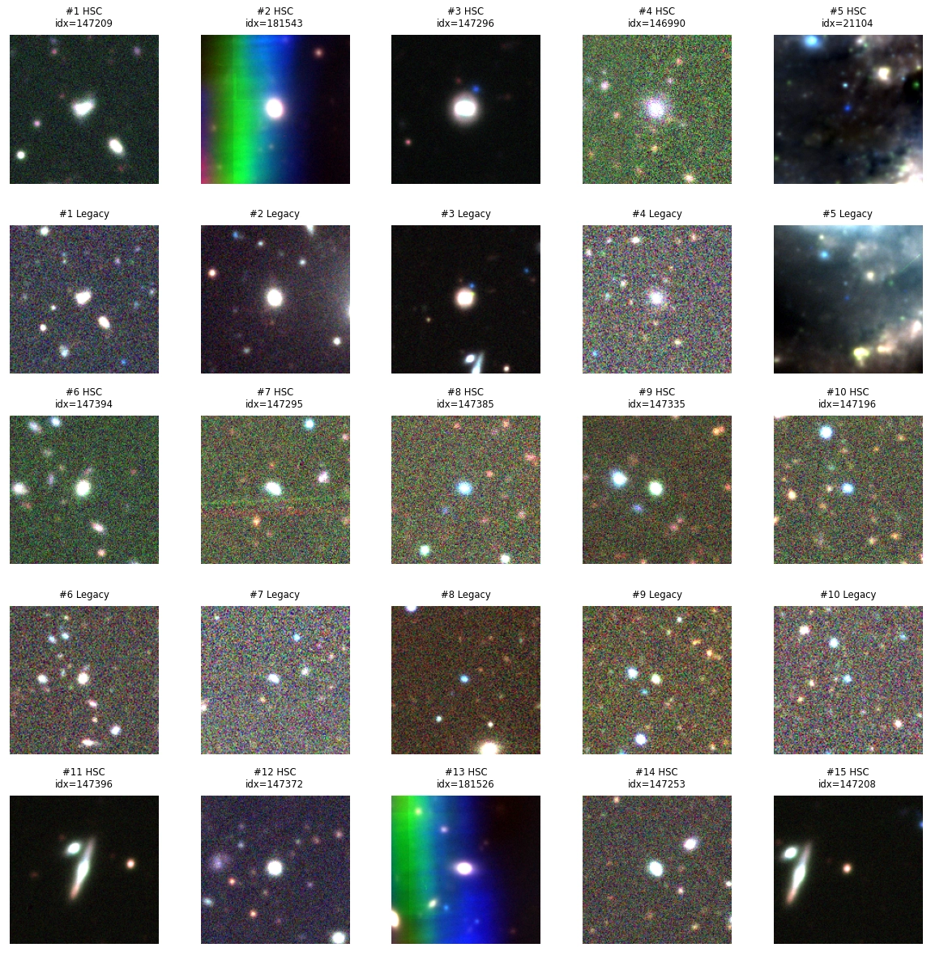
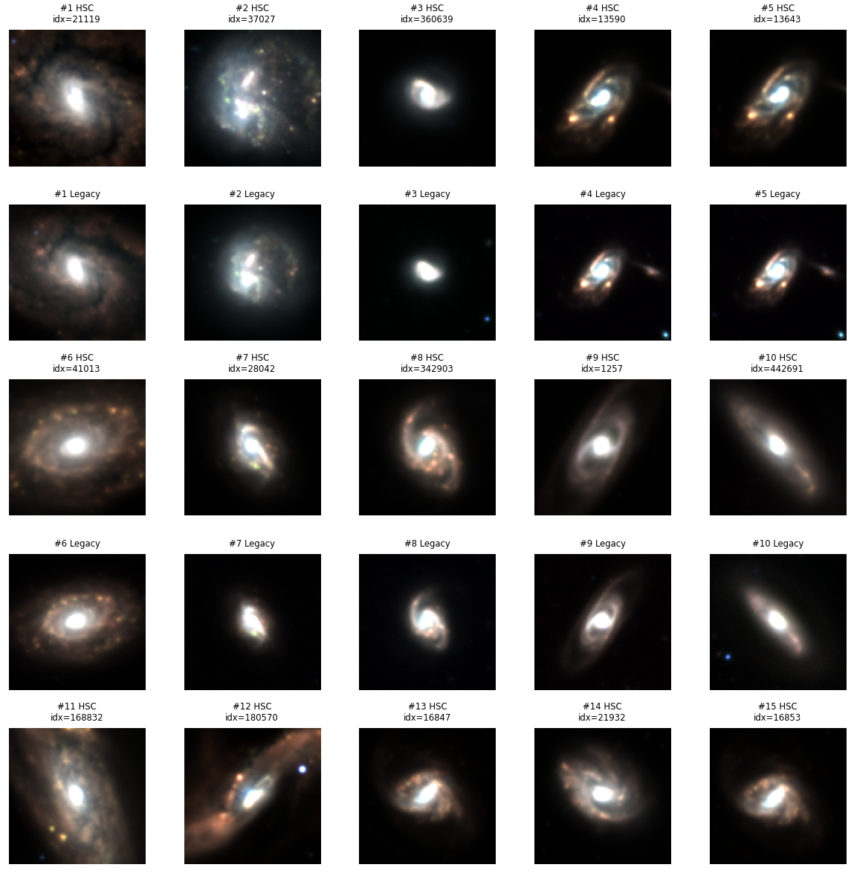
AION’s (state of the art)
top 25 anomalies
CausalFM – Physics latent
top 25 anomalies
Pablo Mercader-Perez
MIT PhD Student
AION, Polymathic Team, Parker+ 2025, https://arxiv.org/abs/2510.17960
Paper at ICLR applying novel CausalFM to galaxy images
Mercader-Perez, Cuesta, Muthukrishna et al. 2026 · https://arxiv.org/abs/2604.09787
→ Standard methods’ anomalies are often instrument artifacts. ClearSkyAI will find real discoveries
Notes:
And what’s really cool is what happens with anomaly detection!
All standard methods including AION, the current state of the art in astronomy struggle to discover interesting anomalies
and instead the top-ranking anomalies are plagued by instrument artefacts.
But, my novel method which explicitly disentangles the instrument, finds actually interesting anomalies, with no systematic effects clouding what is “interesting”.
massive breakthrough result for the field across astrophysics and beyond
here interacting/merging galaxies
Assymmetries, distorted spiral arms.

Slide 31
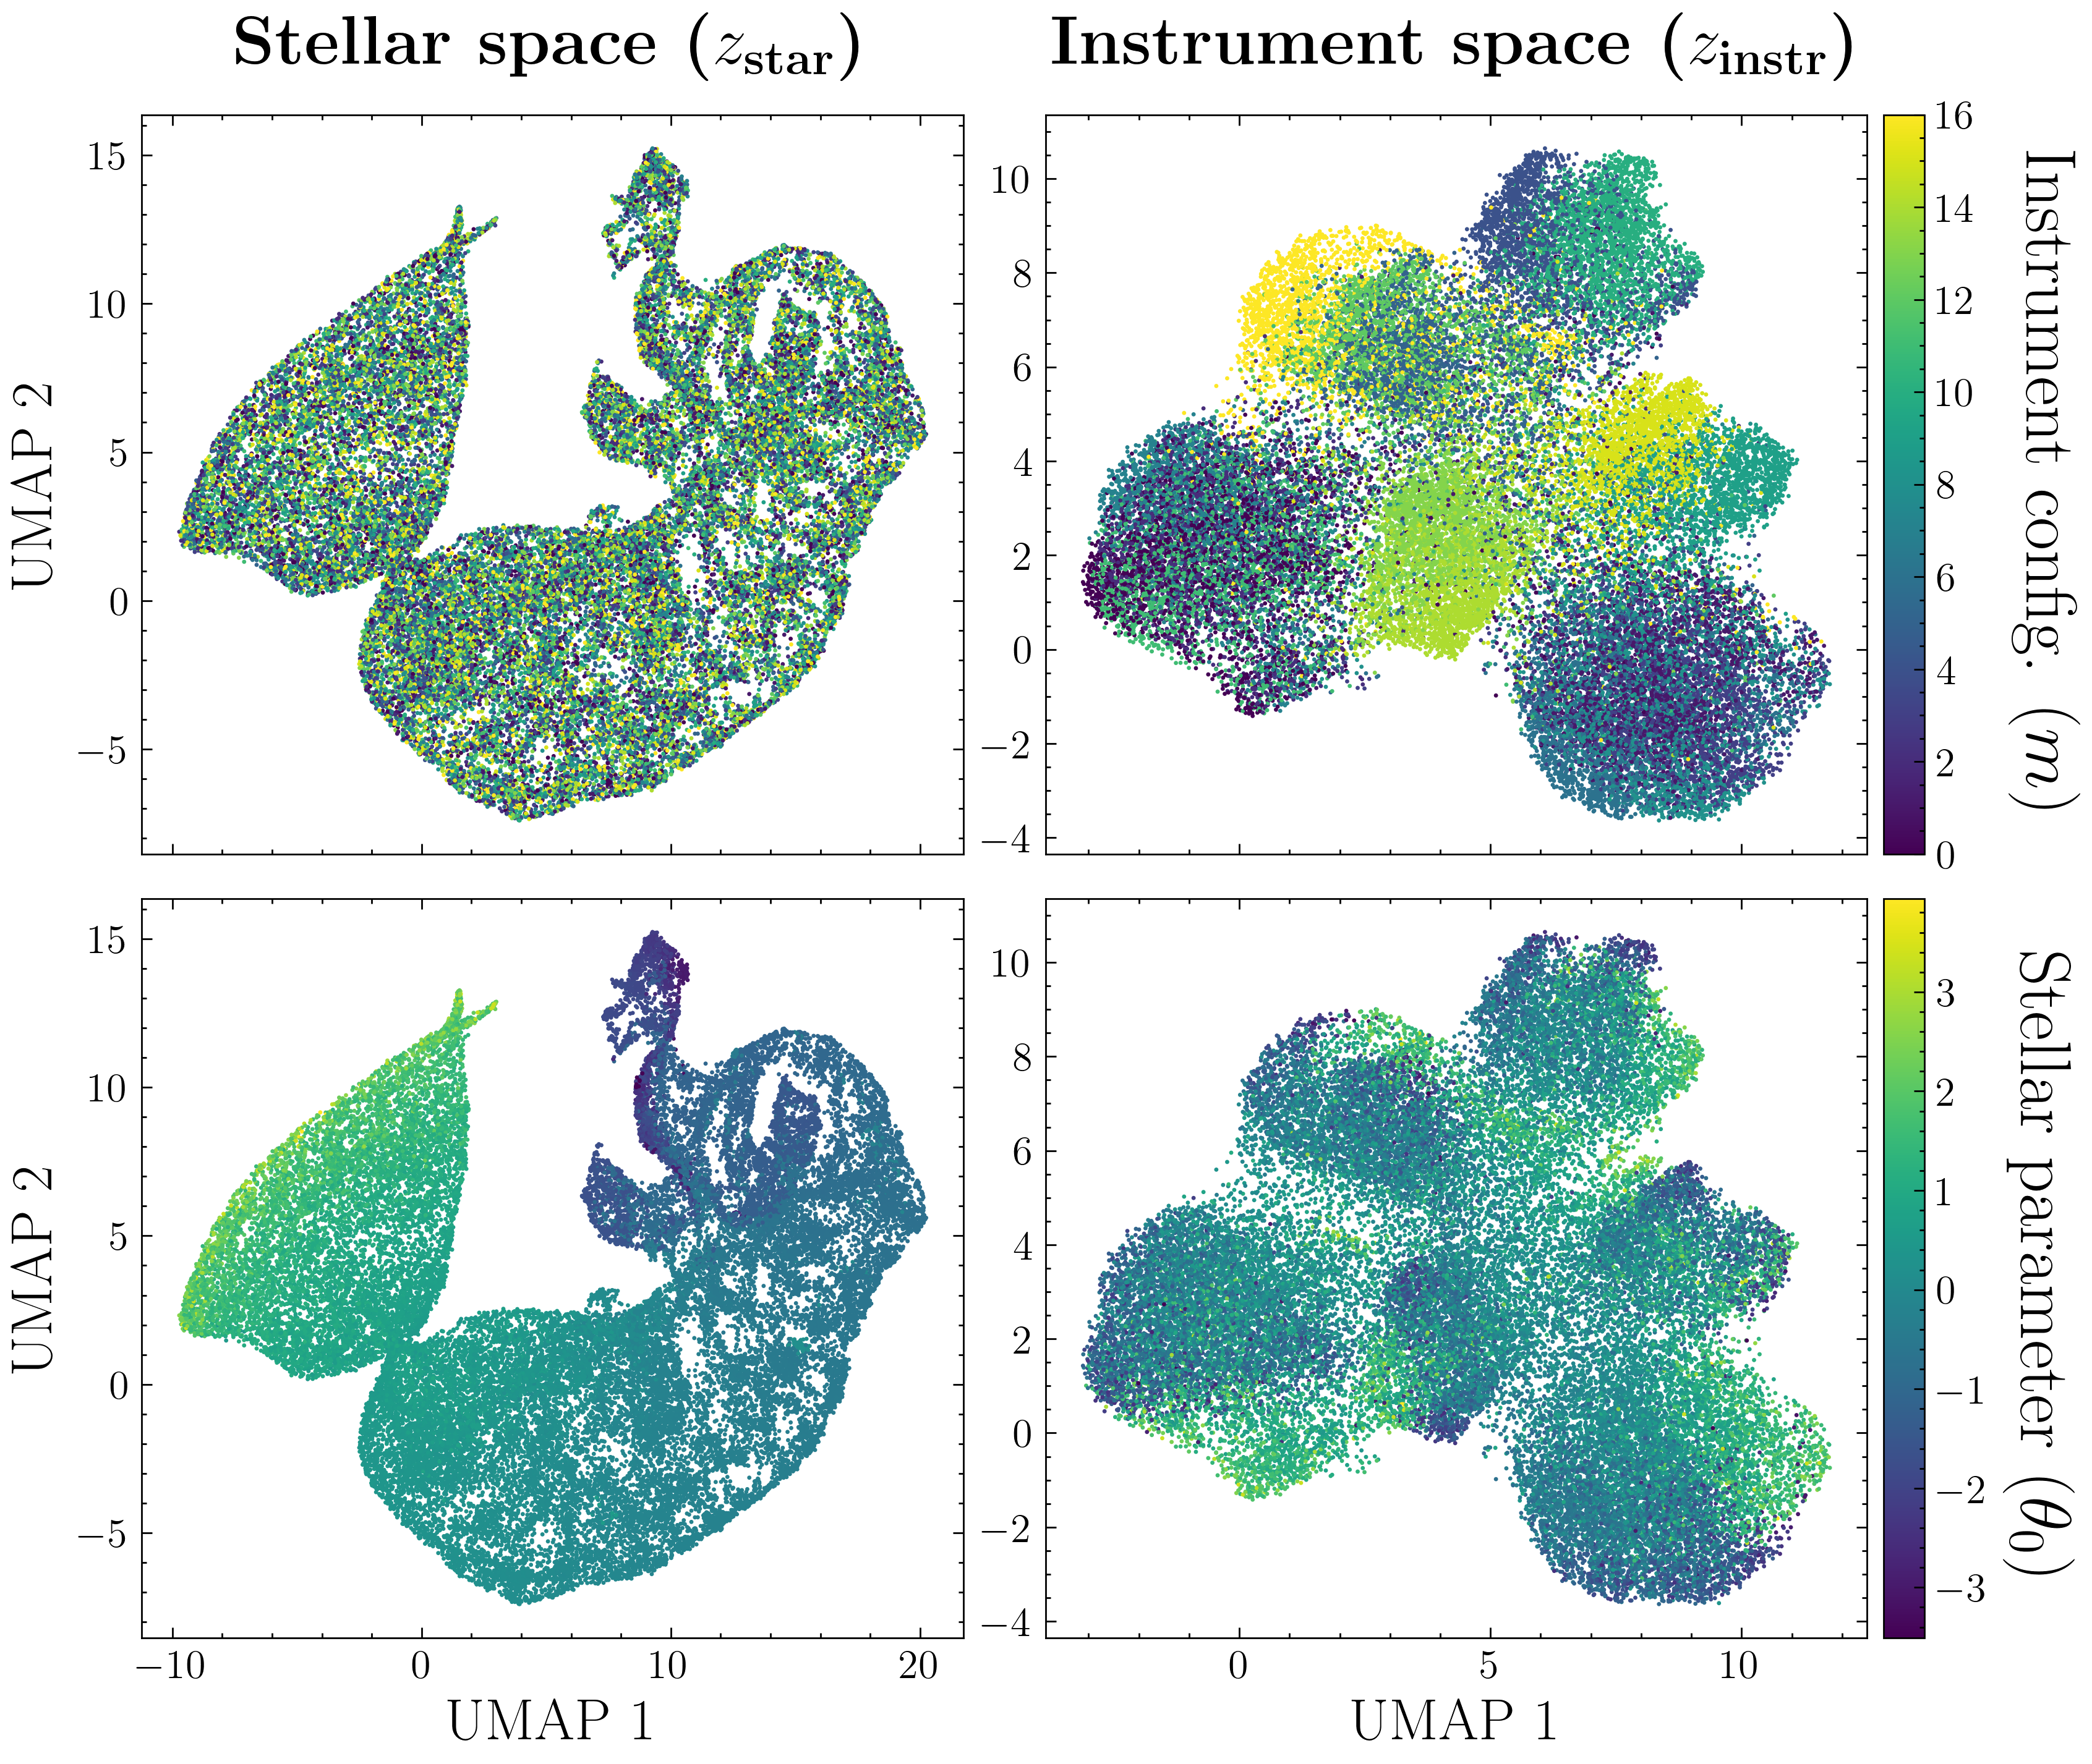
“Sector”

Slide 32
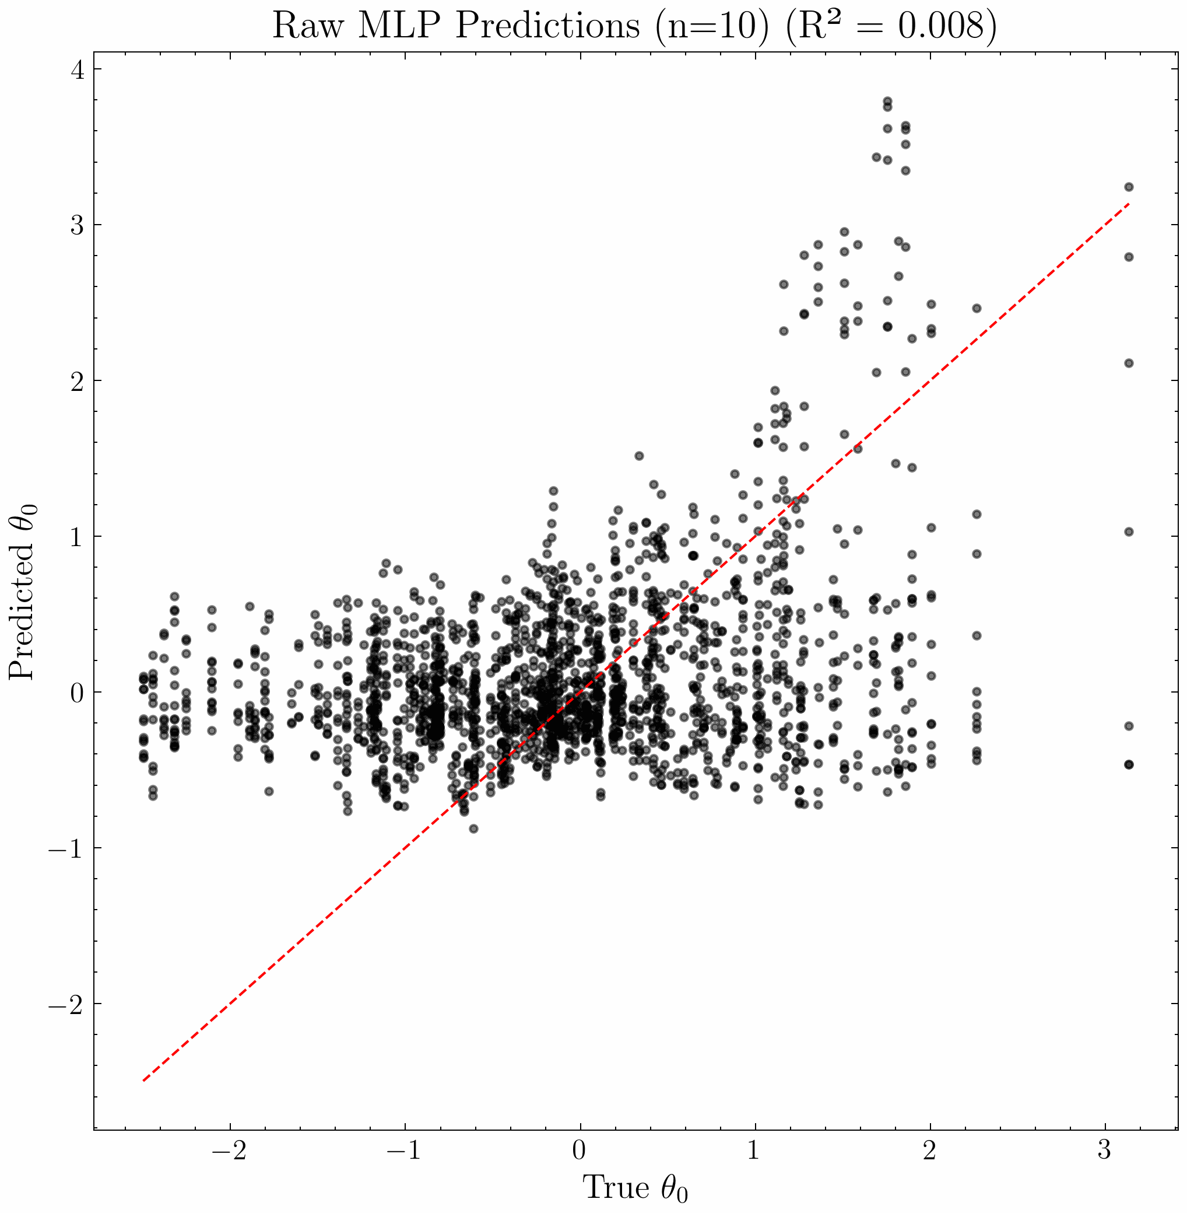
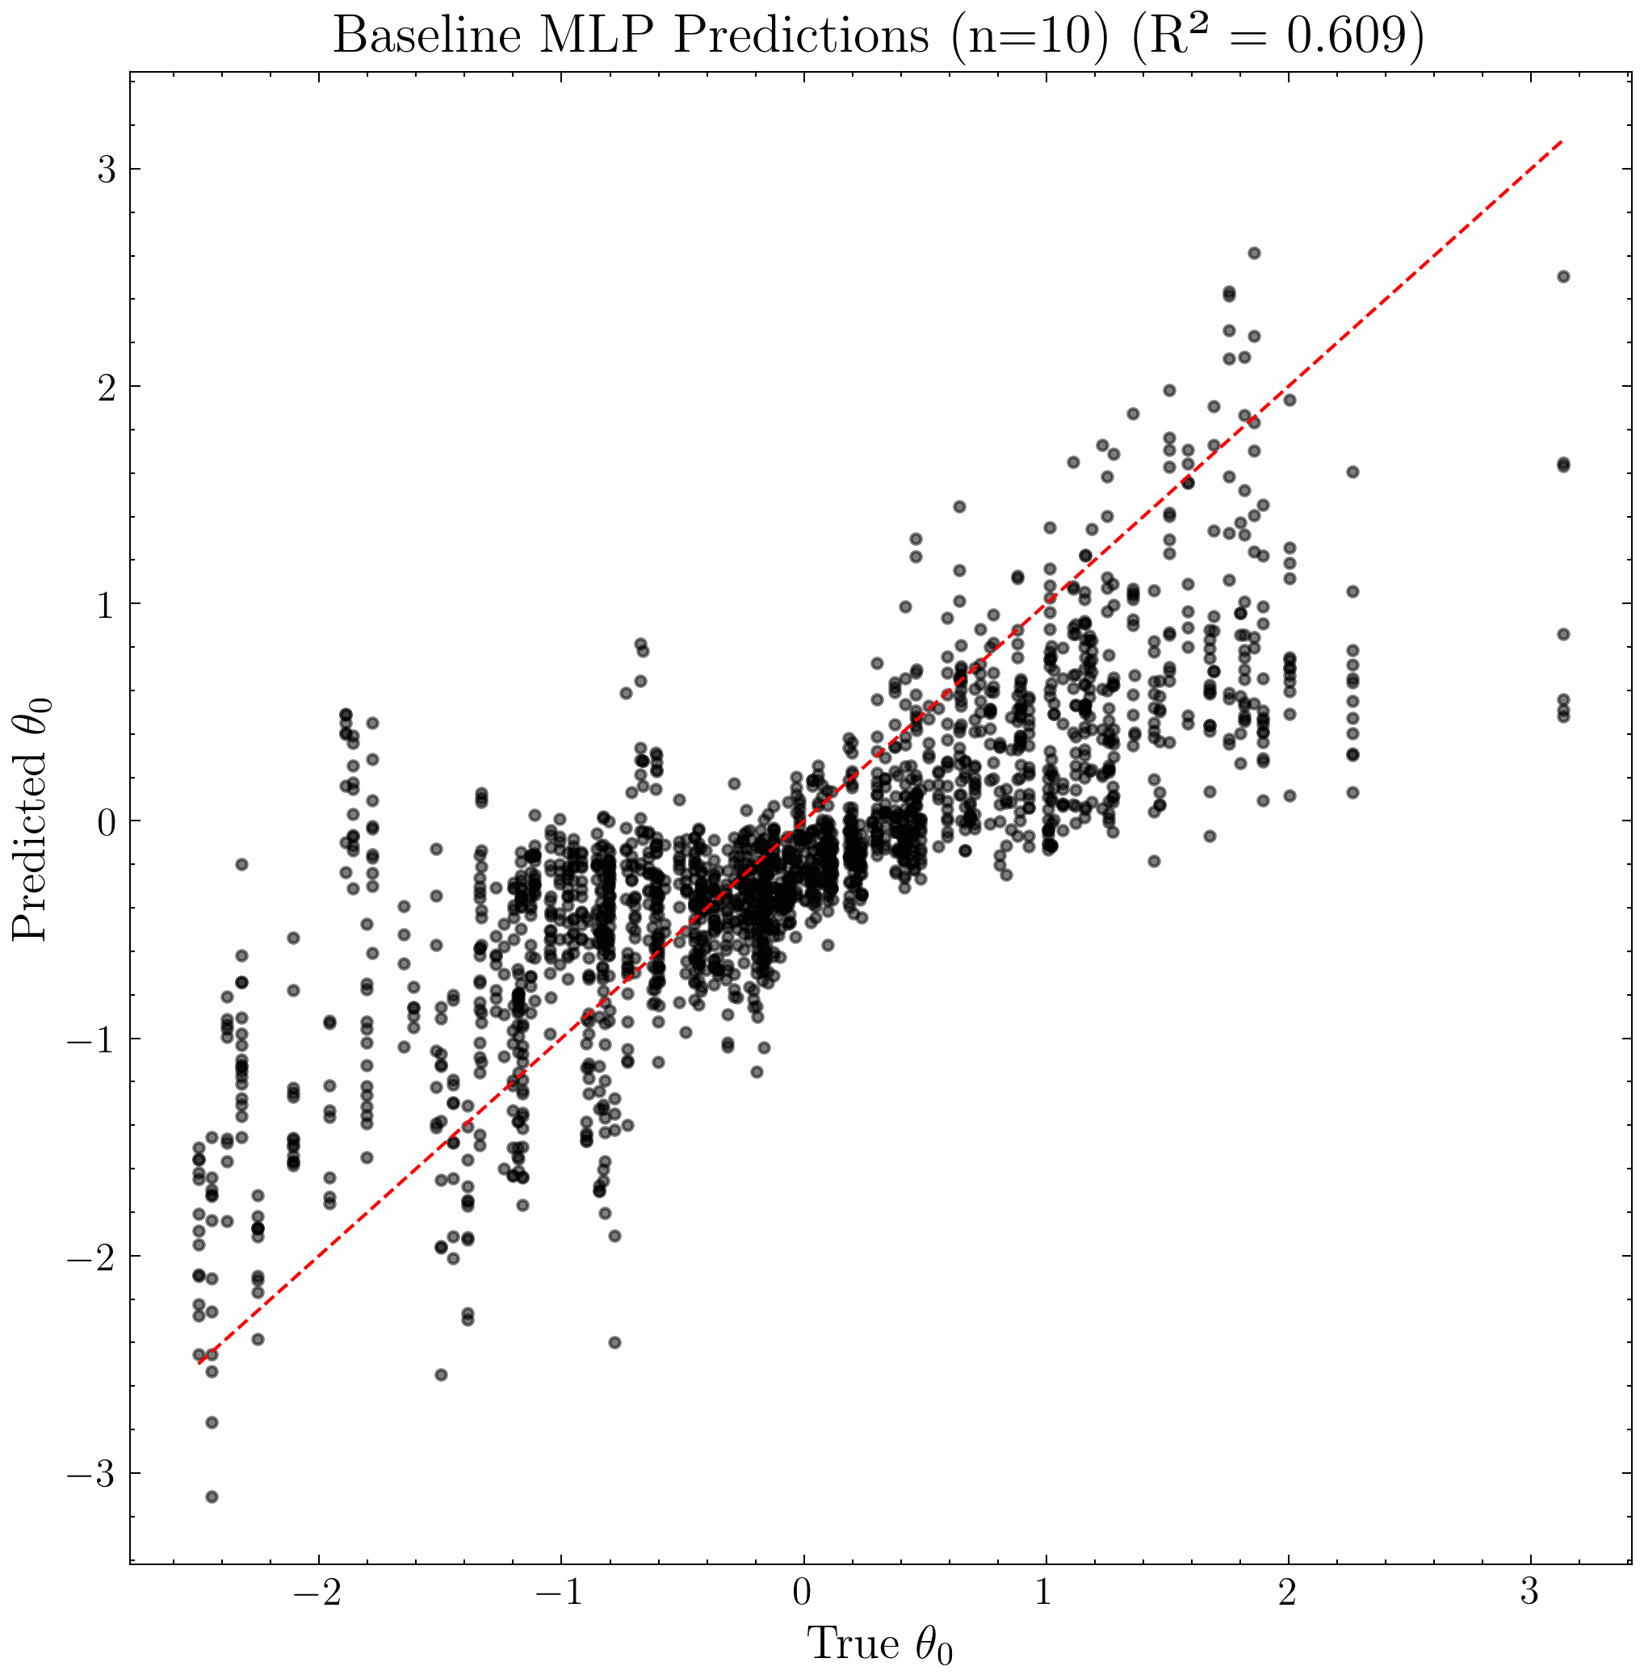
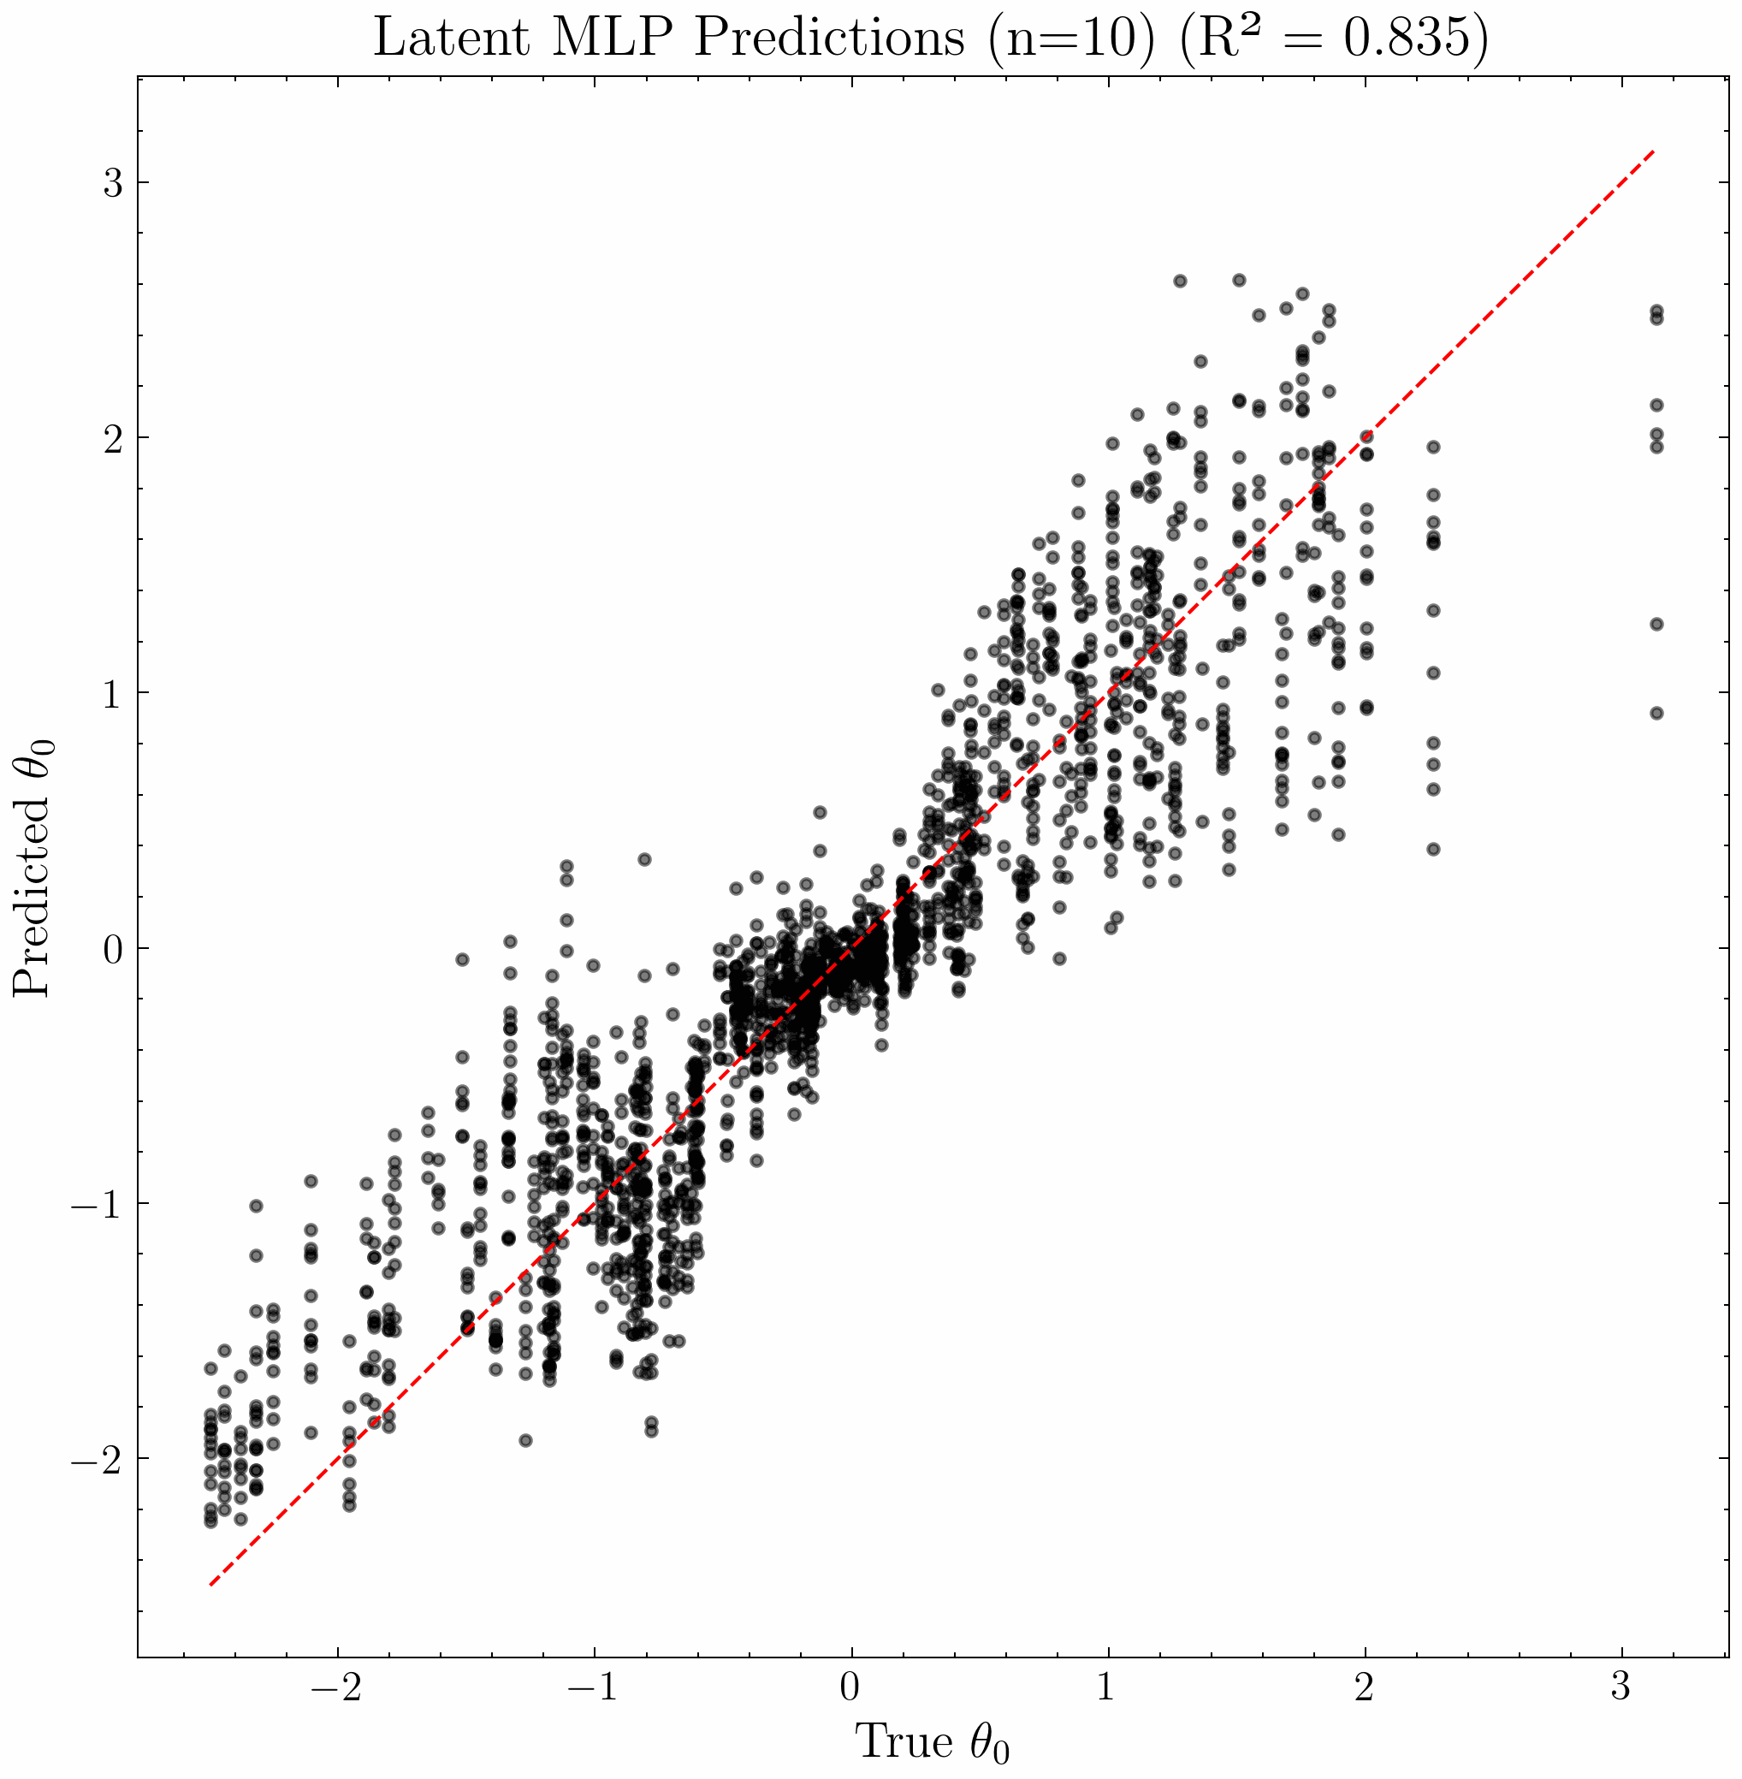
Downstream Tasks
Baseline
– MLP on raw data
Baseline
– MLP on pretrained typical FM
MLP on pretrained Causal FM

Slide 33
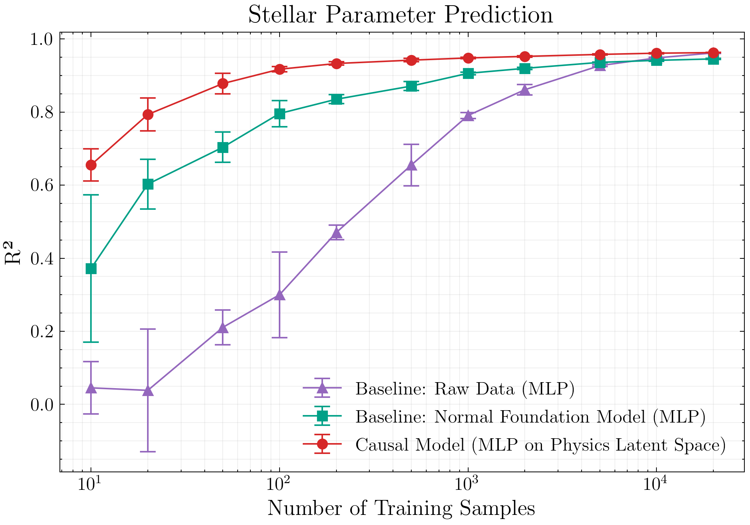
Downstream Tasks Comparison

Slide 34
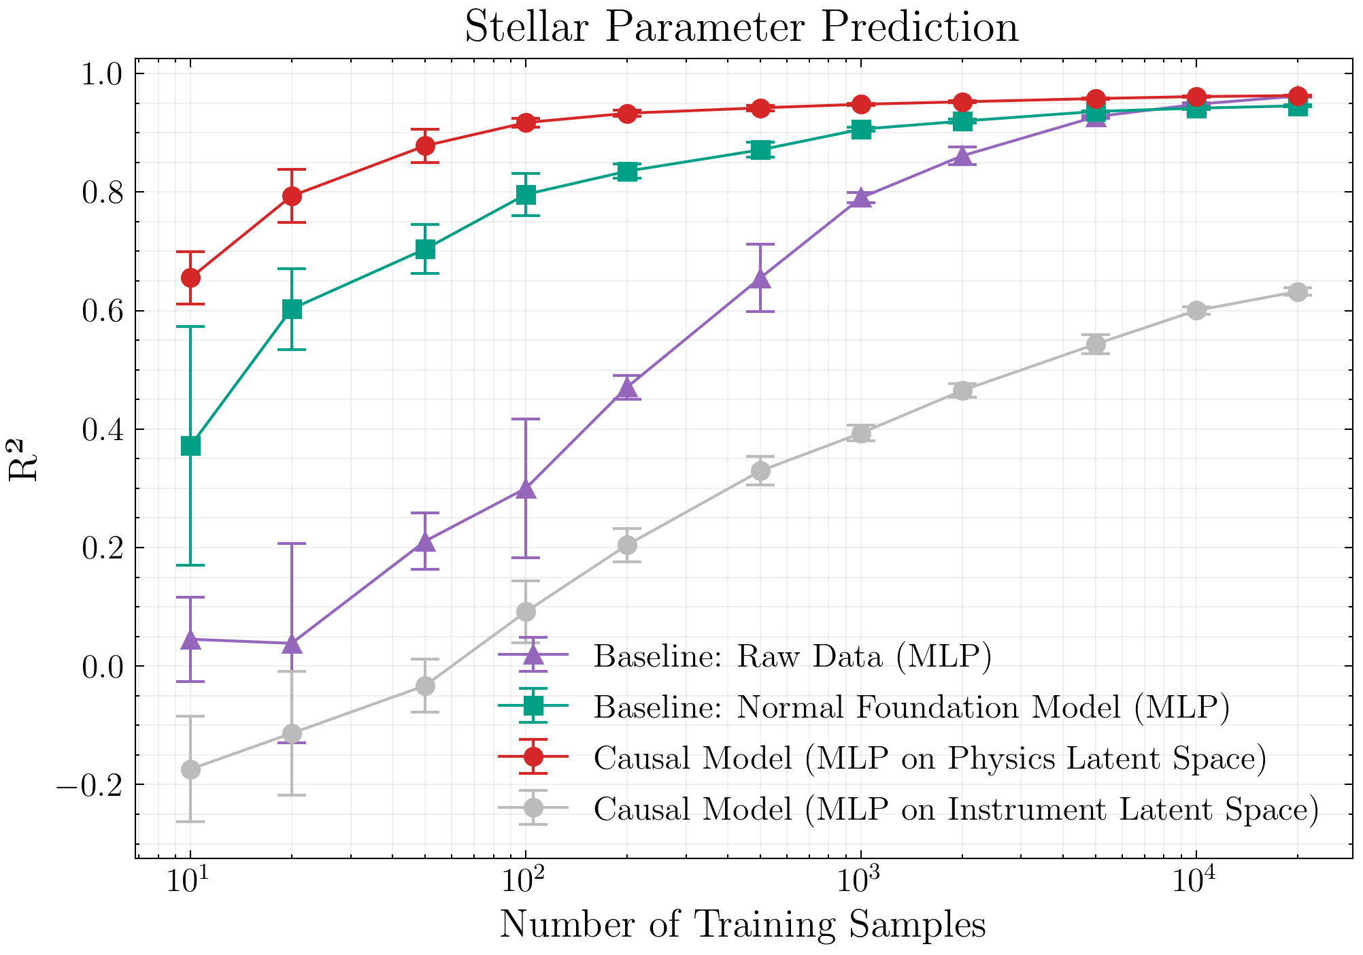
Downstream Tasks Comparison

Slide 35
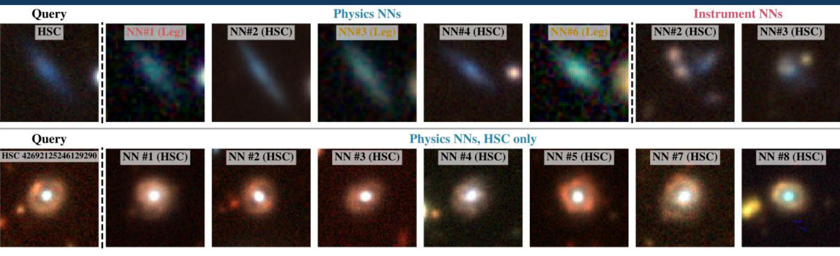
Instrument-Invariant Search and
Rare Object Discovery
Nearest neighbours in the physics latent space across Legacy and HSC, enabling cross-survey object search.
Searching for known strong gravitational lens as query yields interesting examples.

Slide 36
Conclusions
We know our instruments cause distortions, let’s build this into the model!
Building foundation models using a causally-motivated framework may lead to better performance than standard single-latent space FMs and can enable a domain-agnostic (survey-independent) model
Our Causal FM consists of:
  Two latent spaces for the Physics and Instruments
A generative approach can condition on multiple telescopes at once and enable cross-survey generation
  i.e. what would this galaxy look like if observed by a different instrument?

Slide 37
Anomaly Detection

Slide 38
Latent Space

Slide 39
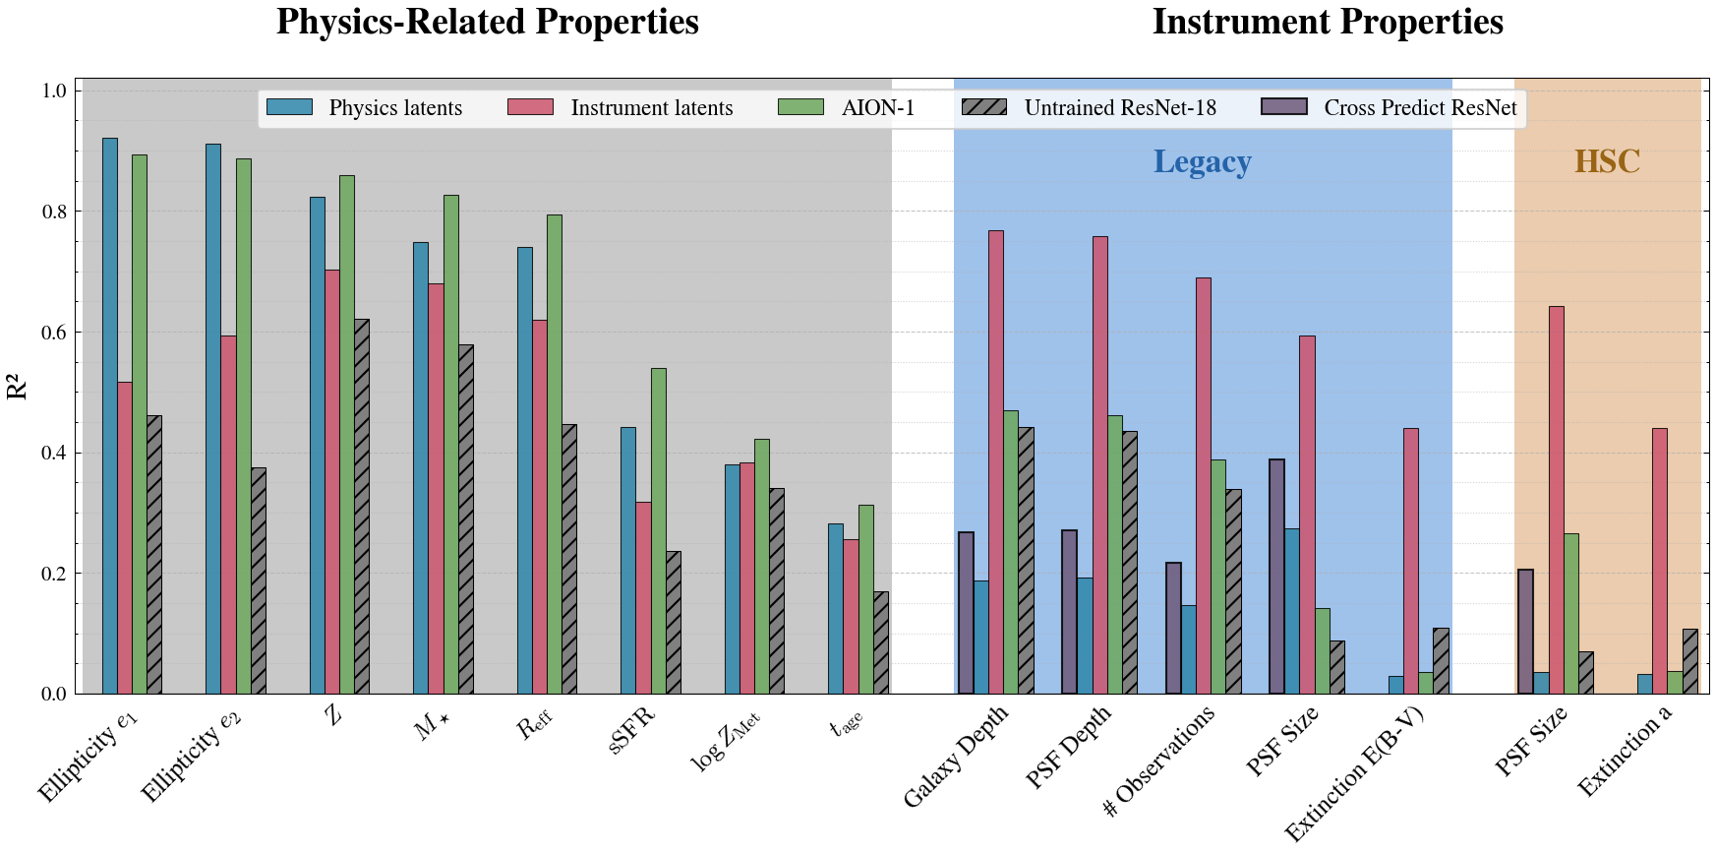
Downstream Tasks

Slide 40
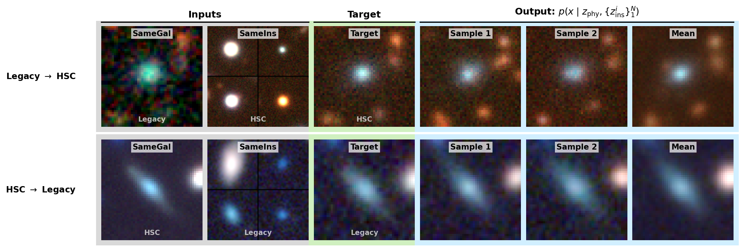
Counterfactual Reconstruction

Slide 41
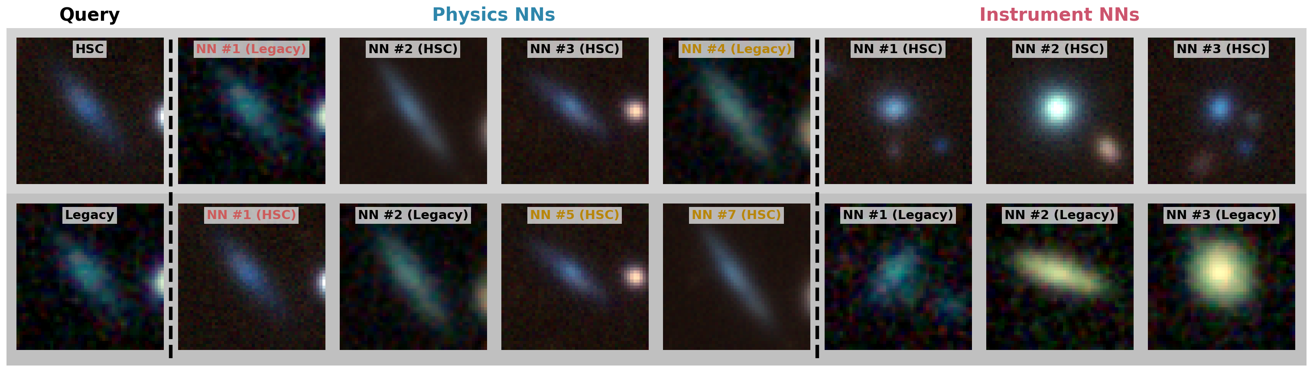
Nearest Neighbours Search

