Slide 1
Characterizing Underconstrained
DEM Analysis
Mark Weber*
CfA – Harvard – UCI AstroStats Seminar
Cambridge, MA
July 26, 2011
*Harvard-Smithsonian Center for Astrophysics

Slide 2
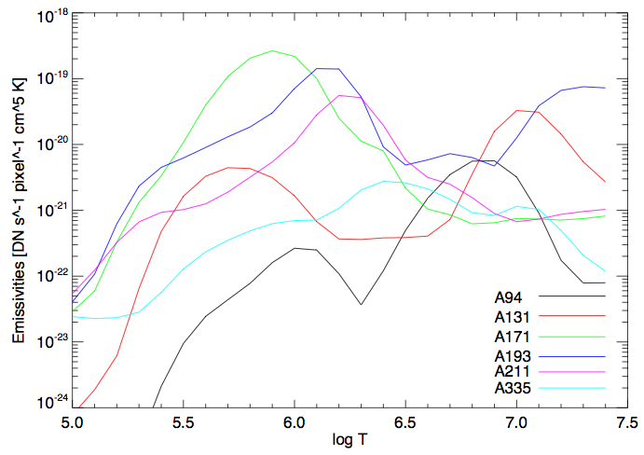
AIA Temperature Responses

Slide 3





The DEM Equation
C = channel (e.g., AIA 94Å, 131Å, etc.)
I = Intensity in channel / passband
F_{c}(T) = Instrument temperature response function for channel “c”
DEM(T) = Differential emission measure function
➔

Slide 4
DEM Difficulties & Complications
Inversion is (often) under-constrained
Inversion must constrain DEM(T) to be non-negative everywhere
Random errors (e.g., photon noise)
Systematic errors (e.g., inaccuracies in atomic databases)
PSF deconvolution
Absolute cross-calibration if combining instruments
Line blends

Slide 5
DEM Difficulties & Complications
Inversion is (often) under-constrained
Inversion must constrain DEM(T) to be non-negative everywhere
Random errors (e.g., photon noise)
Systematic errors (e.g., inaccuracies in atomic databases)
PSF deconvolution
Absolute cross-calibration if combining instruments
Line blends
ALSO MUST ASSUME:
Optically thin plasma
Abundance model
Ionization equilibrium
Solar variations much slower than exposure times and cadence

Slide 6
Categories of Concern
(not mutually exclusive)
“MATH”: How to do the inversion? What information is constrained by the data and by the instrument responses?
“PHYSICS (Models)”: How to choose/reject between DEM solutions that are comparably valid (i.e., that are equally good at fitting the data)?
“UNCERTAINTIES”: How to put error bars on the DEM solutions and derivative results?
“PHYSICS (Spectra)”: Do we have accurate knowledge of the solar spectra seen in the instrument channels? Are the response functions accurate?

Slide 7
Categories of Concern
(not mutually exclusive)
“MATH”: How to do the inversion? What information is constrained by the data and by the instrument responses?
“PHYSICS (Models)”: How to choose/reject between DEM solutions that are comparably valid (i.e., that are equally good at fitting the data)?
“UNCERTAINTIES”: How to put error bars on the DEM solutions and derivative results?
“PHYSICS (Spectra)”: Do we have accurate knowledge of the solar spectra seen in the instrument channels? Are the response functions accurate?
Easily separable

Slide 8
Categories of Concern
(not mutually exclusive)
“MATH”: How to do the inversion? What information is constrained by the data and by the instrument responses?
“PHYSICS (Models)”: How to choose/reject between DEM solutions that are comparably valid (i.e., that are equally good at fitting the data)?
“UNCERTAINTIES”: How to put error bars on the DEM solutions and derivative results?
“PHYSICS (Spectra)”: Do we have accurate knowledge of the solar spectra seen in the instrument channels? Are the response functions accurate?
Easily separable
Not easily separable

Slide 9
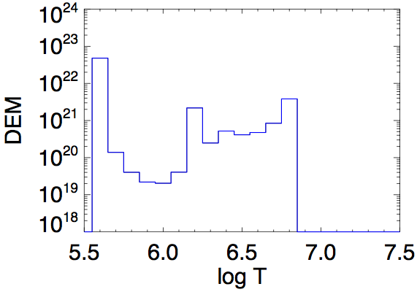
The “Under-Constrained” Aspect
N_{channels} < N_{temperature bins} (E.g., DEMs with imagers)

Slide 10
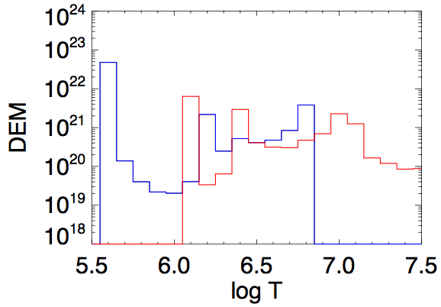
The “Under-Constrained” Aspect
These two DEMs give the SAME EXACT observations in the six AIA Fe-dominated EUV channels!

Slide 11

The Data-constrained and Unconstrained Parts
Consider a DEM reconstruction with the six AIA Fe-dominated EUV channels (94, 131, 171, 193, 211, 335), using a temperature grid with 21 steps from logT = 5.5 to 7.5.
6 data and 21 unknowns
Singular Value Decomposition allows us to calculate a 21-member basis set for DEM functions for these temperature responses on this temperature grid.
6 particular members (the “real” part of the basis set) have their linear coefficients uniquely determined by the 6 data values. The other 15 functions comprise the “null” basis.
i = 1 to 6; j = 1 to 15

Slide 12
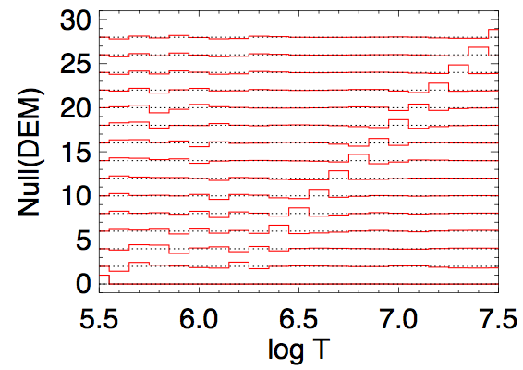
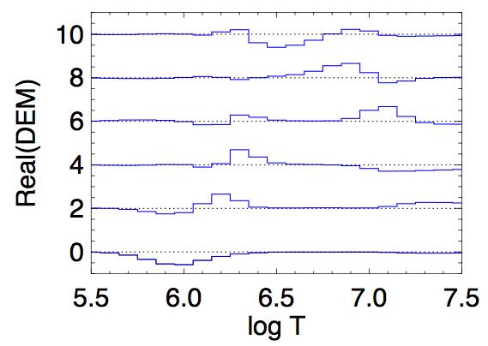
Real and Null Basis Functions

Slide 13




The Data-constrained and Unconstrained Parts
i = 1 to 6; j = 1 to 15
for each j and any β_{j}
➔

Slide 14
The Data-constrained and Unconstrained Parts
i = 1 to 6; j = 1 to 15
The null coefficients β_{j} may be freely set to any value, and they determine the “under-constrained” aspect of the solution.
for each j and any β_{j}
➔
Real(DEM) represents ALL of the information in the data.

Slide 15
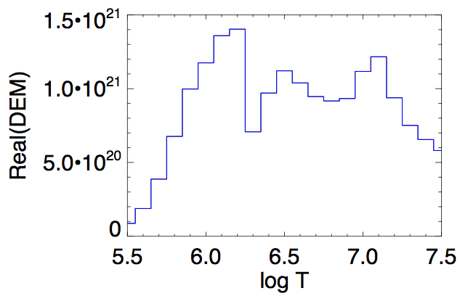
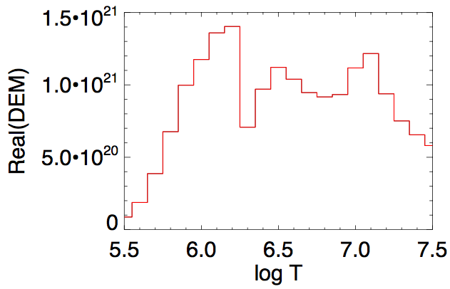
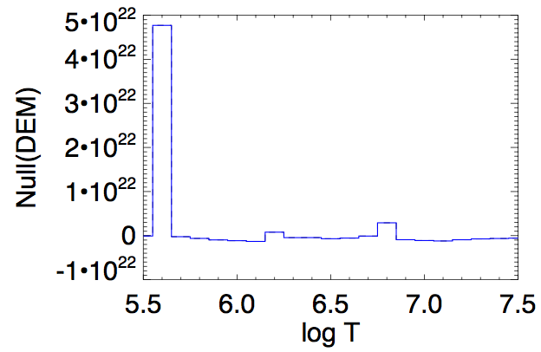
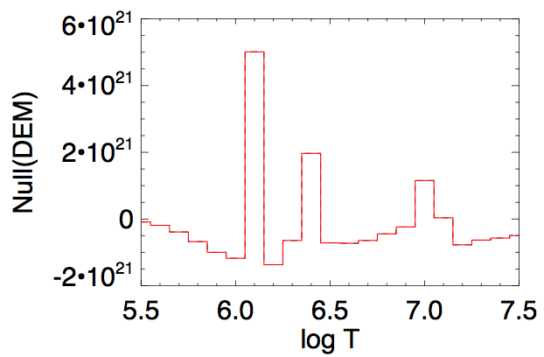
Revisit the Under-Constrained Example
These DEMs have the same real part, which is why they correspond to the same observations in the six channels.

Slide 16
Revisit the Under-Constrained Example
These DEMs have the same real part, which is why they correspond to the same observations in the six channels.
Warning: it is rare that the real part is non-negative. Hence, SVD alone is inadequate for DEM inversion.

Slide 17
Separating Inversion Math from Physical Selection
Note what the real/null distinction on DEM solution achieves for analysis:
There is a simple direct inversion calculation of the real coefficients from the data. This encodes all of the evidence from the data into an identified part of the DEM solution. This tells us what the data show independent of our physical notions of DEM models.
The null functions are the “knobs” that take the DEM solution across the range of equivalent forms. This is where physical notions are applied to constrain the range of DEMs.
BIG problem: The real part is almost never a viable non-negative solution by itself, and it is difficult to figure out what combinations of nulls are needed to get you to positivity.

Slide 18
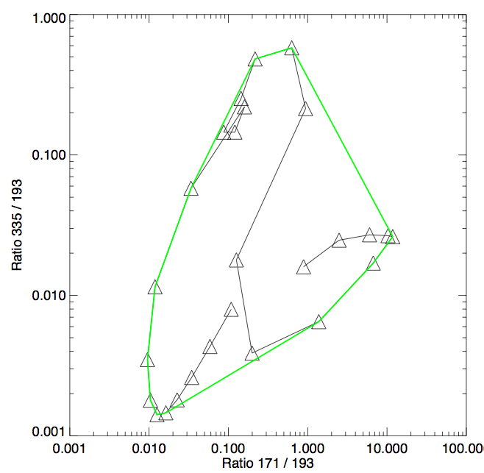
The “Convex-Hull” Method
Given a T-grid with N_{T} bins,
And given N_{c} passband channels,
“N_{T} choose N_{c}” combinations of N_{c} T-bins.
The domain = the set of all positive DEMs.
The linear map = the AIA response functions.
The range of the linear map = the observation sets that the instrument can possibly return.
The “Convex-Hull” Method states that:
Try all 6-temperature DEM inversions:
IF the input obs is within the range, THEN there will be at least one 6-bin DEM that solves it perfectly.
IF there is NO 6-bin DEM that solves the input obs, THEN the input obs is not within the range.
6-bin combos are SUFFICIENT and NECESSARY to perform solution and range-evaluation.
N_{T} = 26. LogT = [5.5, 5.6, .. 7.9, 8.0]
N_{c} = 6. [94, 131, 171, 193, 211, 335]
230,230 combos of 6-bin DEMs.
(Convex-Hull ➔ only need 74,613 combos.)

Slide 19
DEM Inversion Techniques
 | Simple inversion | Simple iterative | Model fitting | Regularized inversion | SVD + Convex-Hull
Fit to data | χ² = 0 Global minimum | 1st local minimum encountered | Trade degree of constraint vs χ² | Controlled parameter | χ² = 0 Global minimum
DEM positivity enforced? | ✖ | ✔ | ✔ | ✔ | ✔
Speed | Fastest | Slower | Fast | Faster(?) | Faster
Error bars? | ✖ | ✔ | ✔ | ✔ | ✔
Find ALL underconstrained solns? | (SVD can find a basis set, but not positivity) | ✖ | ✖ | ✖ | ✔ (Initial set plus null functions)
Determine whether there even IS a soln? | ✖ | ✖ | ✖ | Maybe…? | ✔

Slide 20
Layers of Uncertainties
We consider this scenario:
  There is a “true” source DEM.
  There is a “true” set of observations associated with the “true” DEM.
  We want to find a solution DEM that accurately estimates the “true” DEM.
  There is a set of model observations associated with the solution DEM.
Random errors, noise: The observation data we work with are likely not exactly equal to the “true” observations. (Noise-perturbed data)
Only converged to local χ² solution: If the solution method is not guaranteed to reach the global solution for even the noise-perturbed data. (Non-global, noise-perturbed data)
Under-constrained: Many solution DEMs associated to the non-global, noise-perturbed data set. (Non-unique, non-global, noise-perturbed DEM solution)

Slide 21


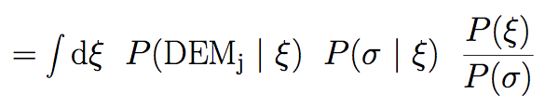
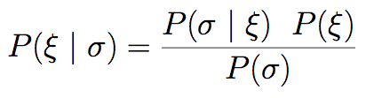
Layers of Uncertainties
ξ = true intensity in 6 channels
σ = observed intensity in 6 channels

Slide 22
Layers of Uncertainties
ξ = true intensity in 6 channels
σ = observed intensity in 6 channels
Bounded by Convex Hull
Physics
Poisson
Bounded?

Slide 23
In Closing…
Solving DEMs in underconstrained scenarios is still highly relevant.
I believe that the under-constrained aspects of the DEM inversion problem have been under-appreciated and under-developed. In particular, the impacts of these aspects are larger and introduce more qualititative variation than I usually see people discuss.
We understand and can quantify the parts of DEMs that are constrained by the data, and the parts that determine the range of under-constrained solutions.
We can easily identify observation sets (per pixel) that have been knocked out of the range of solvability, and this has implications for careful estimations of confidence levels.
We can find the globally minimum χ² solutions.
We can separate the inversion math from the selection of DEM fits by physical criteria.
I believe that we are about to see DEM analysis make a discrete jump to a higher level of sophistication, with respect to inversions and confidence estimations, and that we will be able to achieve results with greater robustness.

Slide 24
End

