Slide 1
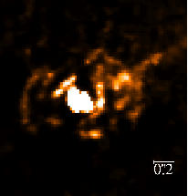
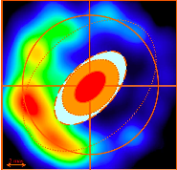
Ribeiro et al 2009
Luna et al 2009
What’s your glow, RS Ophiucchi?
Hubble & Radio look kind of spooky

Slide 2
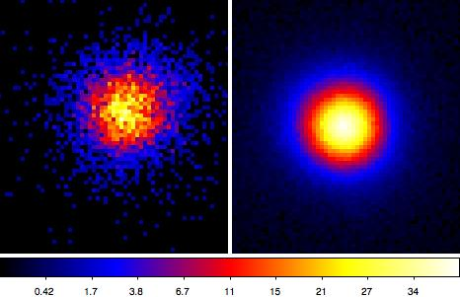
So let’s see your X-ray Glow

Slide 3
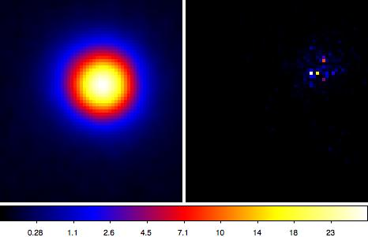
Those low counts could well defeat us –
Unless LIRA joins the chorus

Slide 4
Then data/model mis-match will show!
Low-count Image Restoration and Analysis:
Bayesian posterior
Poisson-likelihood
Full instrument response
Param Model + Multi-scale
Works – many challenges remain!!
Summary statistics, Energy/time, …

