Slide 1
Looking for True X-ray Modulation through Energy Quantiles
Jaesub Hong
Spring, 2011

Slide 2
Outline
The X-ray sources in the Galactic Bulge
Quantile Analysis
Periodic Bulge X-ray Sources and Modulating Energy Quantiles

Slide 3
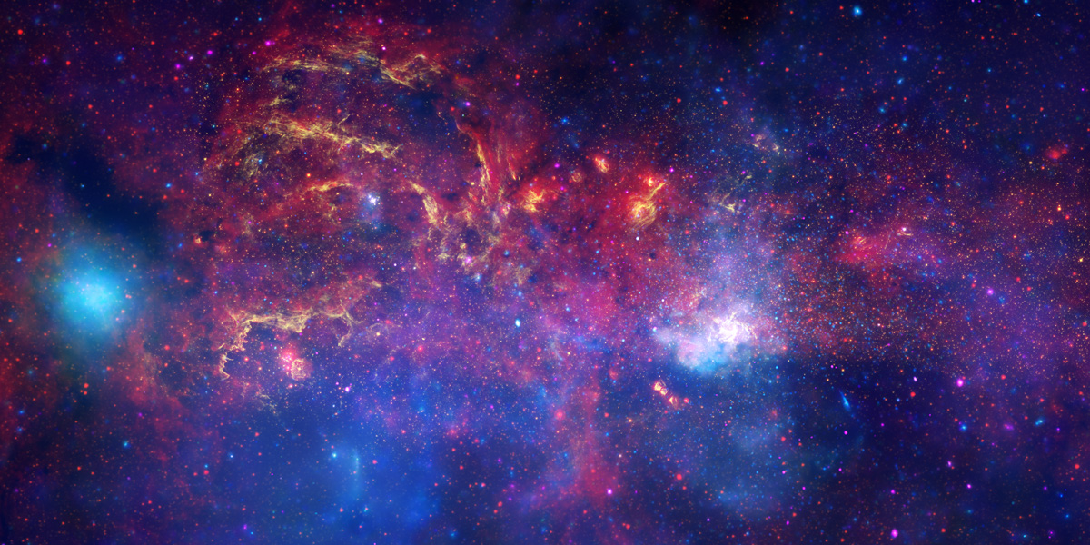
Galactic Center Region (32’ x 16’)
X-ray (Blue, Purple): NASA/CXC/UMass/D. Wang et al.
Optical/nIR (Yellow) : NASA/ESA/STScI/D. Wang et al.
IR (Red) : NASA/JPL-Caltech/SSC/S. Stolovy

Slide 4
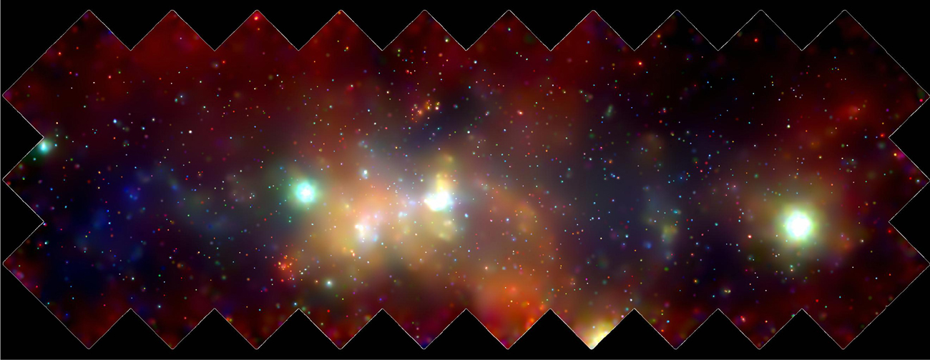
X-ray Sources in the Galactic Center Region
Chandra/ACIS shallow survey of 2 deg x 1 deg around Sgr A*
~1300 discrete X-ray sources (Wang et al. 2002)

Slide 5
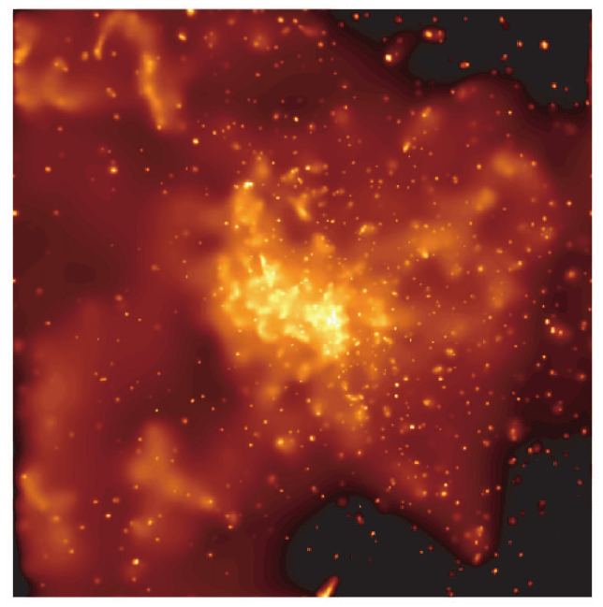
X-ray sources in the Galactic Center (GC)
Chandra’s superb spatial resolution revealed >3000 low luminosity X-ray sources in the Galactic center region
Formation and evolutionary history of the inner Galaxy
Accreting Binary Systems and their evolution
What are these X-ray sources?
8.5’ x 8.5’ Sgr A*
(~500 ks Chandra ACIS)
Muno et al. 2003

Slide 6
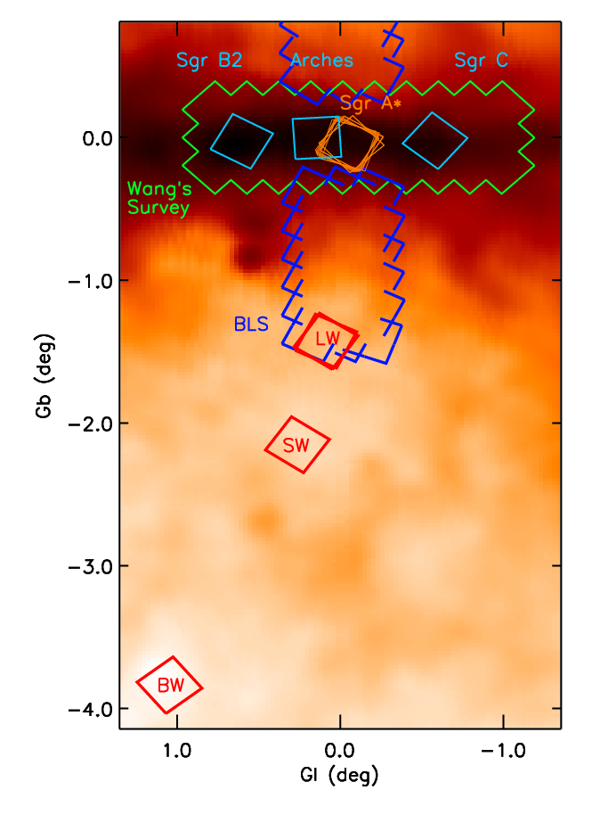
Galactic Bulge Survey
Deep Bulge Window Survey
(100 ks Chandra, HST & Magellan)
Baade’s Window (BW, Av~1.3)
Stanek’sWindow (SW, Av~2.0)
The Limiting Window (LW, Av~4.0)
vs. Galactic Center (GC, Av~25)
Hong 2009, van den Berg 2006, 2009
Shallow Bulge Latitude Survey
  (15 ks Chandra & Magellan)
1 deg x 1.2 deg south and north region of the GC
Grindlay 2011

Slide 7
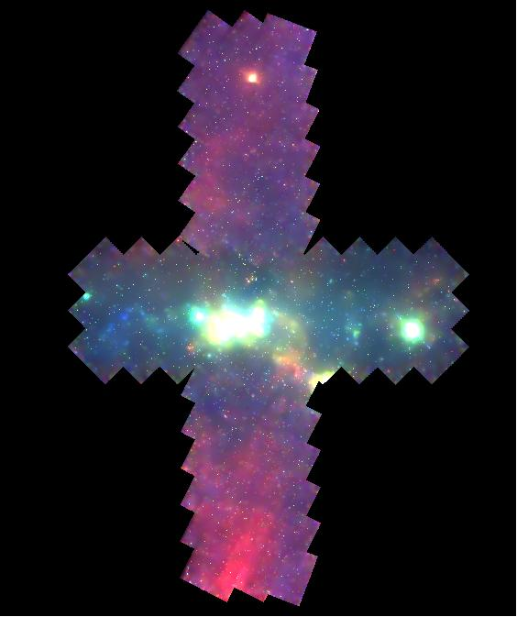

Slide 8
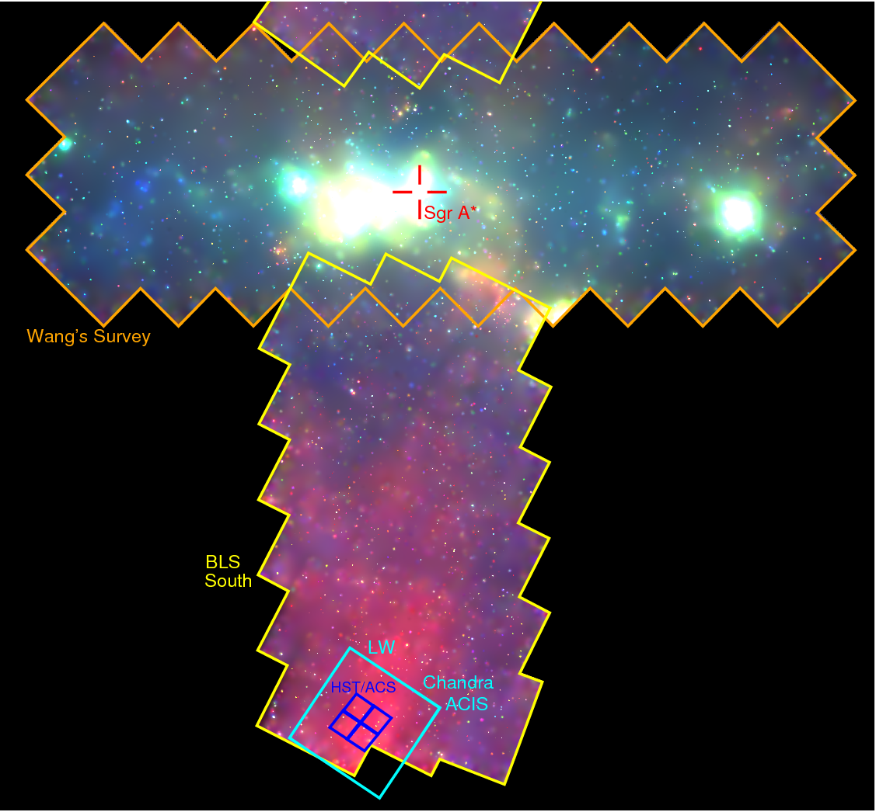

Slide 9
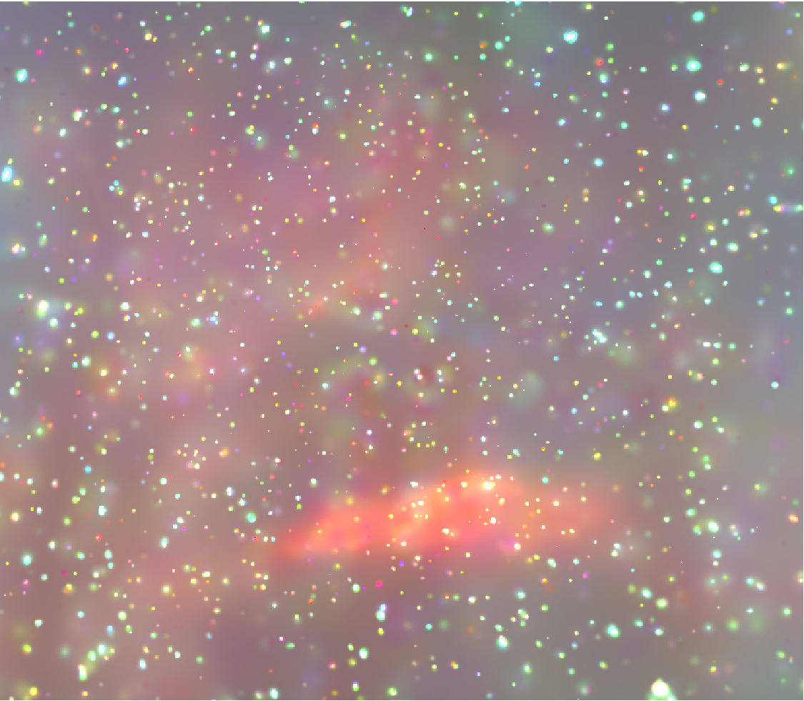
The Limiting Window (1.4 deg south of the GC)
100 ksec Bulge Survey (Hong et al 2009)
+ 900 ksec Ultra-deep Survey (Revnivtsev et al 2009)

Slide 10
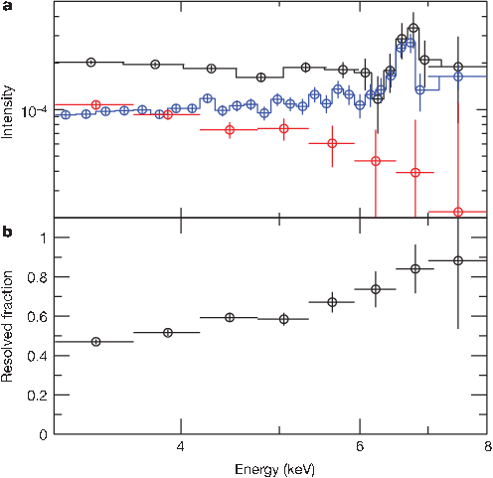
Galactic Ridge X-ray Emission
1 Ms Chandra observations of a low extinction region, the Limiting Window, at 1.4 south of the GC
~ 80% of the X-ray emission was resolved at energies > 6 keV
Resolved fraction of X-ray emission
Revnivtsev et al. 2009

Slide 11
Bulge X-ray Sources
At the Galactic Center
Low Luminosity: 10³⁰⁻³³ erg/s
Relatively Hard X-ray Spectra (Power law Photon Index ~ 0.7)
  Quiescent High Mass X-ray Binaries (qHMXBs):
  <10% (Laycock et al 2005)
  Magnetic Cataclysmic Variables (CVs)
  In the Window Fields
  Also see relatively Soft X-ray Sources
  >10³⁰⁻³¹ erg/s
  Quiescent Low Mass X-ray Binaries (qLMXBs)
  Non-Magnetic Cataclysmic Variables
  <10³⁰⁻³¹ erg/s
  Active Binaries (ABs)

Slide 12
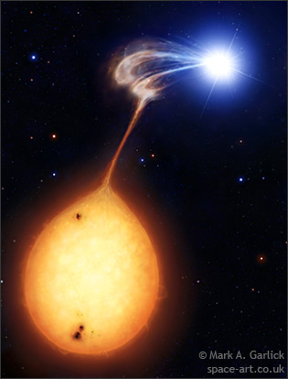
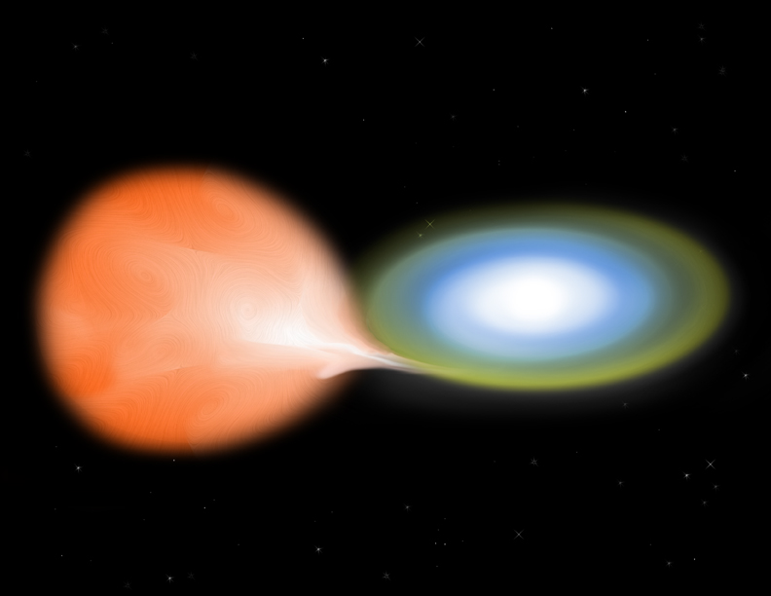
Cataclysmic Variables (CVs):
Compact Binaries with white dwarf accreting from late type companion
Mark Garlick
Mark Garlick
Non-Magnetic CVs
Polars

Slide 13
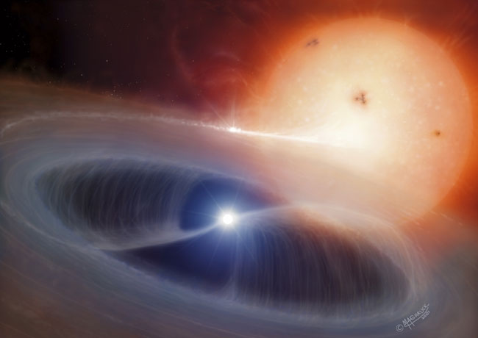
Cataclysmic Variables (CVs):
Compact Binaries with white dwarf accreting from late type companion
Mark Garlick
Intermediate Polars

Slide 14
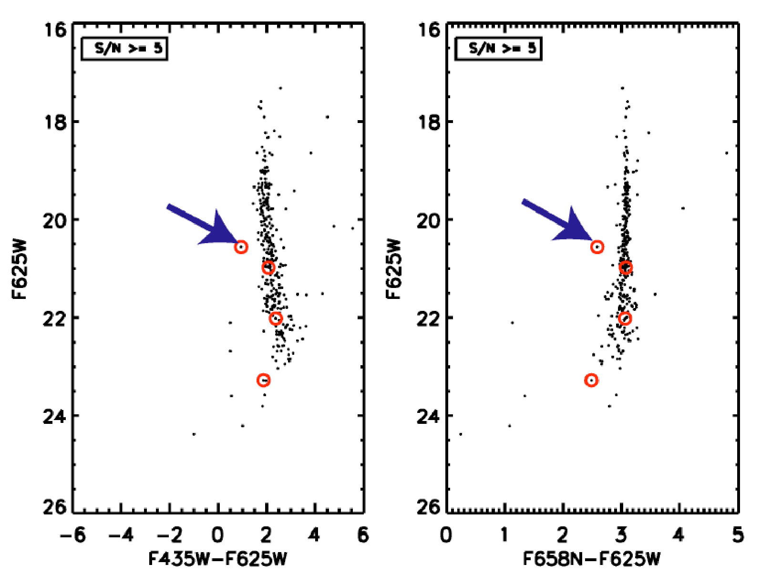
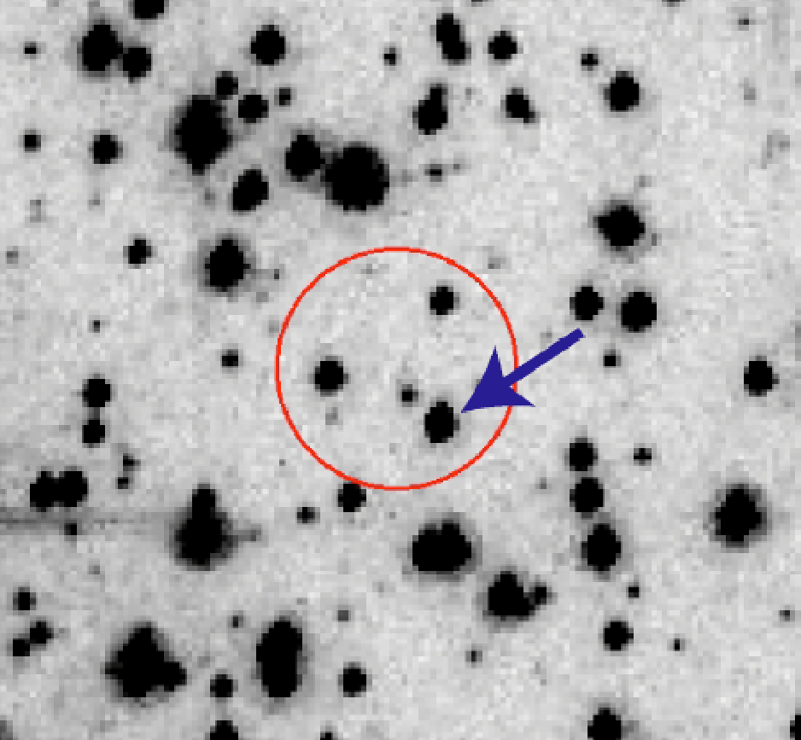
Direct Identification
At the Galactic Center
A_{V} ~ 25, A_{K}~5
Confusion limit: K~15 with Magellan/PANIC (6. 5m)
In the Windows fields (A_{V}< 4)
m_{V} >20-23
many candidate counterparts, no guarantee
HST ACS/F625W image with 1” 95 % conf. radius

Slide 15
Source identification in Windows/HST fields
Fields (100 ks) | X-ray sources | X-ray sources In HST/ACS | CV candidates | Predicted
BW | 403 | 162 | 4 - 9 | 7
SW | 433 | 139 | 2 - 10 | 14
LW | 319 | 100 | 13 - 25 | 14

Slide 16
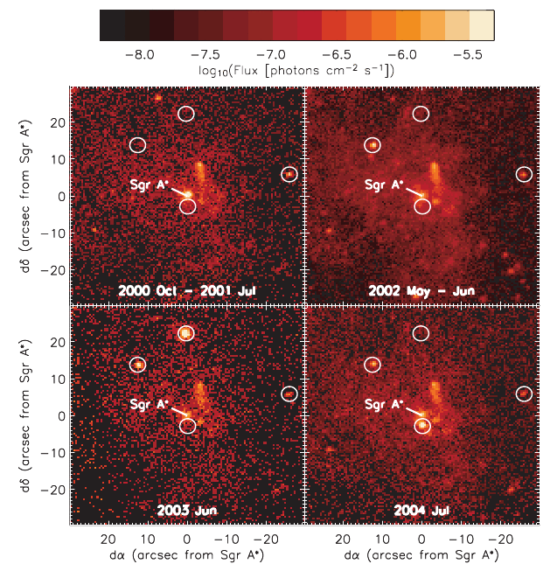
X-ray sources in the Galactic Bulge:
More from X-ray data
Variable X-ray sources
  e.g. Scargle’s Bayesian Block Searches
  4 Transients within 1pc vs. 7 in 25 pc
  (Muno et al 2005)
  8 Transients in the GCR: quiescent LMXBs
  (Degenaar et al 2009, 2010)
Periodic X-ray sources
  Lomb-Scargle
  Buccheri’s z² statistics
  Epoch Folding
  .....
  9 Periodic sources in the GCR: magnetic CVs
  (Muno et al 2003, 2009)

Slide 17
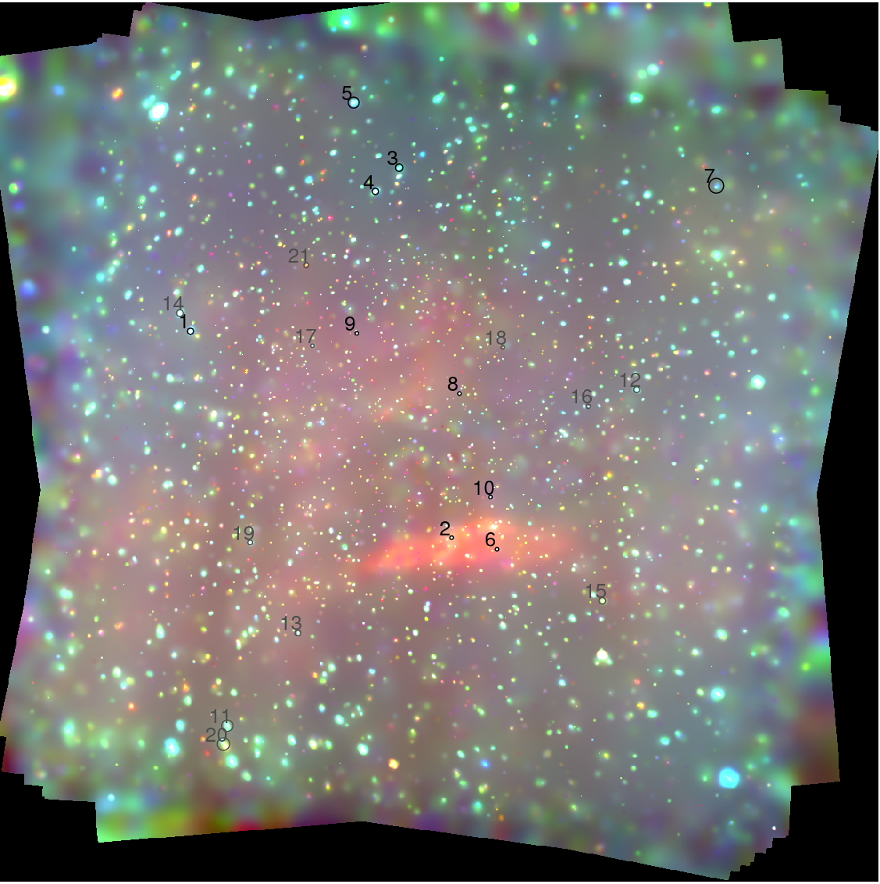
The Limiting Window ( 1Ms Chandra/ACIS-I)
10 periodic sources and 11 candidates
Hong et al 2010, arXiv:1103.2477

Slide 18
Variable X-ray sources in the Bulge Fields
(not complete)
Fields | Periodic | Variables
BW (100 ksec) | 1 | -
SW (100 ksec) | 0 | -
LW (1 Msec) | 10 + 11 | ~80 (short + long)
GCR (1+1 Msec) (Muno et al) | 9 | 856 (long) + 198 (short)

Slide 19
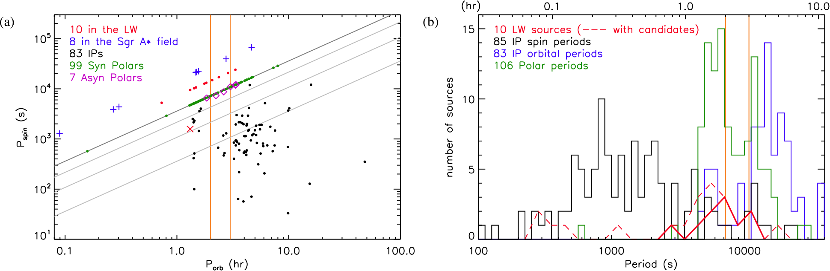
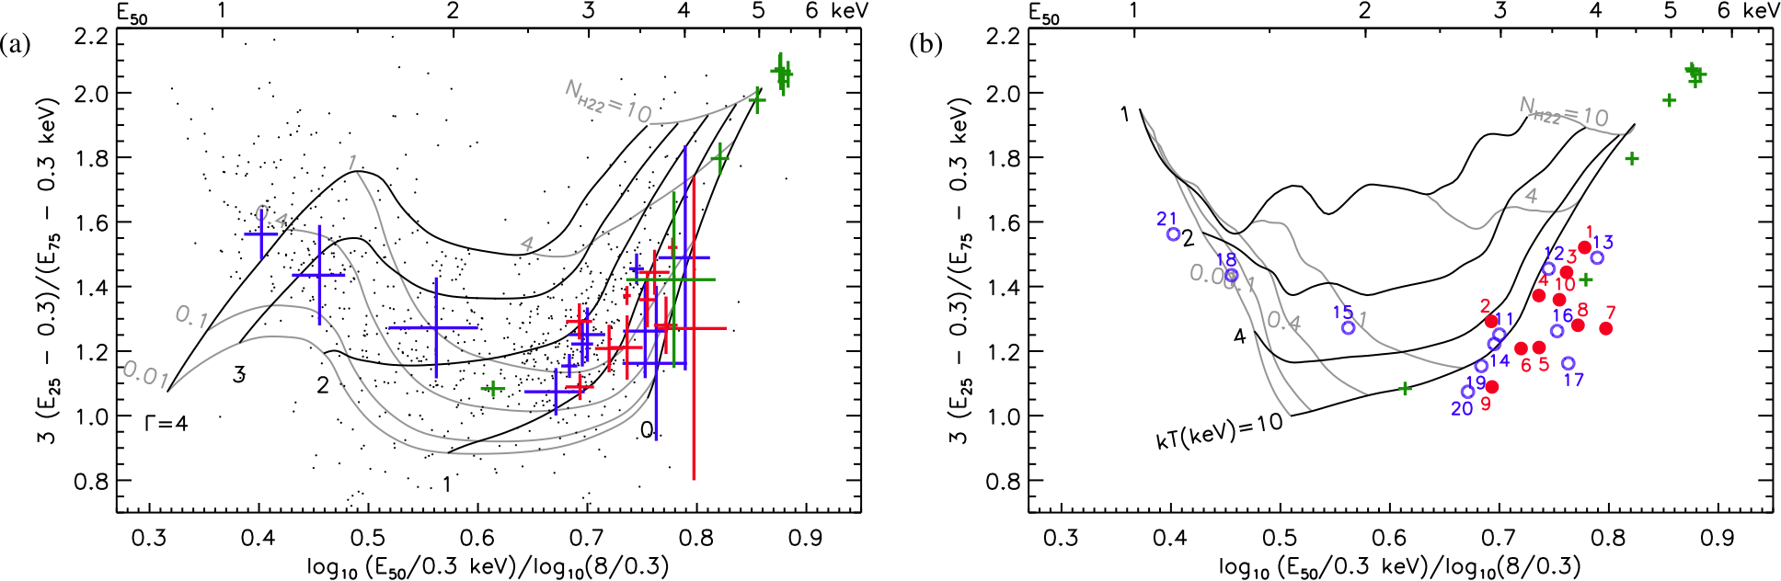
The Limiting Window ( 1Ms Chandra/ACIS-I)
absorption
Intrinsically hard
Very hard spectra
20-30% of hard X-ray sources can be periodic
(Hong et al 2010, arXiv:1103.2477)

Slide 20
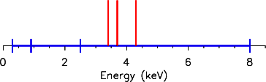
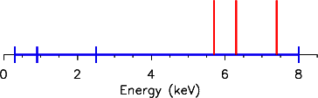
Extracting Spectral Properties or Variations
from faint X-ray sources
Hardness Ratio
HR₁ =(H-S)/(H+S) or HR₂ = log₁₀(H/S)
e.g. S: 0.3-2.5 keV,
H: 2.5-8.0 keV
HR₁ = 1
HR₁= 1
Bayesian Estimation of Hardness Ratios (BEHR)
Park et al, 2006, ApJ

Slide 21
Quantiles
Low count requirements for quantiles:
spectral-independent
  2 counts for median
  3 counts for terciles and quartiles
No energy binning required
Take advantage of energy resolution
Optimal use of information
Median (E₅₀) = 3.7 keV
Median (E₅₀) = 6.5 keV

Slide 22
X-ray Spectral Models of Astronomical Objects
Power law (Photon Index: Γ)
Black Body (Temperature: kT)
Thermal Brems. (Plasma Temperature: kT)
MeKaL or APEC (Plasma Temperature: kT, Abundance, …)
….
+ Interstellar Absorption (N_{H})
Goal: acquire two parameters to describe basic spectral shapes.
cf. Hardness ratio using three bands:
S, M, H => HR1 = S/M, HR2 = M/H

Slide 23
Two independent parameters from Quantiles
Median (E₅₀)
Energy
Energy
Energy
Quartile Ratio (E₇₅/E₂₅)
Energy
Energy
Energy

Slide 24
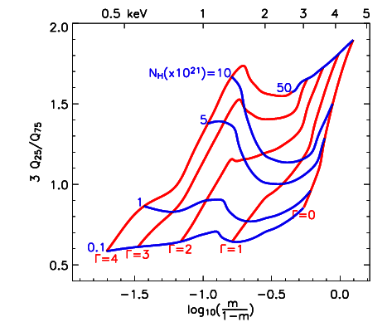
Quantile Diagram
E_{50%}=
Quantiles are not independent
m=Q₅₀ vs Q₂₅/Q₇₅
Power-Law : Γ & N_{H}
Proper spacing in the diagram
More
Absorption
Intrinsically
Hard
ACIS-S detector
0.3-8.0 keV

Slide 25
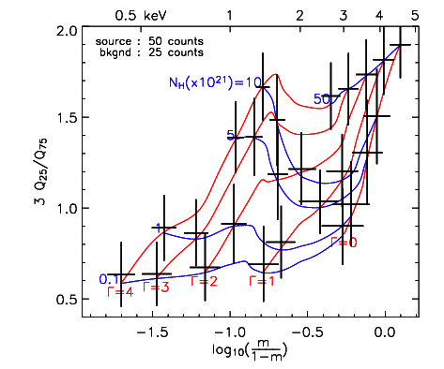
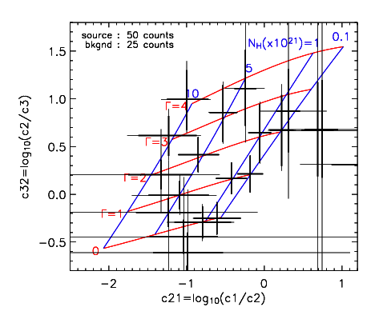
50 source count/ 25 background count
Quantile Diagram
0.3-8.0 keV
Conventional X-ray
Color-Color Diagram
0.3-0.9-2.5-8.0 keV

Slide 26
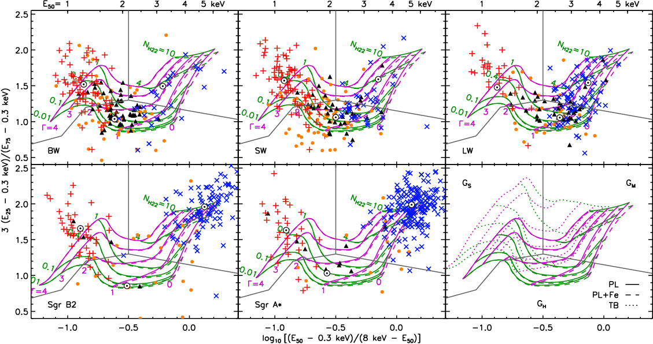
Quantile Diagrams for Windows and Galactic Center Fields

Slide 27
Future Improvement of Quantile Analysis
Logit (Median) => Log (Median)
Quantiles for Photons with Weighting
e.g. Swift/BAT: each count with weight
Allows a unified phase space for a given energy band
regardless of response function
=> Atlas of X-ray spectral type,
Physical meaning in Quantiles
Improve Error Estimates

Slide 28
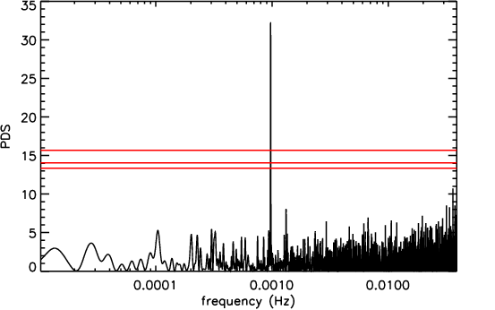
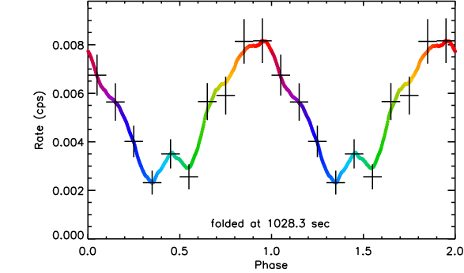
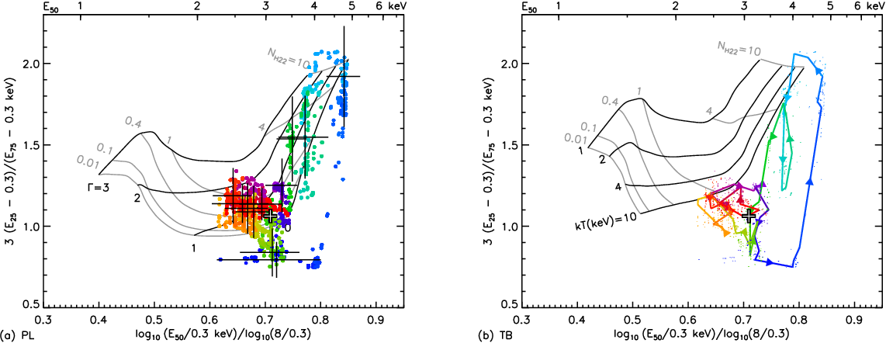
Magnetic CV in Baade’s Window :
CXOPS J180354.3 – 300005 (1028.3 s)
absorption
Intrinsically hard

Slide 29
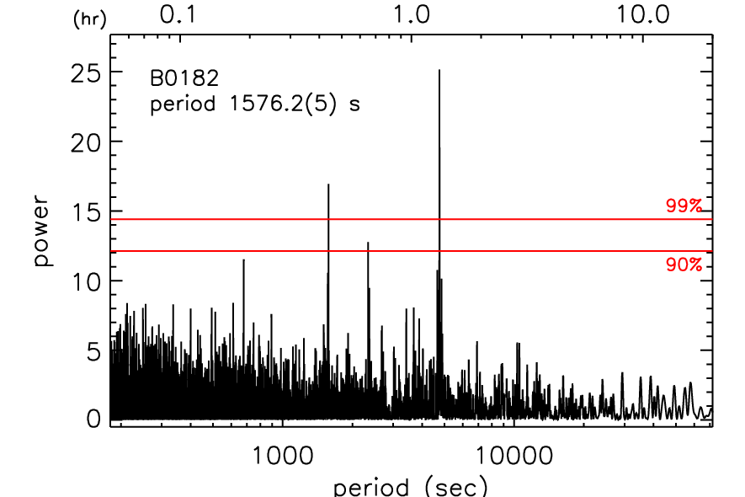
Magnetic CV in LW : CXOPS J175118.7 – 293811 (4731 s)

Slide 30
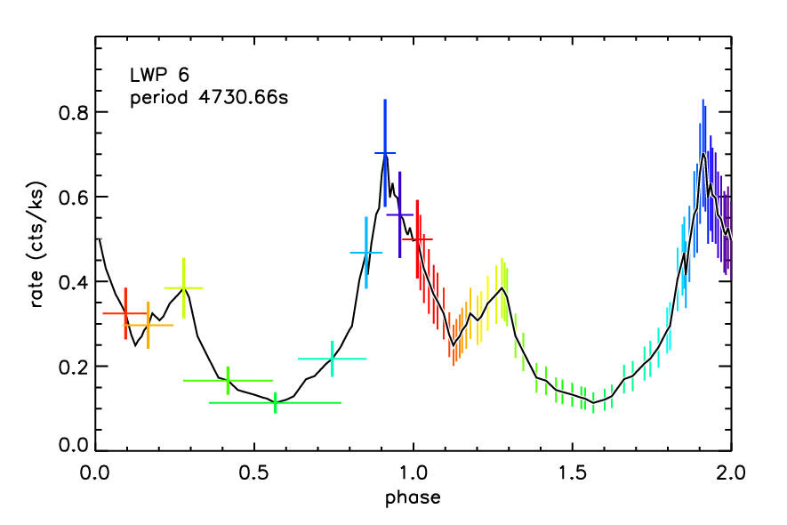
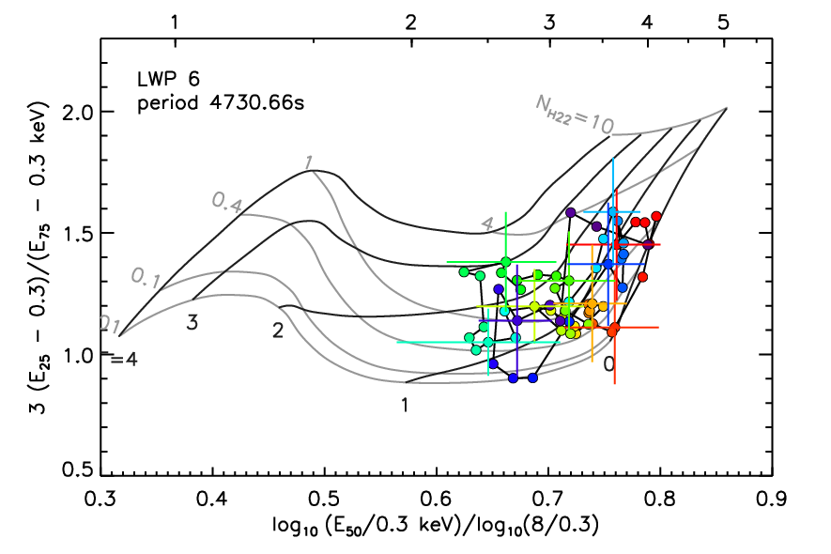
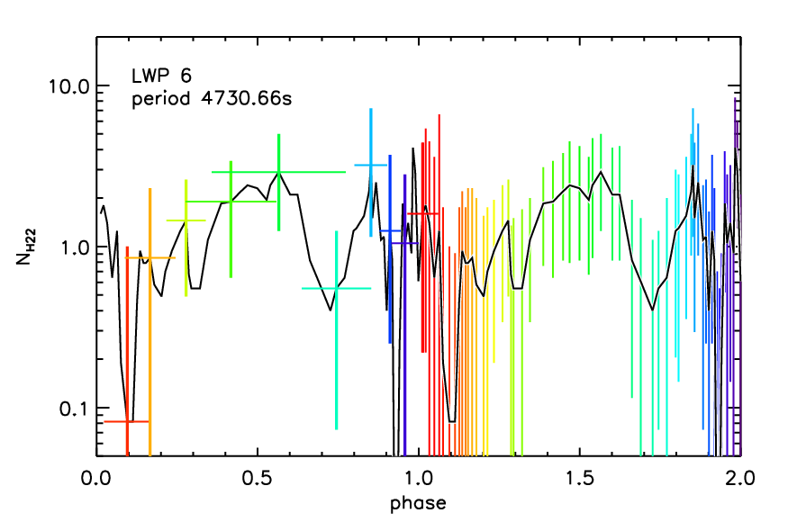

Slide 31
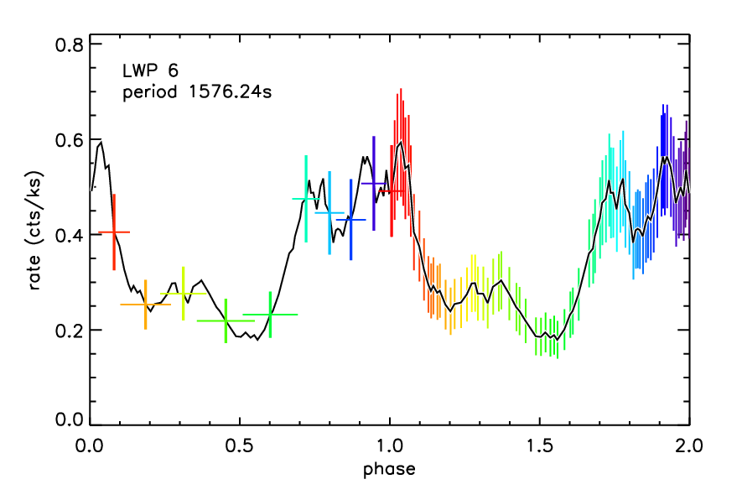
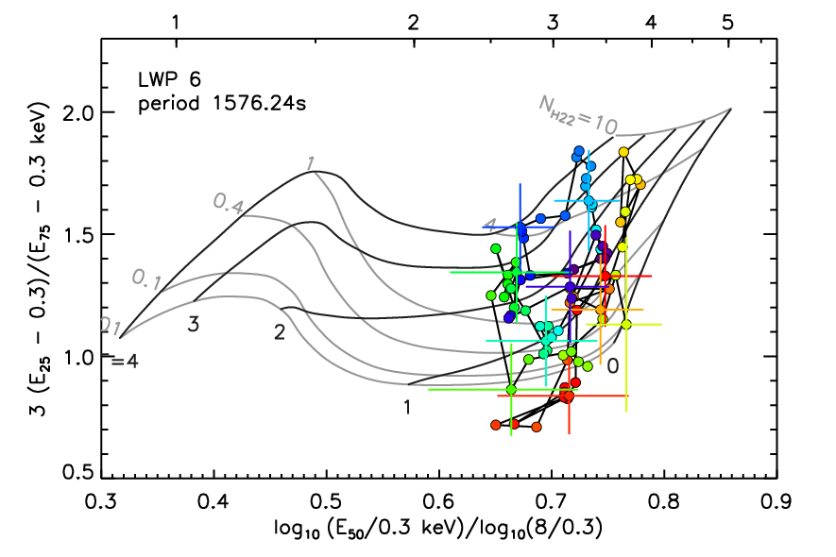
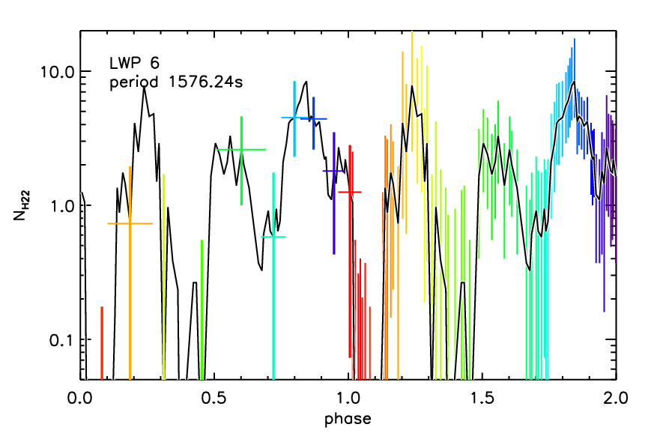

Slide 32
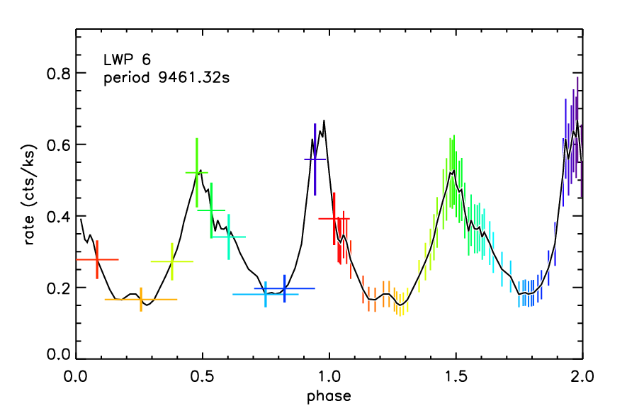
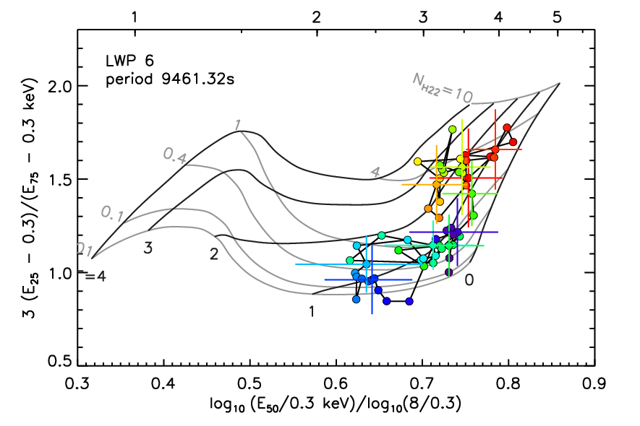
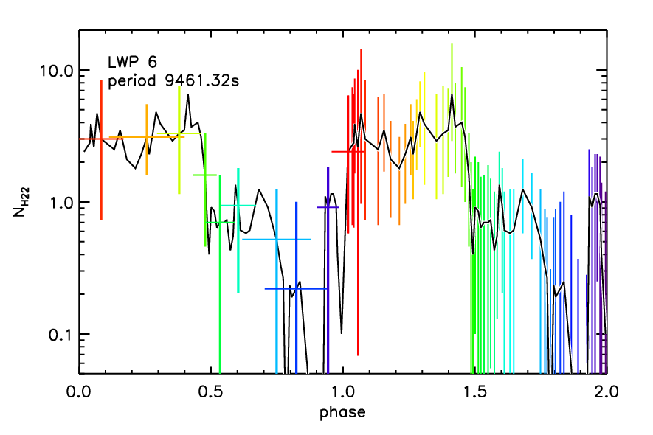

Slide 33
Cataclysmic Variables (CVs):
white dwarf with late type companion
Intermediate Polars

Slide 34
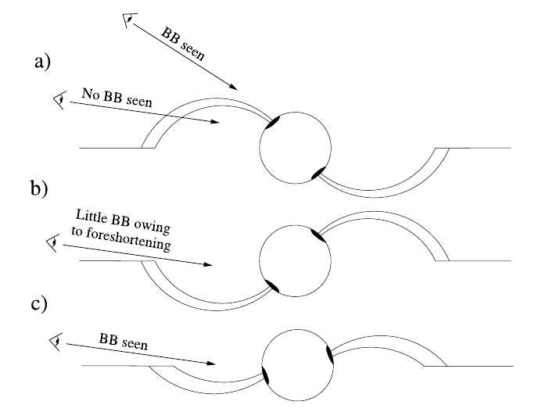
Evans & Hellier 2007

Slide 35
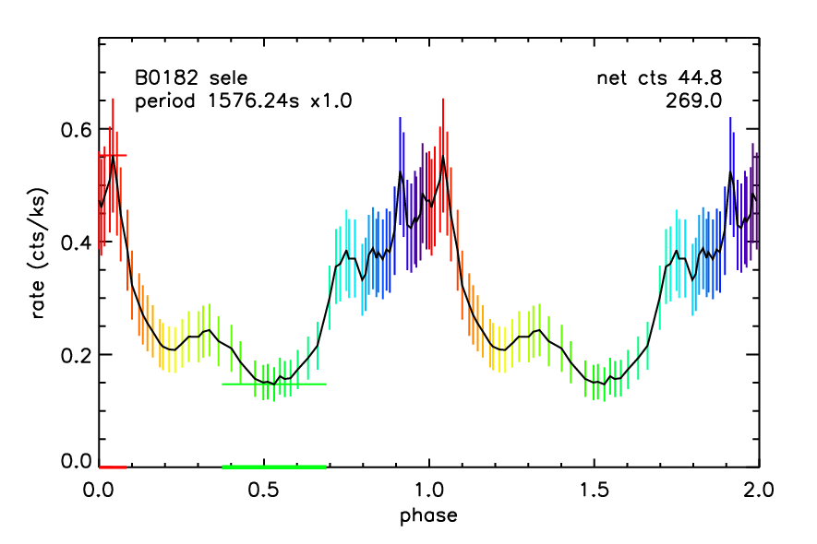
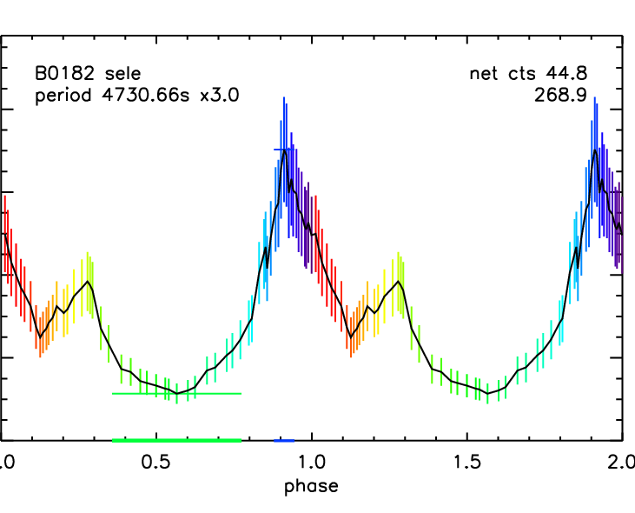
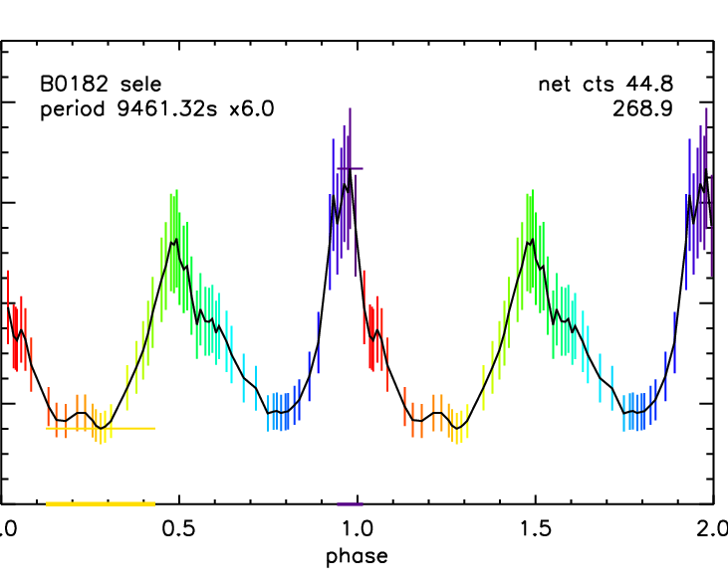
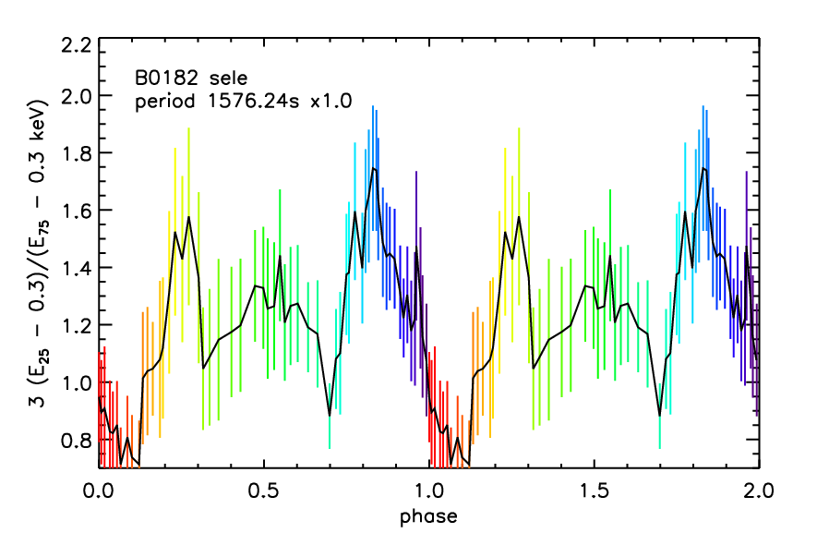
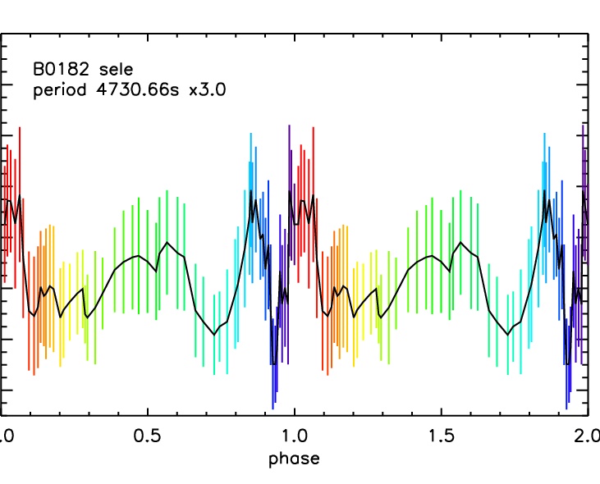
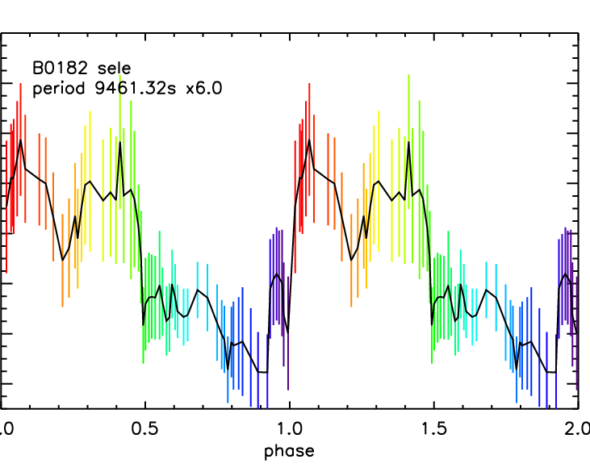
1576 s
4730 s
9461 s

Slide 36
1576 s
4730 s
9461 s

Slide 37
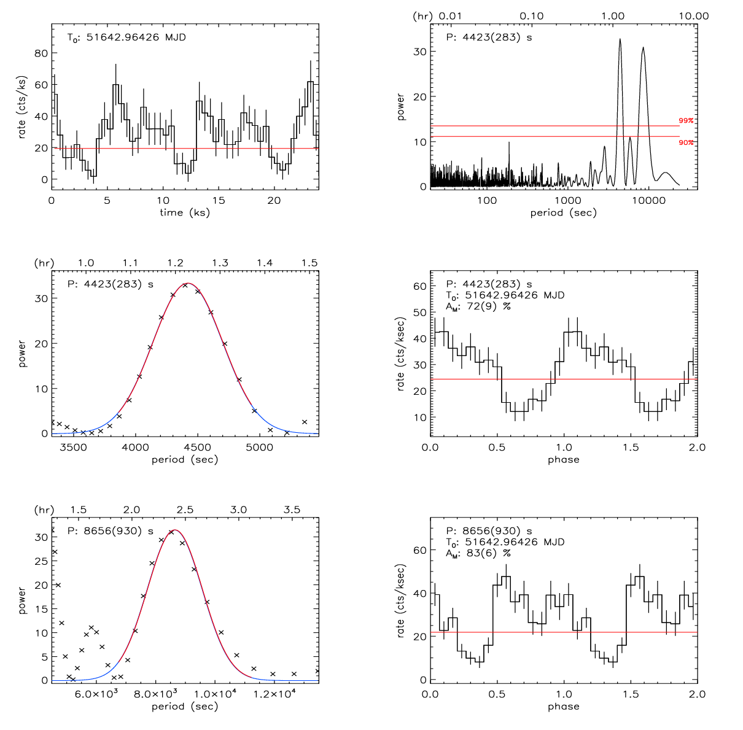
Bright X-ray source in ChaMPLane
(van den Berg et al 2011)

Slide 38
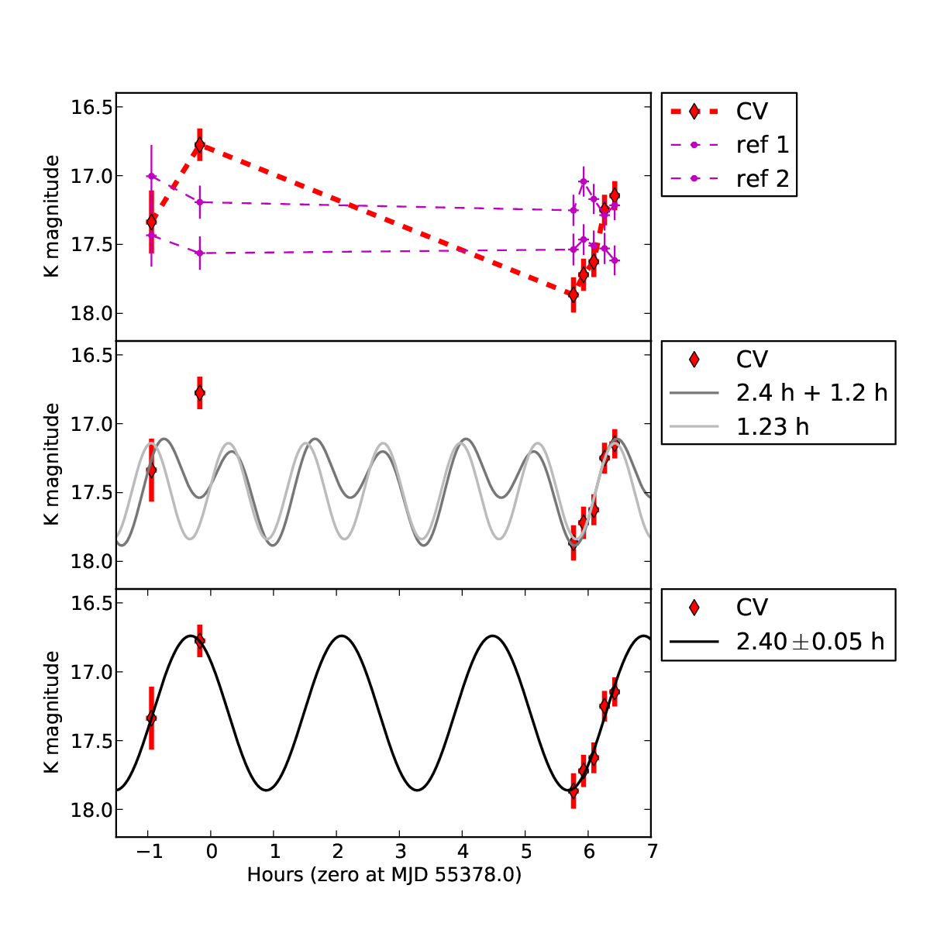
Bright X-ray source in ChaMPLane
(Servillat et al 2011)

Slide 39
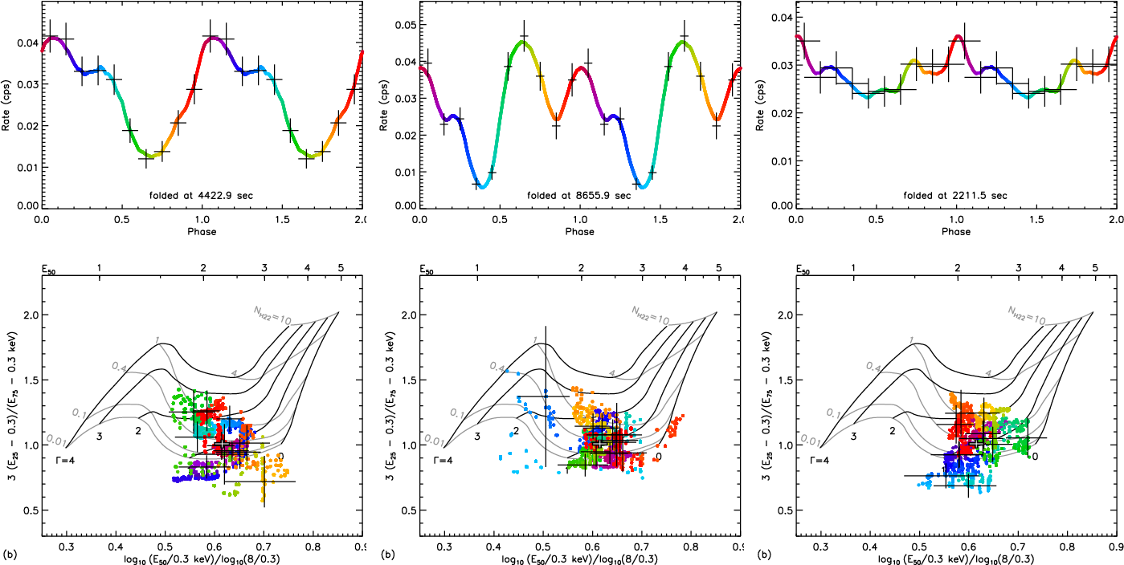
Bright X-ray source in ChaMPLane

Slide 40
Modulation associated with peculiar spectral state
Observables
vs.
Phase folded at P
Phase folded at P’
Not much variations
Noticeable variations

Slide 41
Pattern or order of values gives a clue?
Observables
vs.
Phase folded at P
Phase folded at P’
Chaotic
Orderly
e.g. DisCan for quantum gravity photon disperson:
Scargle, Norris, Bonnel, 2008
Sharpness : Shannon, Reny,
Fisher information, variance

Slide 42
Summary
The sheer number of Bulge X-ray sources indicate their importance in understanding the evolutionary history of accreting binaries and the inner Galaxy. But the large number of them are not identified.
High obscuration, faint optical flux and source crowding limit direct spectroscopic identification.
X-ray variability provides another clue. Sometimes multiple periodicities are observed: not all of them are independent.
Energy quantiles (or equivalent quantities) might help revealing the true periodicity. Further study is needed to assign credible statistical significance.

Slide 44
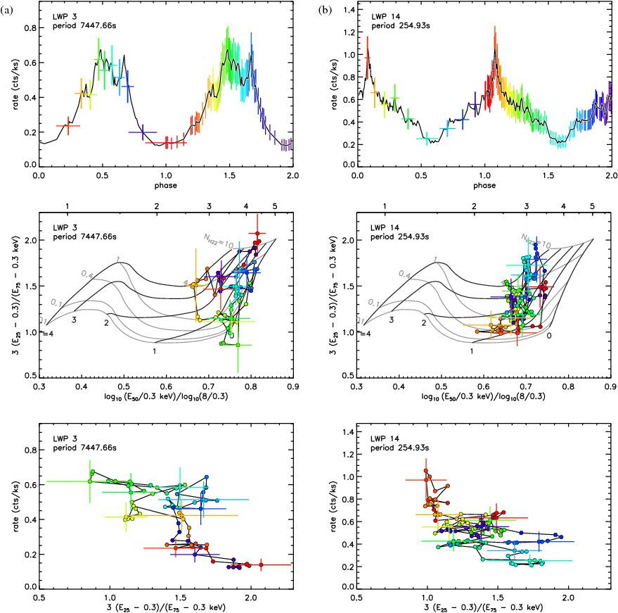
Magnetic CVs
in LW

Slide 45
Evans &Hellier 2007

Slide 46
Identifying X-ray Sources by Periodicity
(Lomb-Scargle Method)
A Magnetic CV in Baade’s Window (100 ks) :
CXOPS J180354.3 – 300005 (1028.3 s)
Hong et al, ApJ, 2009

Slide 47
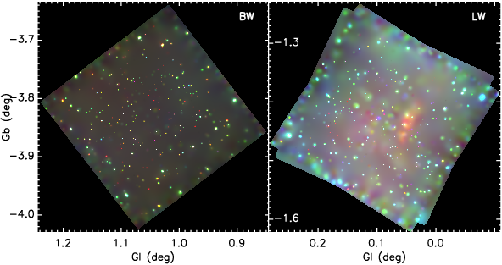
Chandra ACIS Image of BW and the LW
~320 – 400 X-ray sources with 100 ks

Slide 48
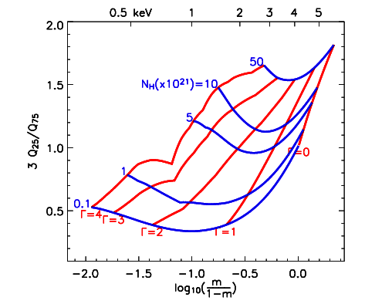
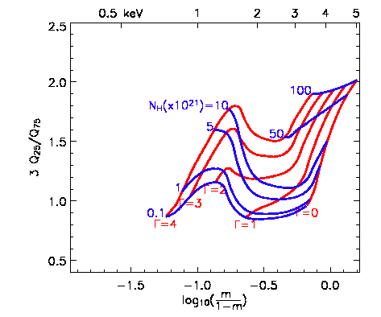
Realistic Cases
E_{50%}=
An ideal detector
ACIS-I response

Slide 49
Realistic Cases
E_{50%}=
An ideal detector
ACIS-S response

Slide 50
Quantile Diagram
E_{50%}=
Quantiles are not independent
m=Q₅₀ vs Q₂₅/Q₇₅
Power-Law : Γ & N_{H}
Proper spacing in the diagram
More
Absorption
Intrinsically
Hard
An ideal detector
03-8.0 keV

